Slide 1
Uniform Motion and Graphing
Uniform motion – objects travel equal displacements in equal amounts of time.
Ex. Think of Ice skating, when you push off the boards, you would glide across the ice and then eventually stop because of the friction between the ice and your skate blades. But if it was uniform motion, when you pushed off the boards, you would never stop!

Slide 2
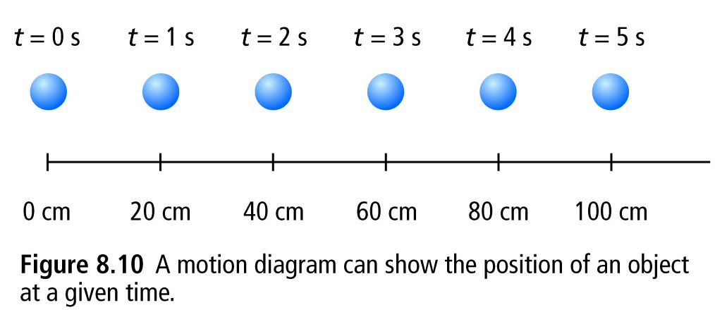
Say you roll a pool ball across a table… you can show it in a motion diagram

Slide 3
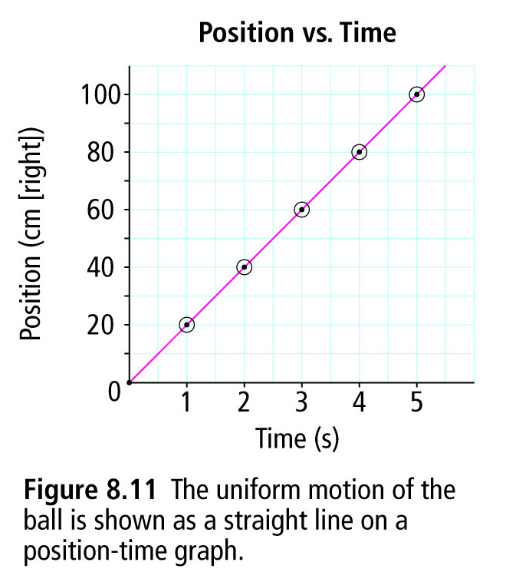
Another way to show position and time is in a Position-Time graph
TIME (s) | POSITION (cm)
0 | 0
1 | 20
2 | 40
3 | 60
4 | 80
5 | 100
Best fit line
(straight line or smooth curve that fits the shape of graph)

Slide 4
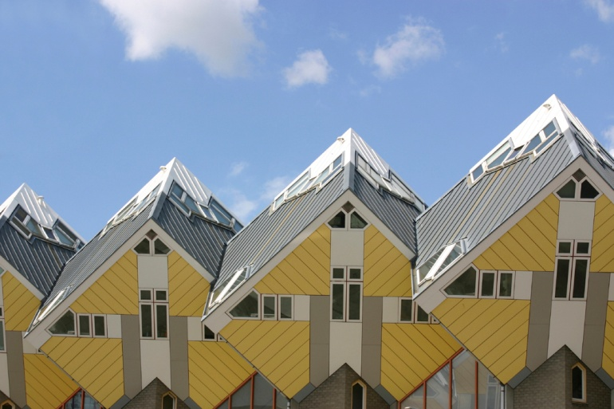
Slope!!
Slope is the steepness of a line (whether it goes up or down at an angle, or is horizontal) – think of house roofs… you could have really steep roofs (to shed lots of snow), or flat roofs(in hot countries where there is no snow)
The steep roofs have a high slope, whereas the flat roofs have no slope (0 slope).

Slide 5
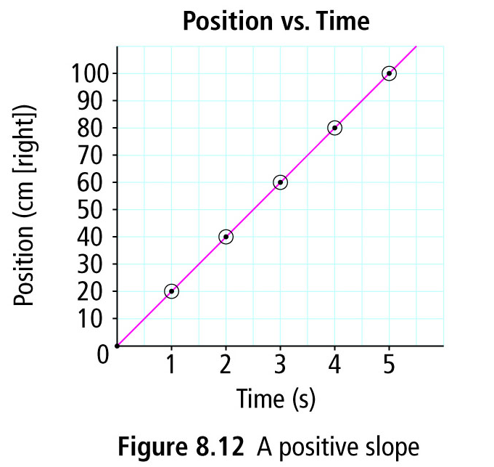
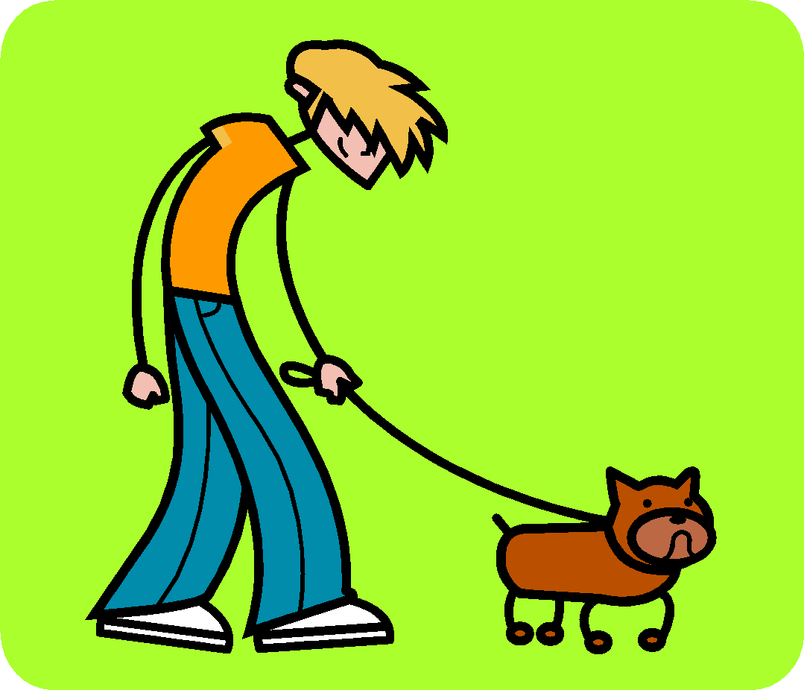
Positive Slope
The line slants up to the right.
Picture a little stick man walking along the line – he’d be walking uphill (positive)
What does it mean?

Slide 6
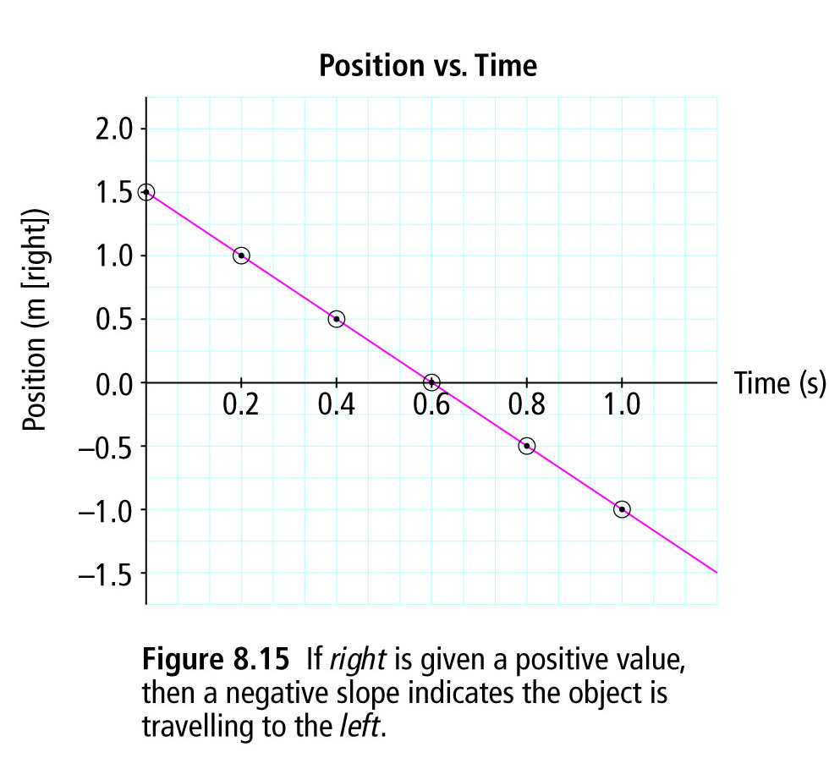
Negative Slope
The line slants down to the right.
Picture a little stick man walking along the line – he’d be walking downhill (negative)
What does it mean?

Slide 7
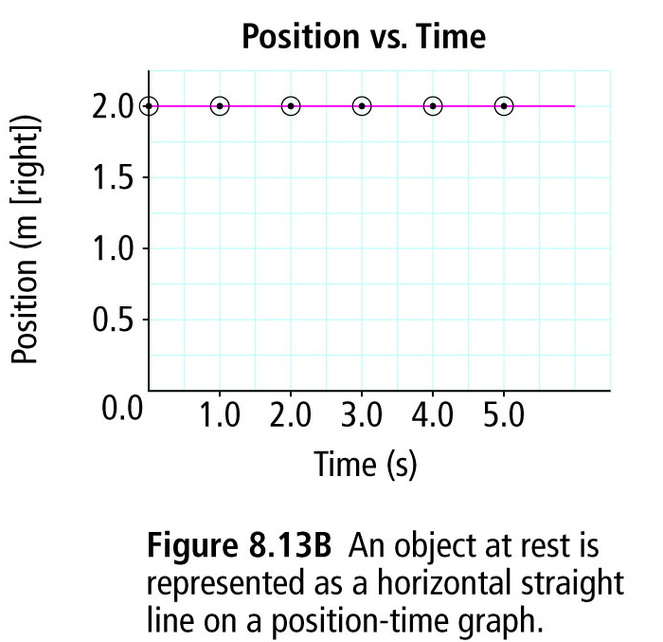
Zero Slope
The line is horizontal.
There is no steepness to the line –so it’s a slope of nothing –zero!
What does it mean?

