Slide 1
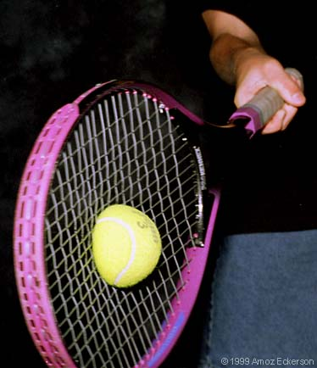
ACCELERATION
Think of playing tennis with Venus Williams – If she were to hit you a serve – it might travel to you at over 200km/h. When the ball hits your tennis racket it will slow to 0 for a fraction of a second and then travel backwards from the direction it came at a different velocity. That situation deals with acceleration!
Acceleration is the rate of change in Velocity!

Slide 2
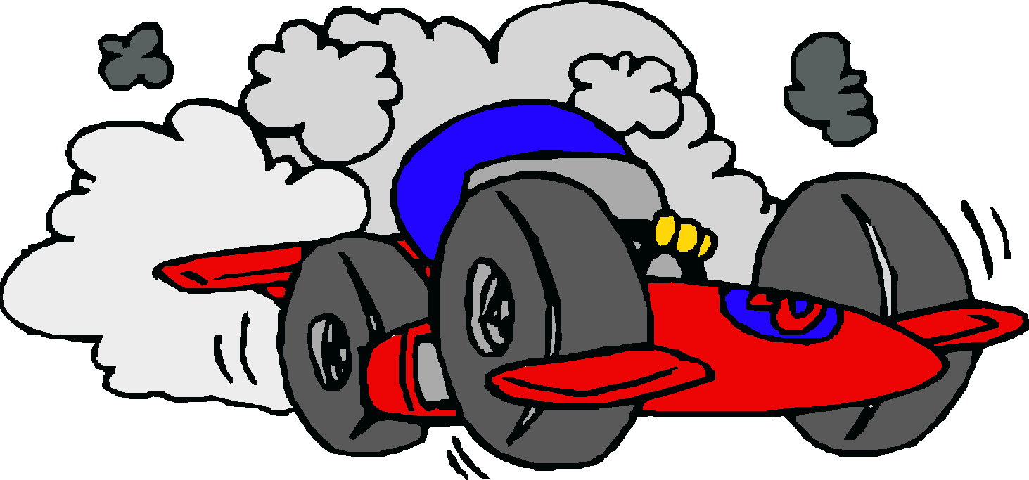
Positive Acceleration:
When speed is increasing (speed is in the same direction of the acceleration) – the acceleration is positive.
When a drag racer gets the green light and hits the gas to move forward by speeding up– that is positive acceleration

Slide 3
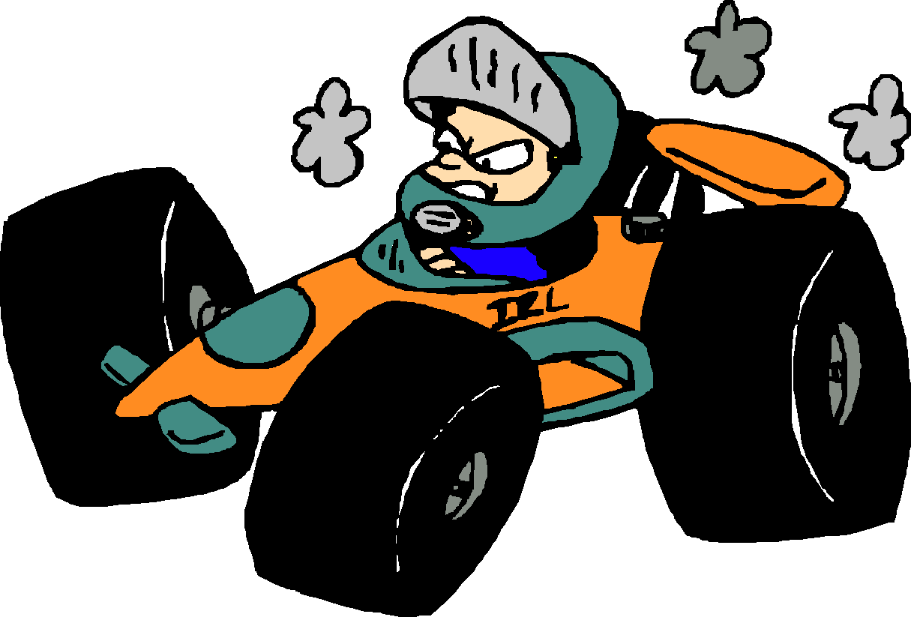
Negative Acceleration:
When velocity is decreasing (in the opposite direction of the acceleration)– the acceleration is negative.
When a drag racer finishes the race – he hit’s the brakes (and uses a parachute out the back) to decrease his velocity rapidly, causing the acceleration to decrease - that is negative acceleration
Screeeeech!

Slide 4
Another Example: Launching a Space shuttle!
Within the first minute after lift-off – the velocity is about 350 m/s and covers about 16 km of distance. During the next minute, the space shuttle’s velocity is about 1200 m/s and covers about 30 km of distance
So in the first minute it moves 16km
In the second minute it moves 30km (must be moving a lot faster!)
That is acceleration!! The velocity is changing

Slide 5
Another Example: Airbags
Airbags are designed so that when a person is halted suddenly by crashing into something – the airbag deploys and slows down the velocity of the person in the car as gradually as possible by creating a cushion for them to hit and slow them down. Causes slower negative acceleration!
So that you don’t go from 60km/hr to 0 in 1 second – you would probably snap your neck because of the jolt.

Slide 6
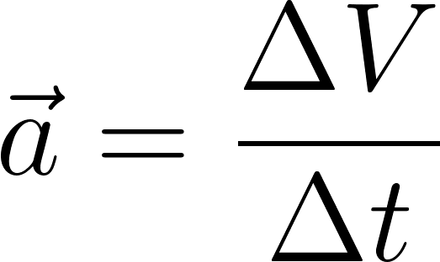
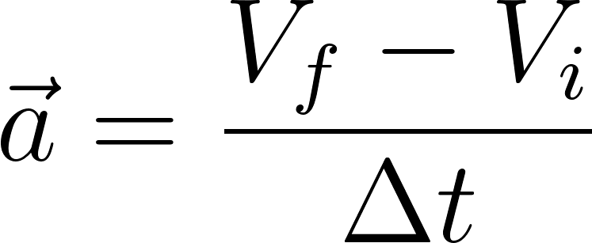
Calculating Acceleration!!!
Acceleration : The change in velocity divided by the change in time.
Equation:
Units: m/s²
How can you show acceleration?: A Velocity-Time graph
The slope of the Velocity-Time graph is the acceleration!
So…

Slide 7
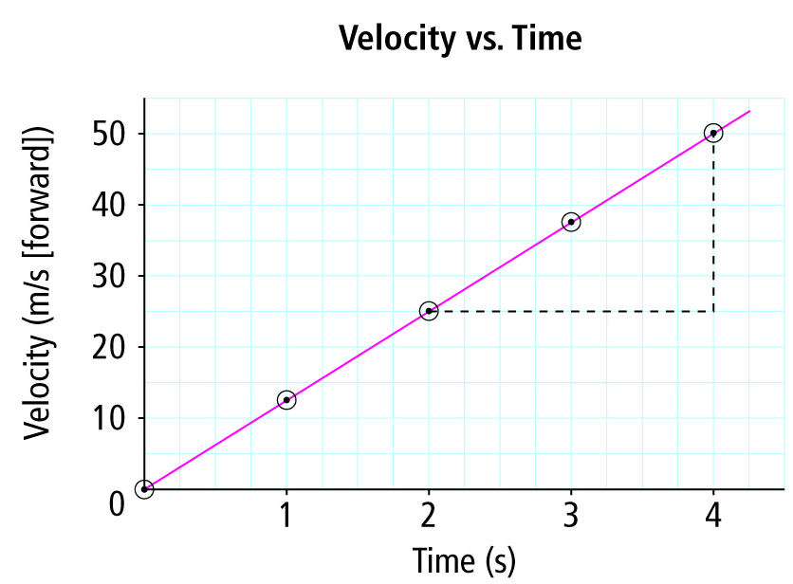
Suppose you plot the data for a roller coaster as it starts out forward at the beginning of a ride and you plot this best fit line – what does it tell you?

Slide 8
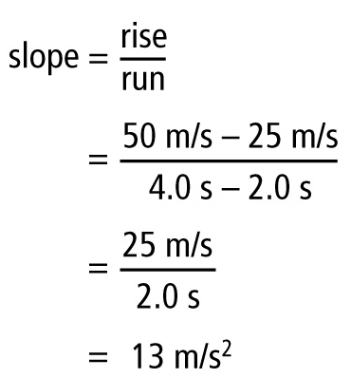
The Slope of that line is the acceleration, so… Let’s find the Slope!
Notice that m/s/s just simplifies to m/s²
Therefore the acceleration is 13 m/s² meaning that the rollercoaster’s velocity increased by 13m/s every 1.0 seconds.

Slide 9
If the best-fit line passes directly through all the points on the graph = constant acceleration ( it’s always exactly the same, so it’s constant
If the best-fit line does not pass directly through all the points on the graph (ie. Some above and some below) = average acceleration (it’s not always exactly the same)

Slide 10
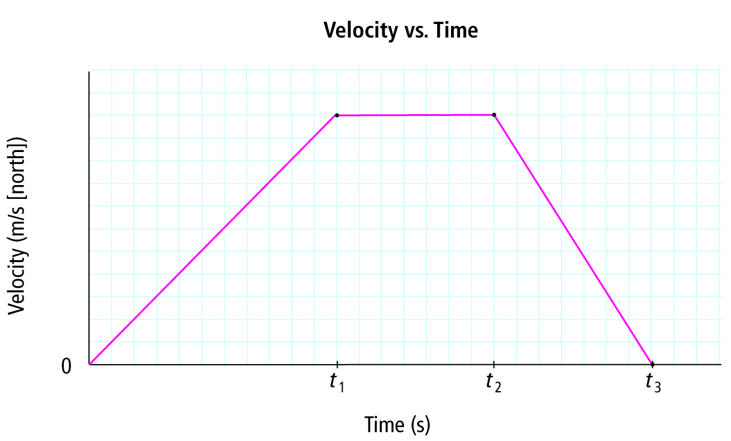
What can you figure out from this graph of the motion of a school-bus?

Slide 11
Time Interval | 0 – t₁ | t₁ – t₂ | t₂ – t₃
Acceleration | + | 0 | -
Velocity | Starts from rest and increases it’s speed at a constant rate | Travels N at a constant speed | Slows down at a constant rate to a stop (still going North

Slide 12
Check if we get it… Answer these!
1) What does the slope of a velocity time graph represent?
Answer: Acceleration
2) What does a straight line on a Velocity-Time graph tell you about:
A) the object’s change in velocity?
B) the object's acceleration?
Answer to A): If line has + slope – the velocity is increasing, if 0 slope – the velocity is constant, if – slope, the speed is decreasing
Answer to B): If line has + slope – the acceleration is constant and in a forward direction, if 0 slope – there is no acceleration, if – slope, the acceleration is decreasing (slowing down)

Slide 13
Here are the equations you need to know!!!

Slide 14
Acceleration Triangle

Slide 15
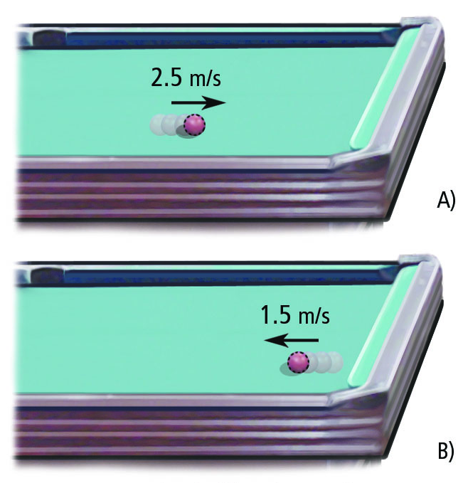
How to find Acceleration without a Graph…
Remember: Acceleration is
Q: Suppose you shoot a pool ball at 2.5m/s and bounce it off the side of the pool table and it travels at 1.5m/s to the far corner pocket. Assuming it was in contact with the side of the table for 0.20s, What is the acceleration of the pool ball as it travels to the corner pocket after hitting the side?

Slide 16
How to start:
1: Make assumptions about + and – first. If the ball is moving right to the side of the pool table – that velocity is “+”. When the ball hits and moves backwards, it is going left and so the velocity is “–”
2: Get the change in velocity:
3: Divide the change in velocity by the time.

Slide 17
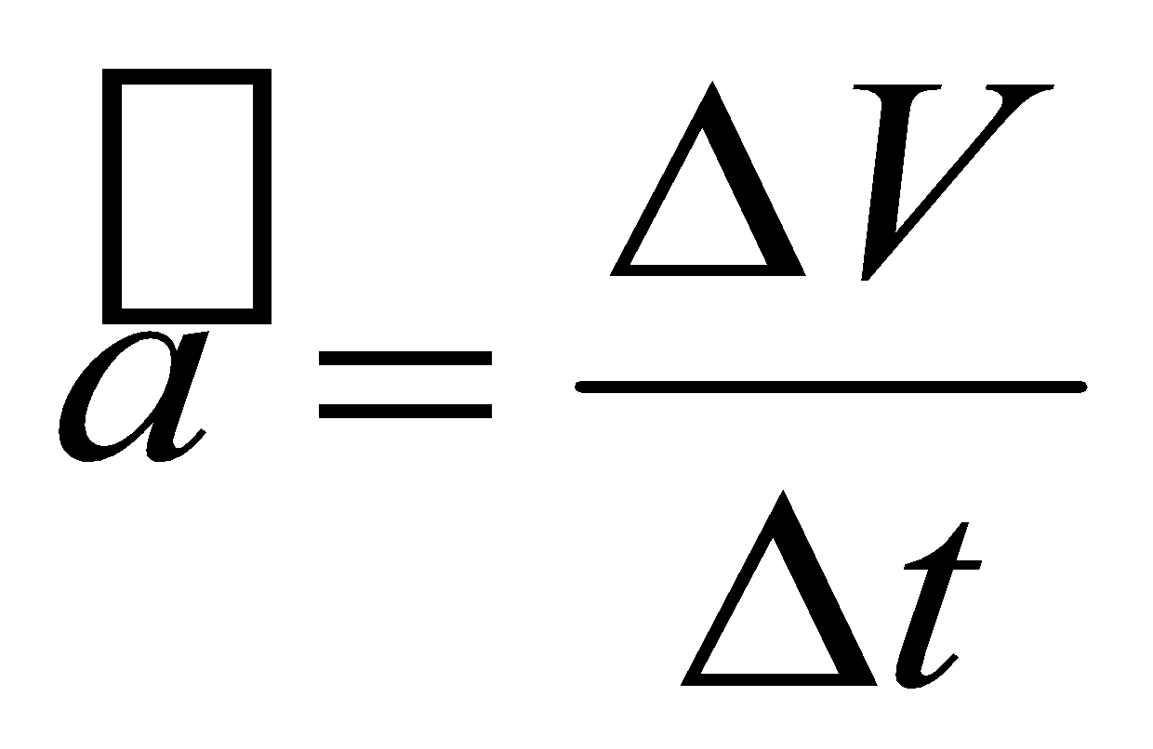
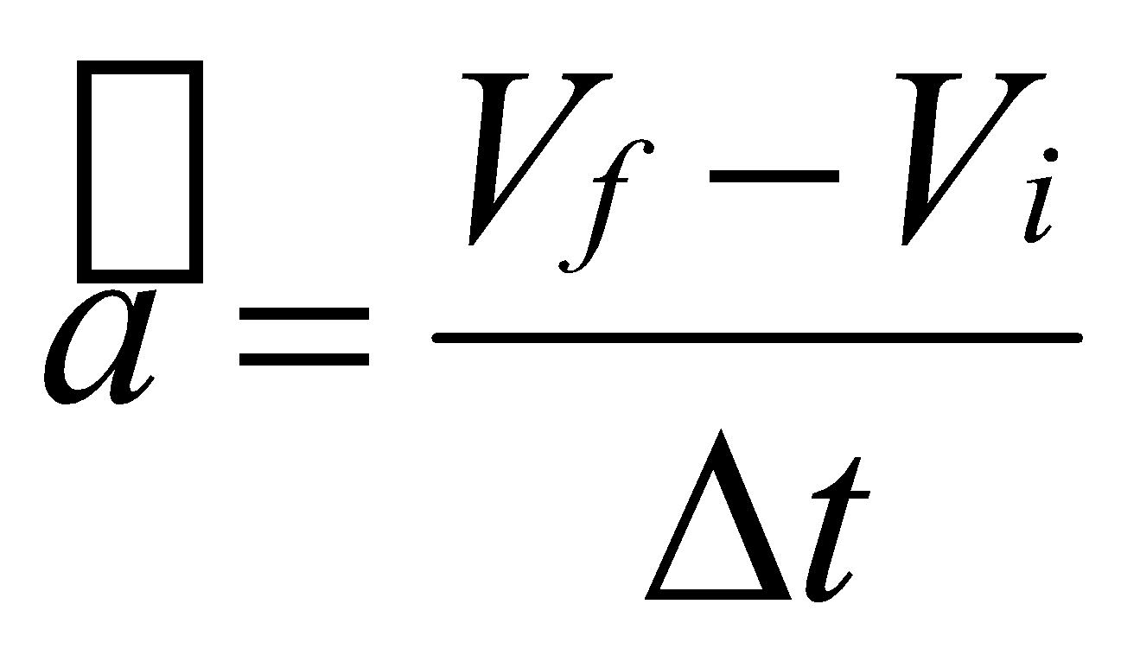
Suppose you shoot a pool ball at 2.5m/s and bounce it off the side of the pool table and it travels at 1.5m/s to the far corner pocket. Assuming it was in contact with the side of the table for 0.20s, What is the acceleration of the pool ball as it travels to the corner pocket after hitting the side?
1. Equation: (E:)
Substitute: (S:) V_{f} = -1.5 V_{i} = 2.5m/s² = 0.20s
Evaluate: (E:)
Answer: -20m/s² . So that means the ball is travelling to the pocket away from the place it hit the side at 20 m/s².
or

Slide 18
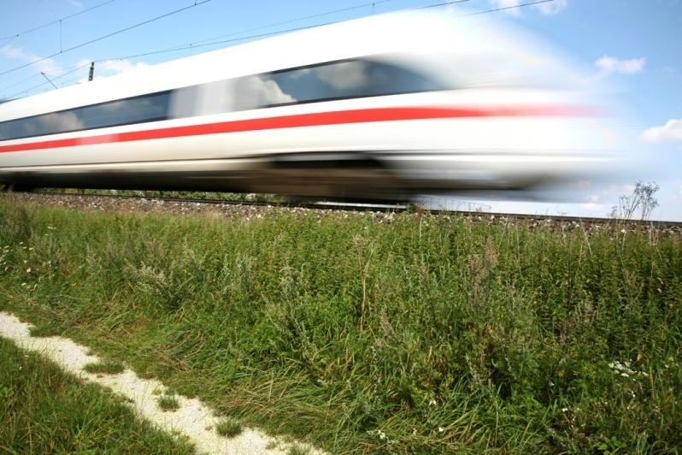
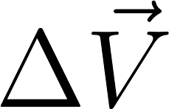
Now let’s try some Questions…
1. The Japanese bullet train accelerates from rest at 2.0m/s² forward for 37s. What is the velocity at the end of the 37 s?
Answer: Use your acceleration triangle to write down the equation. Then substitute… then evaluate.
= (2.0m/s²) (37s)
= 74 m/s forward

Slide 19
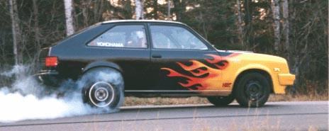
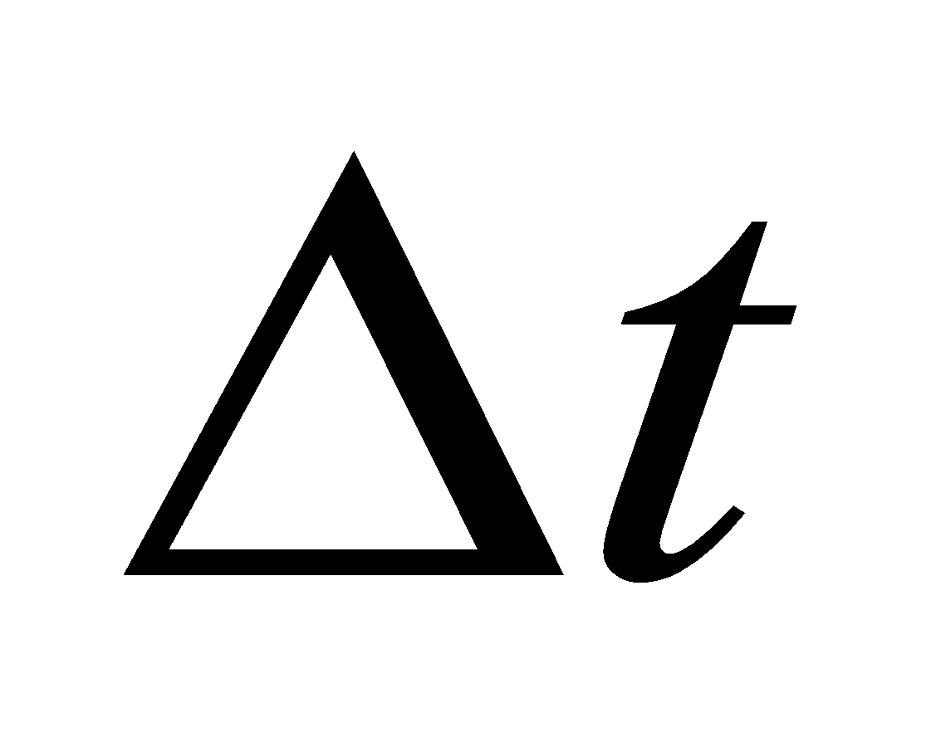
2. A Chevette (car) is travelling North at 22m/s. How long would it take to slow this car to 12 m/s if it accelerates 2.5 m/s²?
Answer: Equation, Substitute, Evaluate
= 12m/s -22m/s
-2.5m/s²
= -10 m/s
-2.5m/s²
= 4.0s to slow the car

Slide 20
A “mo”ped starting from rest accelerates uniformly to 15m/s [E] in 5 seconds. What is the bike’s acceleration?
First: Get your equation, then Substitute what you know, then evaluate
15m/s
5s
3m/s² is the acceleration
=
=

