Slide 1
ACIDS AND BASES
What are they???

Slide 2
What are they?
Acids and bases are very common.
Many familiar compounds are acids or bases.
Acids are Sour , Bases are Bitter
Classification as acids or bases is based on chemical composition.
Acids and bases can be very dangerous!
Acids are corrosive (BURN skin and insides!).
Bases are Caustic (rashes, burning)
The strength of acids and bases in measured on the pH SCALE

Slide 3
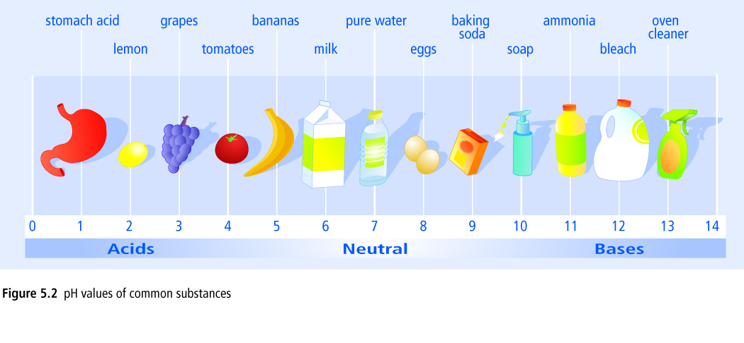
pH SCALE
0 1 2 3 4 5 6 7 8 9 10 11 12 13 14
pH below 7 = acidic pH above 7 = basic pH 7 = neutral

Slide 4
What does the pH scale mean?
Each decrease of 1 on the pH scale indicates 10X more acidic
For example, pH 4 is ten times more acidic than pH 5
pH 3 (Grapes) is 1000X more acidic than pH6 (milk)

Slide 5
How do we determine the pH? aka. How do we determine if something is an Acid or a base?
The pH of acids and bases cannot be determined by sight, instead, pH is measured by 2 other methods:
1) Indicators –chemicals that change colour depending on which pH they are placed in.
∙The most common type of indicator is Litmus, used on litmus paper. There are two colours of litmus paper: Blue and Red
If litmus paper turns/stays Blue = pH above 7 = Base
If Litmus paper turns/stays Red = pH below 7 = Acid

Slide 6
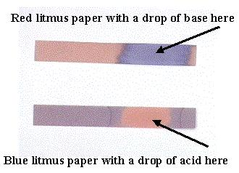

Slide 7
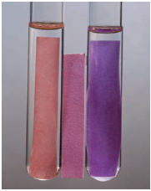
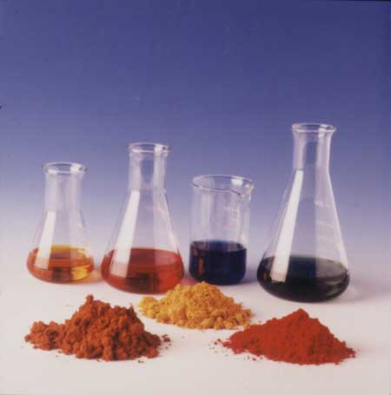
Liquid Chemicals are another common type of indicator. These chemicals change colour at different pH’s
Eg. Bromothymol Blue is an indicator used to test for pH 6 - 7.6,
Eg. Phenolphthalein is an indicator used to test for pH 8.2 – 10
Many natural sources, such as beets and cabbage, are also indicators
http://ca.youtube.com/watch?v=6Y4Y-__ME60

Slide 8
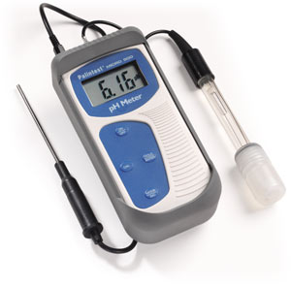
The second method of determining pH
2) A pH meter is another method of measuring pH
∙ Both Acids and Bases conduct electricity when dissolved in water. A pH meter measures the electrical conductivity of the solution – it uses electric probes that you place in a solution and it measures how electricity is conducted in the solution.

Slide 9
There is 1 easy way to tell if something is an Acid or a Base…
If you know the chemical formula of your unknown chemical – you can tell if it is an acid or a base.
Acids are often written with subscript (aq) = aquatic = water
Acids conduct electricity because they release hydrogen ions, H⁺_{(aq)}
The chemical formula of an acid usually starts with Hydrogen (H-).
Acids with a carbon usually have the C written first.

Slide 10
Examples of some Acids
HCl_{(aq)} = hydrochloric acid,
HNO_{3(aq)} = nitric acid
CH₃COOH_{(aq)} = acetic acid

Slide 11
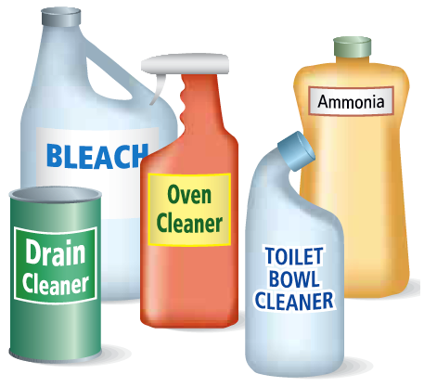
Bases, like acids, are often written with subscript (aq) = aquatic = water
Bases release hydroxide ions OH–_{(aq)}
The chemical formula of a base usually ends with hydroxide (-OH).
Bases can be harmless or very caustic
Examples of common bases
NaOH_{(aq)} – Sodium Hydroxide
Mg(OH)_{2(aq)} – Magnesium Hydroxide
Ca(OH)_{2(aq)} – Calcium Hydroxide
NH₄OH_{(aq) –} Ammonium Hydroxide

Slide 12
ACIDS | BASES
pH less than 7, corrosive | pH more than 7, caustic
You get RED Litmus Paper | You get BLUE Litmus paper
Have (aq) behind their chemical formula | Have (aq) behind their chemical formula
Conduct electricity (when dissolved in water) | Conduct electricity (when dissolved in water)
Chemical Formula starts with H | Chemical Formula ends with OH

