Slide 1
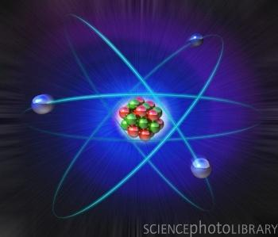
INTRODUCTION/ REVIEW OF ATOMIC STRUCTURE

Slide 2
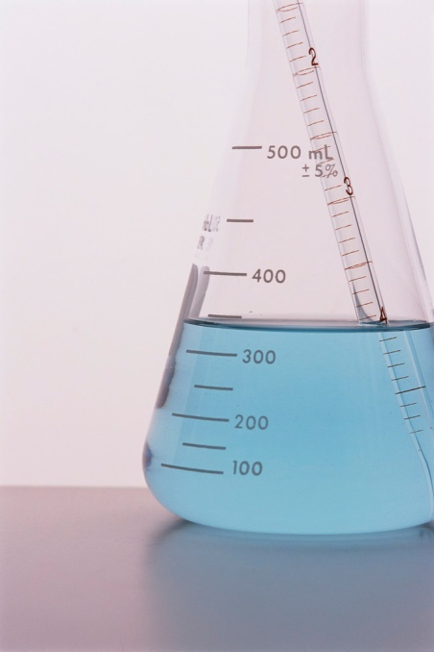
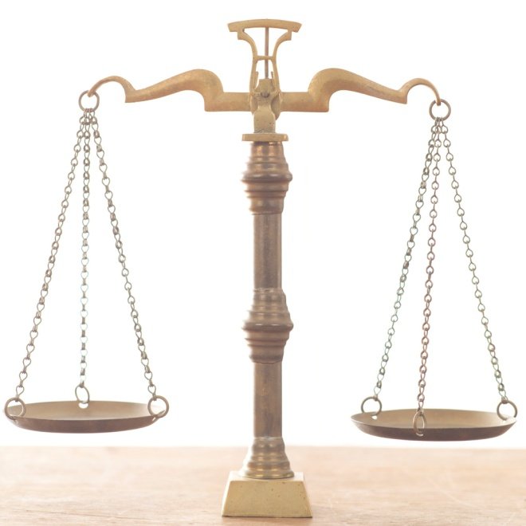
What is matter?
Matter is any substance which:
Occupies space (i.e. has volume)
Has mass
Is air matter?
Does it occupy space? Does it have mass!
YES!

Slide 3
Types of Matter
Matter can be classified as a:
Pure substance- any material having constant composition; in other words, that has the same properties in any sample you choose and is homogeneous (the same) throughout.
Mixture- has two or more kinds of particles and thus may have different properties in different samples

Slide 4
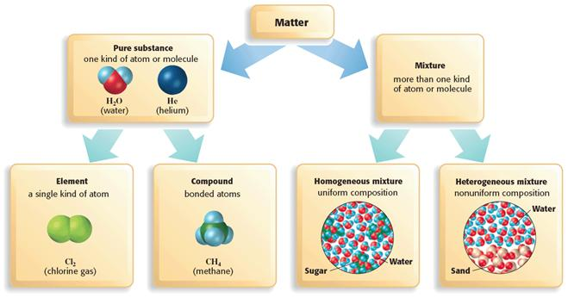
Matter Map

Slide 5
Types of Pure Substances
Pure substances are classified as:
Elements- a substance that cannot be separated into two or more substances by ordinary chemical (or physical) means
The atom is the smallest unit of an element
Compounds- a substance which has its own properties but which can be broken down into other substances
The molecule is the smallest unit of a compound that still retains all of the properties of the compound

Slide 6
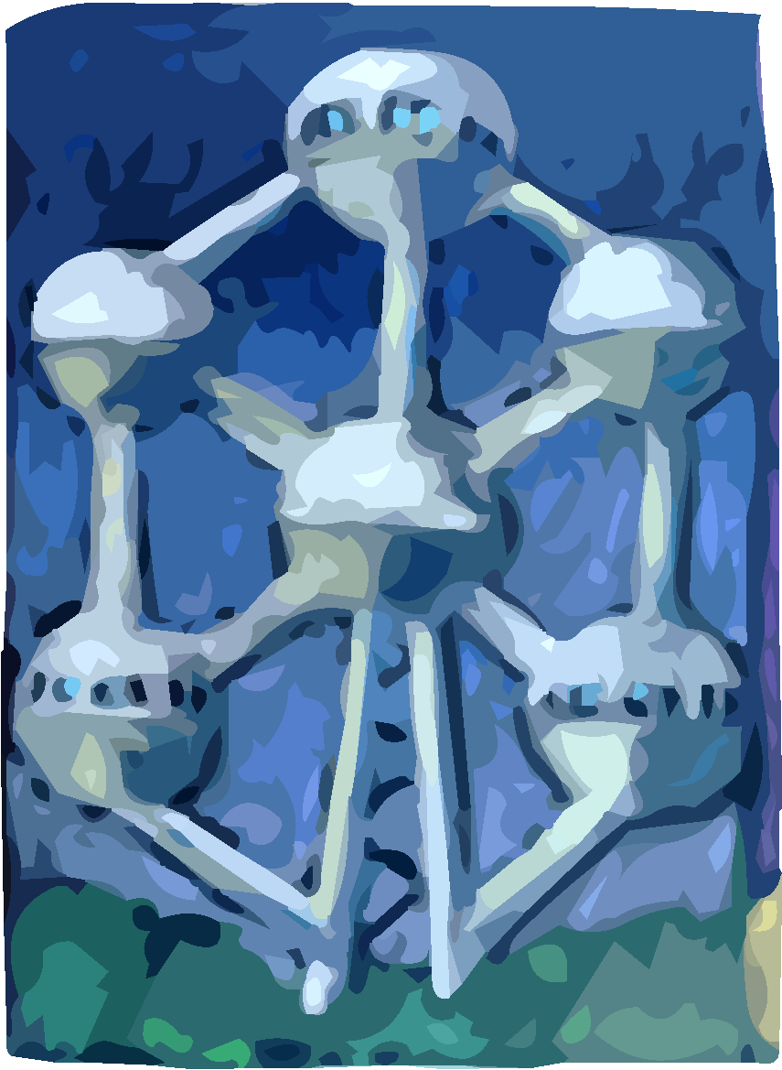
What is an atom?
The atom is the basic unit of matter. Ultimately all classes of matter can be identified or classified based on the type or types of atom that it contains.
The atom is the smallest, indivisible particle of matter which retains its chemical properties

Slide 7
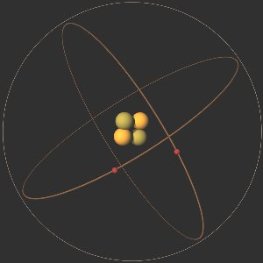
What makes up an atom?
Atoms are made of three types of subatomic particle (“below the level of the atom”)
Protons (p⁺)- a positively charged particle located in the nucleus
Neutron (n⁰)- a neutral (uncharged) particle located in the nucleus
Electron (e⁻)- a negatively charged particle located outside the nucleus
Name | Symbol | Charge | Location | Relative Mass
Proton | p | 1+ | nucleus | 1836
Neutron | n | 0 | nucleus | 1836
Electron | e | 1– | area surrounding the nucleus | 1

Slide 8
Complete Elemental Symbol
Every atom can be described completely using an elemental symbol
The large "X" represents the scientific abbreviation given for the symbol
The symbol "A”, located in the upper left-hand corner, represents the mass number
The symbol "Z", found in the lower left-hand corner, represents the atomic number
General:
Example:

Slide 9
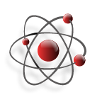
Atomic Number
The atomic number represents the number of protons in the nucleus of the element. In the neutral atom it also represents the number of electrons.
EXTENSIONS:
The atomic number for oxygen is 8; therefore every atom of oxygen has exactly 8 protons in the nucleus. In the neutral atom, there are also 8 electrons to balance charges.
Also, if an atom is known to have 15 protons in its nucleus, its atomic number is also 15 and it is phosphorus.

Slide 10
Mass Number
The mass number represents the number of particles (neutrons and protons) in the nucleus of a specific atom; it is given this name because almost all of the mass of an atom comes from the protons and neutrons.
EXTENSIONS:
If an atom of nitrogen has a mass number of 15 it has 7 protons (by definition because it is nitrogen – and it’s atomic # is 7) and 8 neutrons in its nucleus.
There are 15 particles in the nucleus of which 7 are protons; the other 8 must be neutrons!
So to find the # of neutrons – we subtract the Atomic # from the atomic mass.

Slide 11
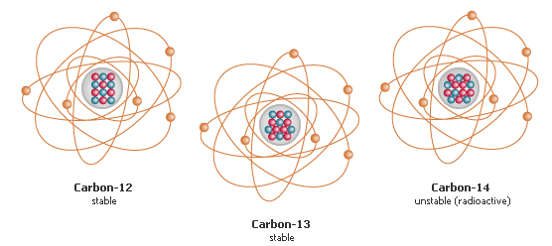
Isotopes:
For a given element, different atoms must by definition have the same number of protons, but can have different numbers of neutrons (i.e. must have the same atomic number but can have different mass numbers)
These atoms are called isotopes (“iso”= the same, “tope”= type or element)

Slide 12
Examples of Isotopes
6
C
Carbon has 3 isotopes.
This is “normal” Carbon – C12
6 protons, 6 electrons, 6 neutrons
Another isotope of Carbon is C13
C13 – 6 p, 6 e, 7 neutrons
The other isotope is C14.
C14 – 6 p, 6 e, 8 neutrons
Carbon
12.001
6
C
Carbon
13.001
6
C
Carbon
14.001

Slide 13
Isotopes – do you get them??
http://www.youtube.com/watch?v=i6-eih43JZM

Slide 14
Practice:
Let’s try and fill in the table using the elemental symbols given!
# of Protons | 3 | 9 | 8 | 56
# of Neutrons (mass number- atomic number) | 4 | 10 | 8 | 80
# of electrons | 3 | 9 | 8 | 56

Slide 15
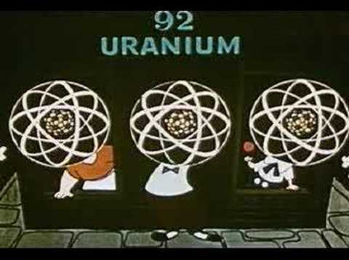
How about a little History
http://www.youtube.com/watch?v=T6UujimddEc&feature=related

