Slide 1
BC Science Connections 8

Slide 2
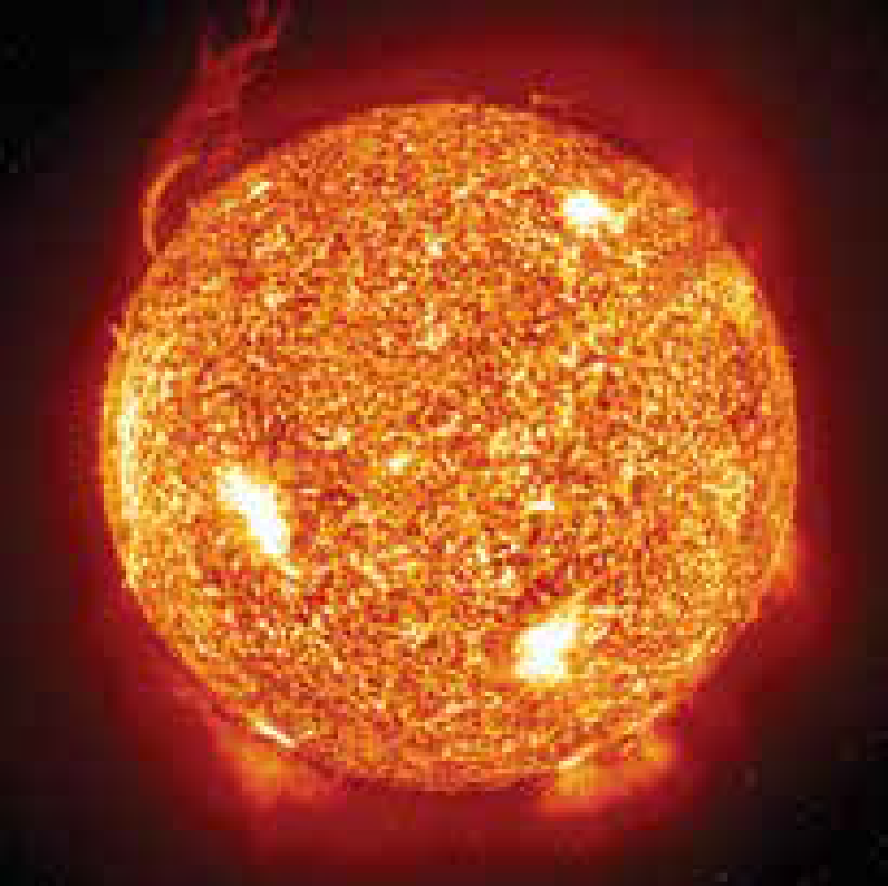
UNIT 1 Life processes are performed at the cellular level
TOPIC 1.1
What are the characteristics of living things?

Slide 3
Topic 1.1: What are the characteristics of living things?
What is a living thing?
What characteristics separate living things from non-living things?
Is the sun a living thing?

Slide 4
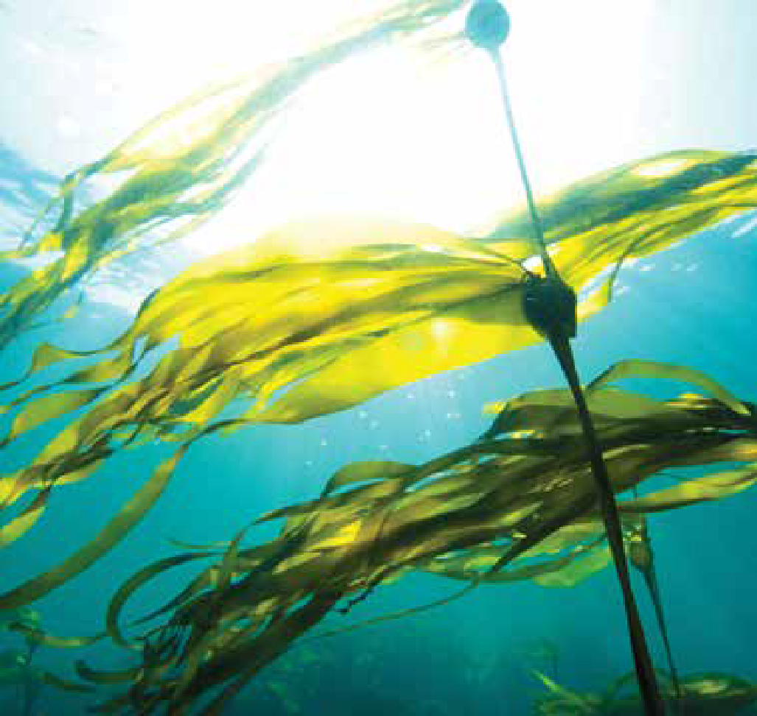
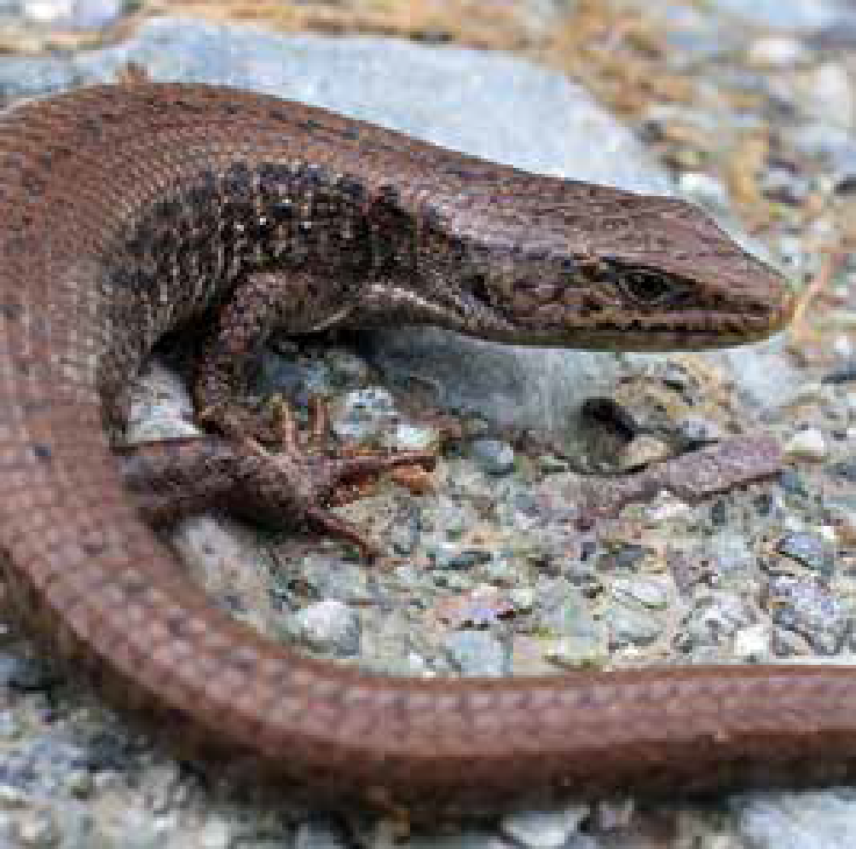
Concept 1: Living things are made of cells, take in nutrients, use energy, and produce waste.
Living things are:
Made of cells
Take in nutrients
Use energy
Produce waste

Slide 5
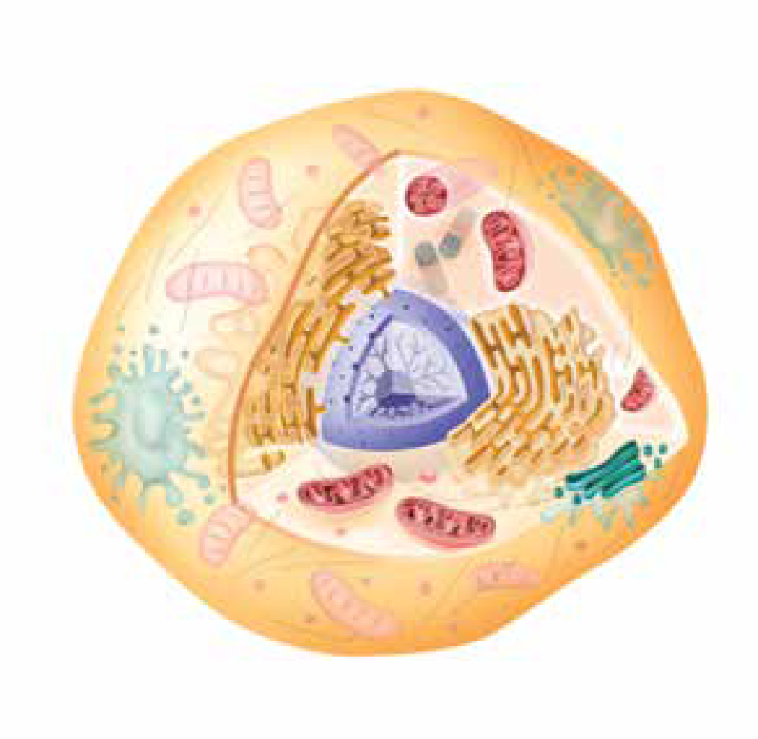
Living Things Are Made of Cells
Cell: The basic structural and functional unit of life
Carries out life processes:
Obtaining and using energy
Breaking down nutrients
Copying genetic material
Excreting waste
Animal cell

Slide 6
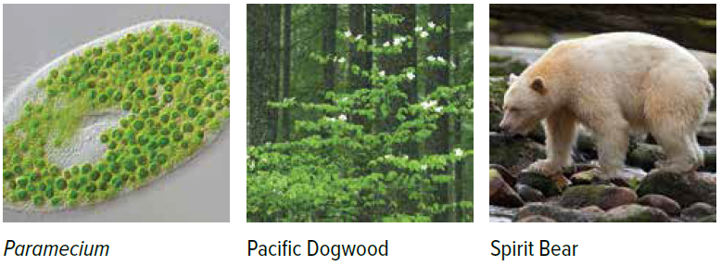
Living Things Are Made of Cells
Living things are made of:
One cell (unicellular or single-celled organisms) or
Multiple cells (multicellular organisms)
Figure 1.1: The cells of all organisms carry out life processes.

Slide 7
Living Things Take In Nutrients
Most organisms get nutrients by eating food
Consumers: Eat (consume) other organisms for food
Producers: Can produce their own food using the Sun’s energy and nutrients from their surroundings
Figure 1.2: Squirrels, sea otters, and humans are all consumers. The grass the squirrel is eating is an example of a producer.

Slide 8
Living Things Use Energy
Living things use energy for life processes (growth, movement, sleep)
Consumers: Get energy from the food they eat
Producers: Use food they make as a source of energy
Figure 1.3: The snowy owl visits southern parts of B.C. from the Arctic in late fall and winter. Mice are among its sources of food energy.
Notes:
cell: the basic structural and functional unit of life
‹#›

Slide 9
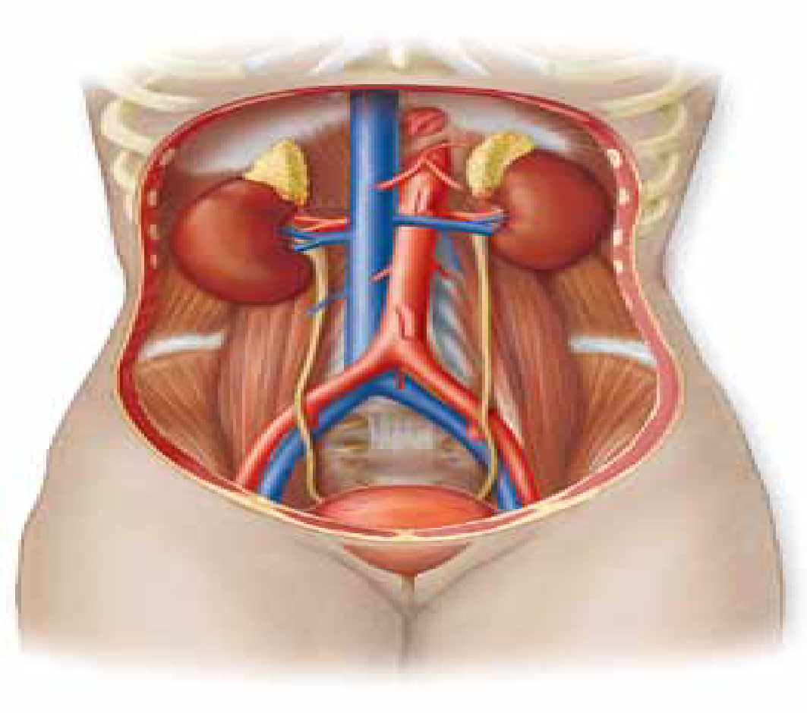
Living Things Produce Waste That Must Be Removed
Living things produce waste that is harmful if not removed
Unicellular organisms:
Waste passes across the membrane of a cell into the environment, or is excreted by a vesicle
Multicellular organisms:
Have structures and systems that collect and remove waste
Humans have kidneys that filter waste from blood
Human excretory system

Slide 10
Discussion Questions
How are unicellular and multicellular living things similar and different?
Why do living things need energy, and where do they get it?

Slide 11
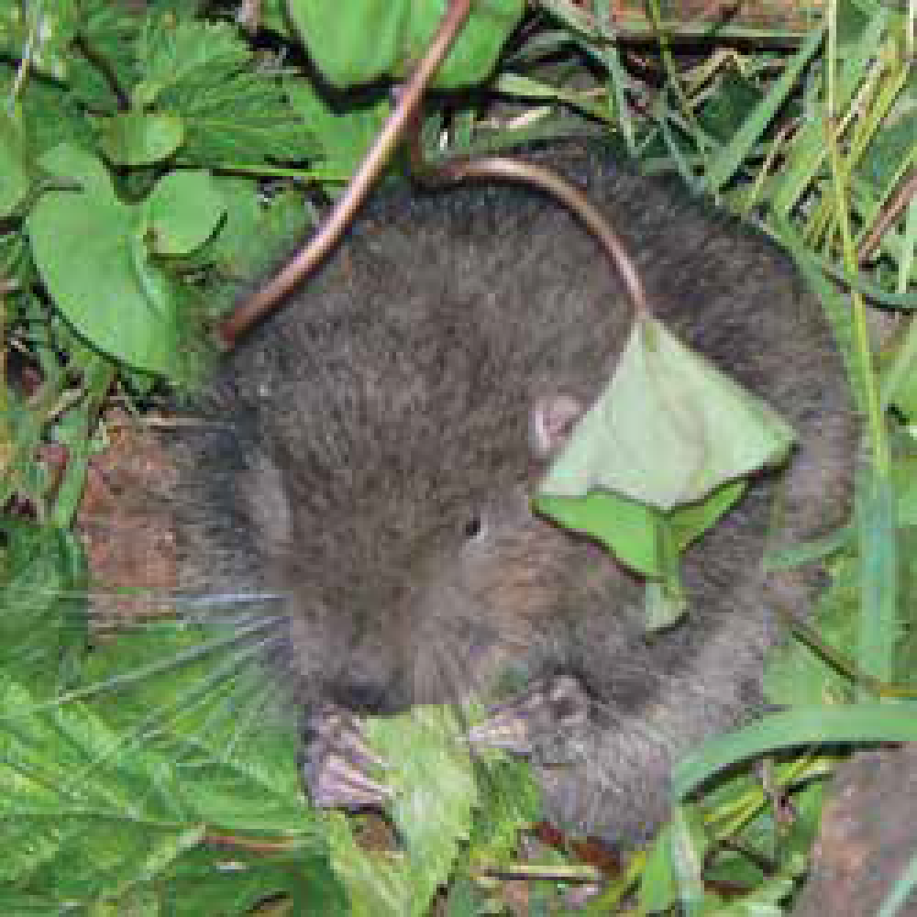
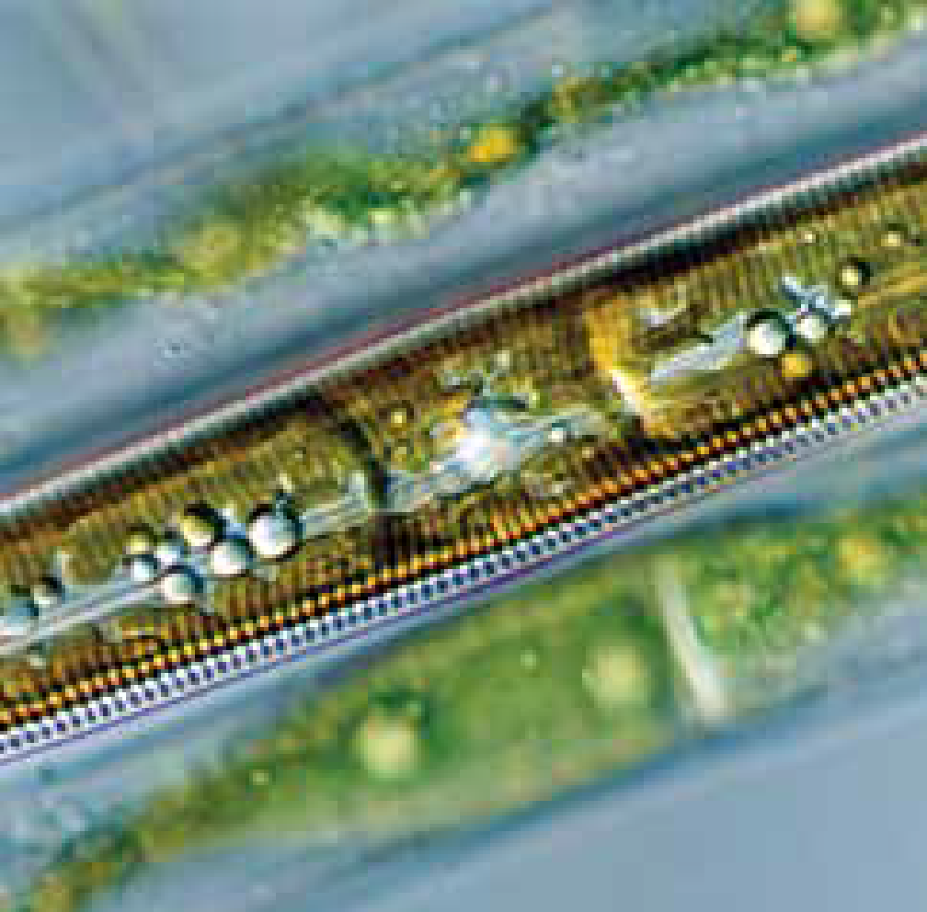
Concept 2: Living things respond to stimuli, grow, and reproduce.
Living things:
Respond to stimuli
Grow
Reproduce

Slide 12
Living Things Respond to Stimuli
Stimulus (plural: stimuli): anything that causes a living thing to respond in a certain way
Type of stimuli | Definition | Example of stimulus | Response to stimulus
Internal stimuli | Things that occur inside a living thing’s body that cause a response | Stomach growling | Eat food
External stimuli | Things that occur outside a living thing’s body in their surroundings that cause a response | Light | Plant: grow towards the light

Slide 13
Living Things Respond to Stimuli
Figure 1.4
The caribou drinks in response to an internal stimulus (thirst).
A plant growing toward the light is responding to an external stimulus.
Euglena have an eyespot that allows them to sense the external stimulus of light.

Slide 14
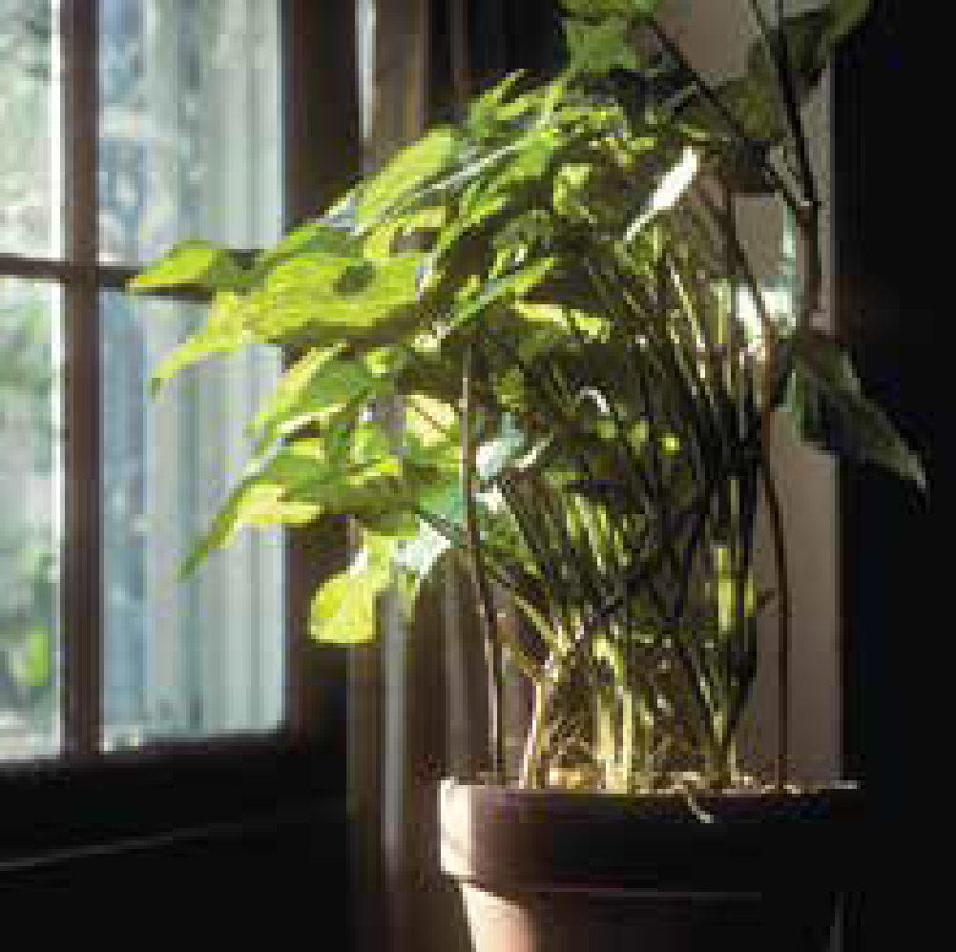
Living Things Grow
Living things grow by increasing in size, or in the number of cells, or both
Unicellular organisms: Grow by increasing in cell size up to a certain point
Multicellular organisms: Grow by increasing the number of cells in their body
Notes:
Figure 1.1 Caption Question: What is the significance of the Spirit Bear to First Peoples? How do First Peoples use the Pacific Dogwood?
‹#›

Slide 15
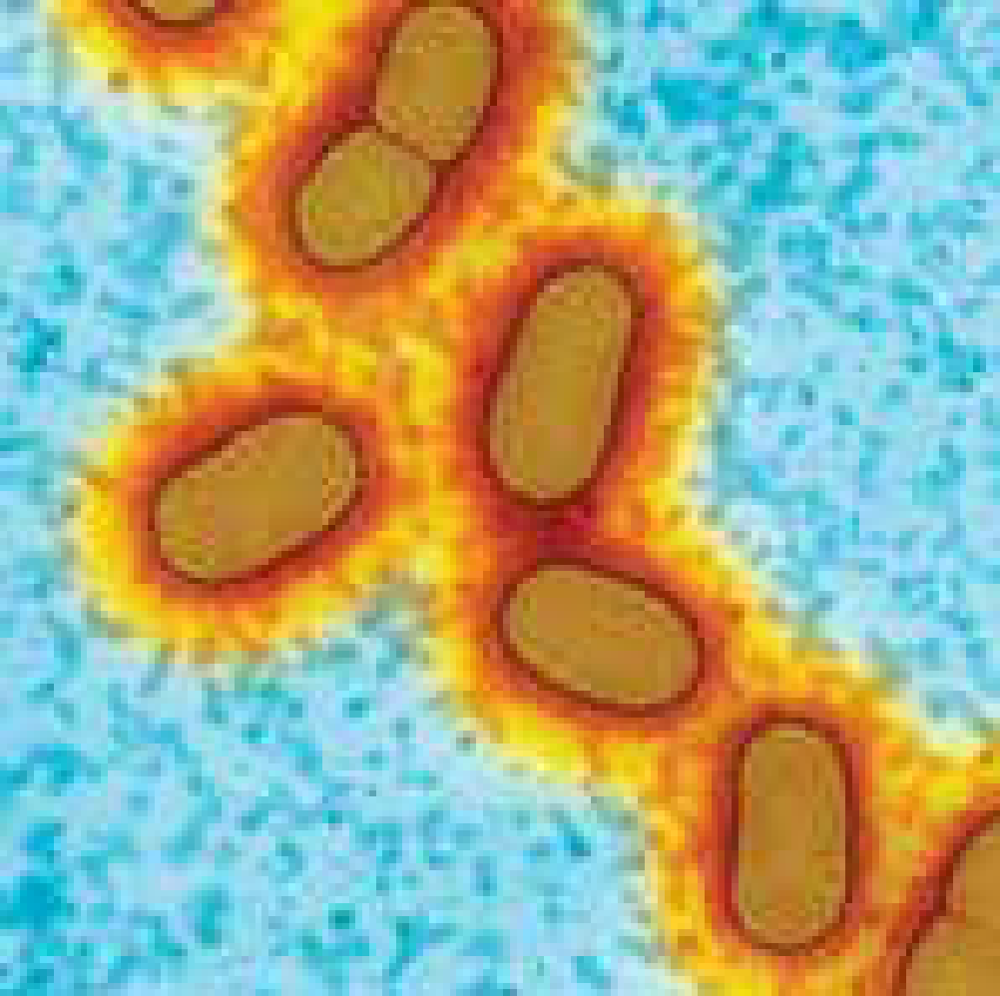
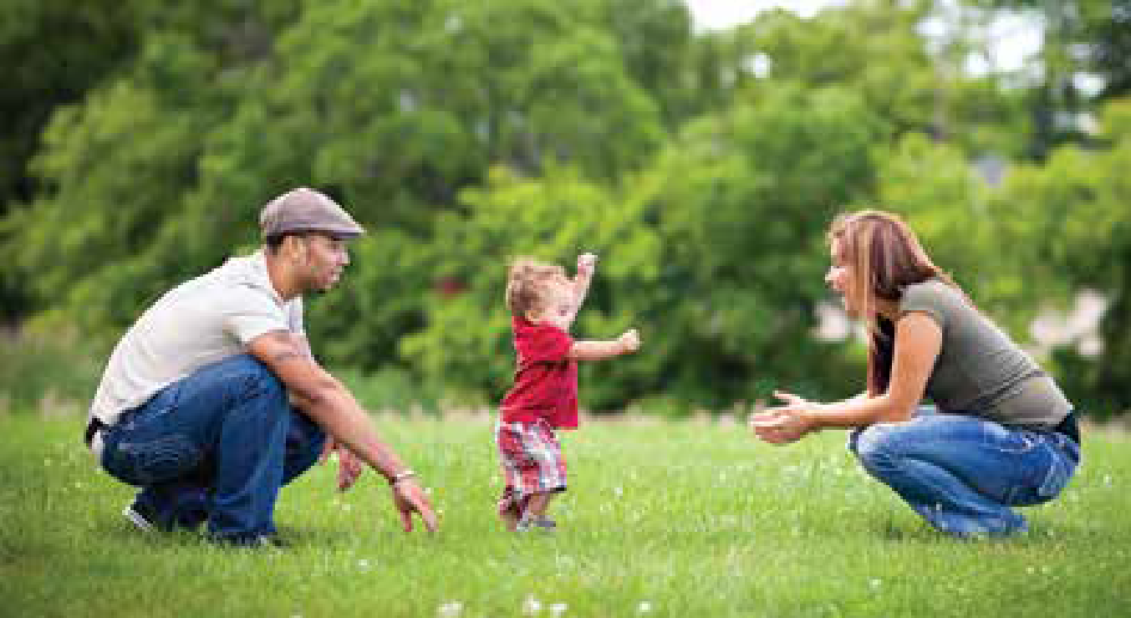
Living Things Reproduce
Living things reproduce using different methods
Cell division: Bacteria divide into two cells
Each new cell is genetically the same as the original cell
Mating: Many organisms mate to reproduce
Offspring are genetically different from parents
Figure 1.5: Bacteria reproduce by dividing into two cells that are identical. Other organisms produce offspring with a mate.

Slide 16
Discussion Questions
Name two internal stimuli and two external stimuli that you respond to. How would your body respond to each of the stimuli?
How is growing different from reproducing?

Slide 17
Summary: Characteristics of Living Things
Living things:
Made of cells
Take in nutrients
Use energy
Produce waste that must be removed
Respond to stimuli
Grow
Reproduce

