Slide 1
BC Science Connections 9
Unit 1: The continuity of life depends on cells being derived from cells

Slide 2
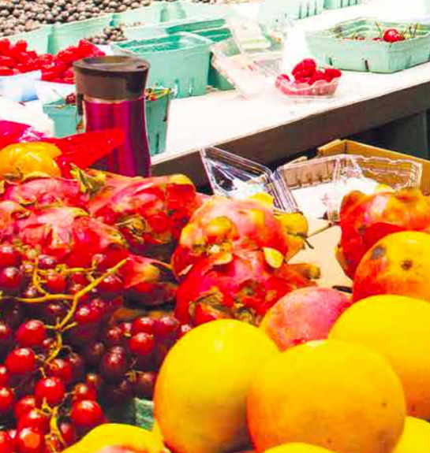
Topic 1.1: Why is the reproduction of cells important?
Reproduction ensures that life exists beyond its present generation
Reproduction transfers genetic information from parents to offspring

Slide 3
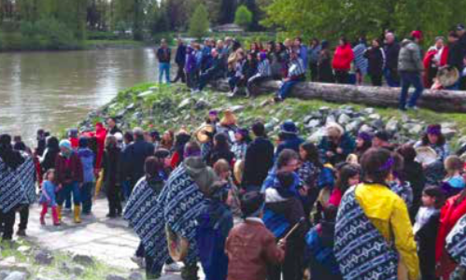
Concept 1: Reproduction ensures that life exists beyond its present generation.
Kwantlen First Nation (Fort Langley): First Foods Ceremony
Welcomes the return of salmon during the start of the salmon run
Honours promise to renew and replenish the spirit and flesh
Figure 1.1

Slide 4
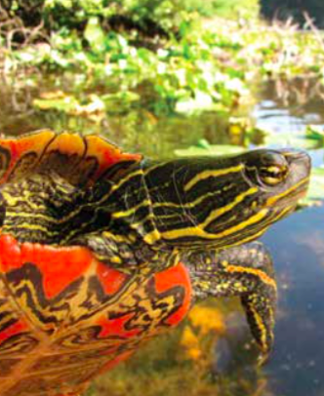
Reproduction and Sustainability
Sustainability: Ability of the environment and living things it supports to endure into the future
Reproduction: New organisms are produced from parent organism(s)
Sustainability of living things depends on reproduction
Figure 1.2: The Western Painted Turtle is found on B.C.’s southwest coast, where it is endangered.

Slide 5
Reproduction and Continuity
Cell Theory: All cells come from pre-existing cells
All cells are formed by reproduction
Continuity: How each species of organism continues to exist over time
Species can only exist in the future if they reproduce (produce offspring)

Slide 6
Discussion Questions
What does the word continuity mean in terms of reproduction?
How are these three terms related: reproduction, sustainability, continuity?

Slide 7
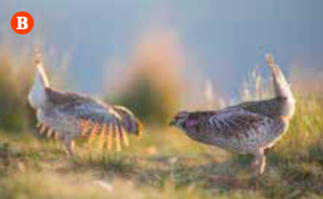
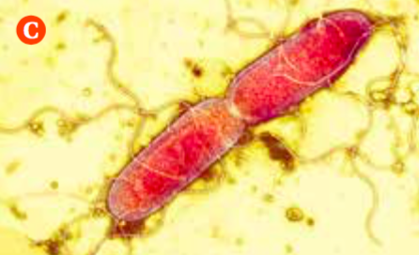
Concept 2: Reproduction transfers genetic information from parents to offspring.
There are several different strategies for reproduction.
A) Flowers: Colours and scents attract animals to transfer pollen
B) Animals: Courtship rituals enable individuals to find mates
C) Bacteria: Reproduce on their own by dividing in two
Figure 1.3: Examples of different strategies for reproduction

Slide 8
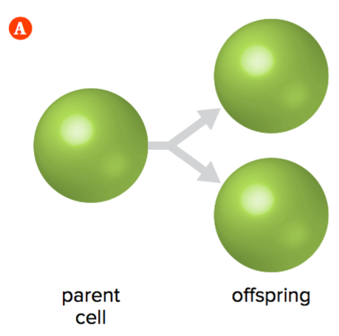
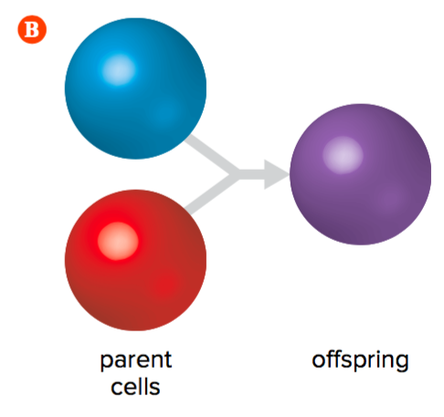
Two Basic Types of Reproduction: Asexual and Sexual Reproduction
A) Asexual reproduction:
Requires only one parent
Produces genetically identical offspring
B) Sexual reproduction:
Requires two parents
Produces genetically different offspring
Figure 1.4: A) Asexual reproduction and B) Sexual reproduction.

Slide 9
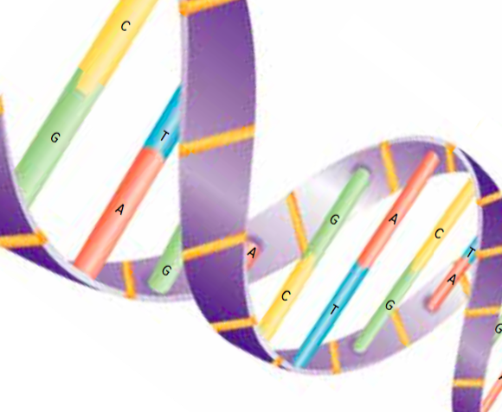
Two Basic Types of Reproduction: Asexual and Sexual Reproduction (continued)
Both asexual and sexual reproduction:
Genetic information is passed onto offspring
Information is contained in DNA (the “molecule of life”)
Figure 1.5: DNA

Slide 10
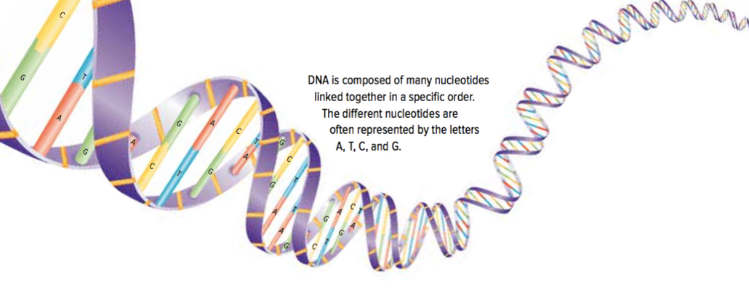
DNA: An Organism’s Genetic Material
DNA: Deoxyribonucleic acid
Stores the genetic information of an organism
Genetic information determines how an organism looks, functions, and behaves
Figure 1.5: An organism’s genetic information is encoded in its DNA sequence.

Slide 11
DNA: Structure and Function
Structure of DNA:
Two long strands shaped like a twisted ladder
Consists of many copies of four different chemical building blocks called nucleotides: adenine (A), thymine (T), cytosine (C), guanine (G)
DNA sequence: The specific order of nucleotides; the “code” that holds the genetic information
Figure 1.5: DNA

Slide 12
DNA: Structure and Function (continued)
Function of DNA:
Stores the genetic information of an organism
An organism’s DNA is stored in each of its cells
DNA molecules coil and compact into a condensed form called chromatin to fit into the cells
Just before reproduction: DNA condenses further into structures called chromosomes
During reproduction: Copies of chromosomes (and therefore DNA) are transferred to the offspring

Slide 13
Discussion Questions
What is the function of DNA?
How is sexual reproduction different from asexual reproduction?

Slide 14
Topic 1.1 Summary: Why is the reproduction of cells important?
Reproduction ensures that life exists beyond its present generation
Reproduction transfers genetic information from parents to offspring

