Slide 1
BC Science Connections 9
Unit 1: The continuity of life depends on cells being derived from cells

Slide 2
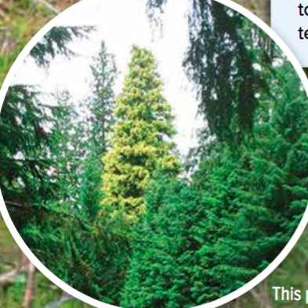
Topic 1.2: What are different ways that living things reproduce asexually?
Bacteria reproduce by binary fission.
All eukaryotic cells reproduce by the cell cycle.
Yeasts reproduce by budding.
Moulds reproduce using spores.
Plants have many ways to reproduce asexually.

Slide 3
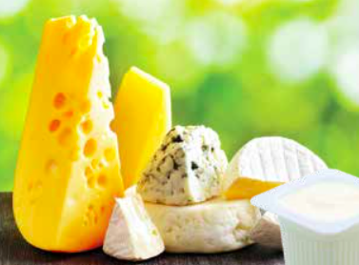
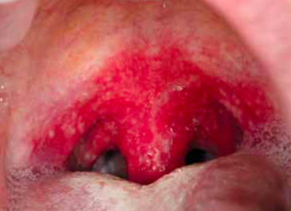
Concept 1: Bacteria reproduce by binary fission.
Bacteria: Micro-organisms that exist as single prokaryotic cells
Reproduce asexually by a process called binary fission
Figure 1.6: Bacteria are in, on, and all around us. Bacteria is used in food production (left) and can cause disease, such as strep throat (right).

Slide 4
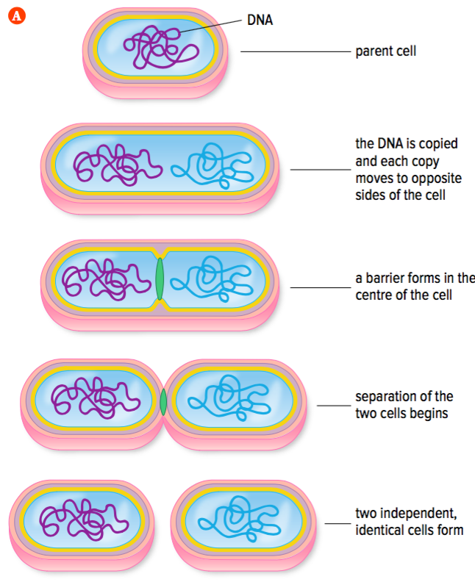
Reproduction by Binary Fission
Binary fission
Type of asexual reproduction
A parent cell splits into two individual, identical cells (daughter cells)
Daughter cells have identical genetic information (DNA)
Figure 1.7: Binary fission

Slide 5
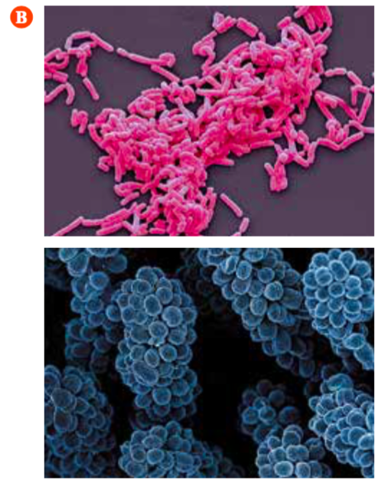
Reproduction by Binary Fission (continued)
Figure 1.7: (A) Binary fission. (B) Many types of bacteria are found as chains and clusters.

Slide 6
Discussion Questions
What key piece of evidence tells you that bacteria reproduce asexually?

Slide 7
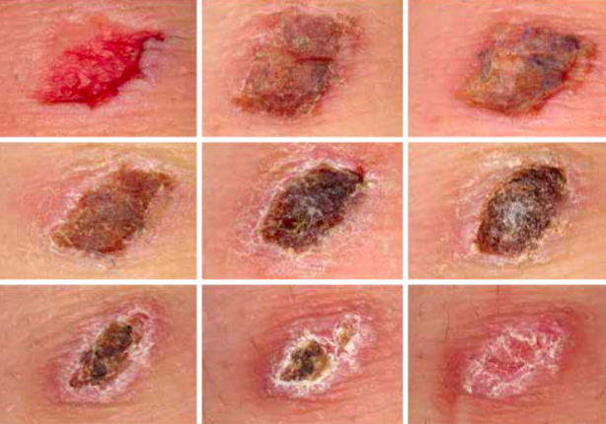
Concept 2: All eukaryotic cells reproduce by the cell cycle.
Functions of eukaryotic cell reproduction:
Replace older cells
Replace damaged cells
Produce new offspring in single-celled organisms (amoebas)
Figure 1.8: A scab forms as some of the remaining skin cells beneath the wound reproduce repeatedly to form a new skin layer to replace what was scraped away.

Slide 8
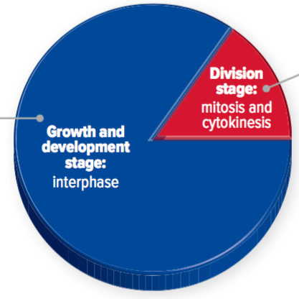
Reproduction and the Cell Cycle
Eukaryotic cells reproduce by a series of events called the cell cycle
The cell cycle has two stages with different events:
Growth and development
Interphase
Cell division
Mitosis
Cytokinesis
Figure 1.10: The cell cycle.

Slide 9
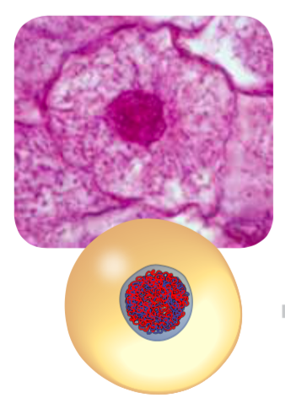
Growth and Development: Interphase
The cell grows and the number of organelles increases
DNA in the nucleus is copied

Slide 10
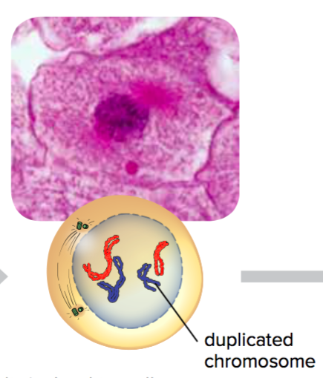
Cell Division: Phase 1 of Mitosis (Prophase)
Nuclear membrane begins to disappear
DNA condenses into duplicated chromosomes
Each chromosome contains two copies of the same DNA

Slide 11
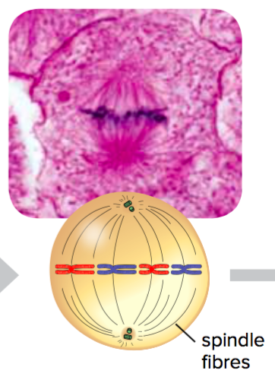
Cell Division: Phase 2 of Mitosis (Metaphase)
Structures called spindle fibres guide chromosome movement
Chromosomes line up along the middle of the cell

Slide 12
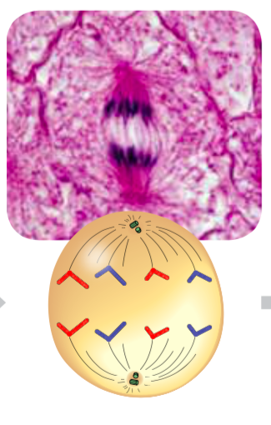
Cell Division: Phase 3 of Mitosis (Anaphase)
Copies of DNA are separated and go to each end of the cell

Slide 13
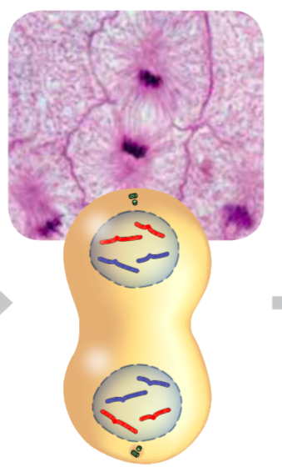
Cell Division: Phase 4 of Mitosis (Telophase)
Two nuclei form
Each nucleus contains a complete copy of the cell’s DNA

Slide 14
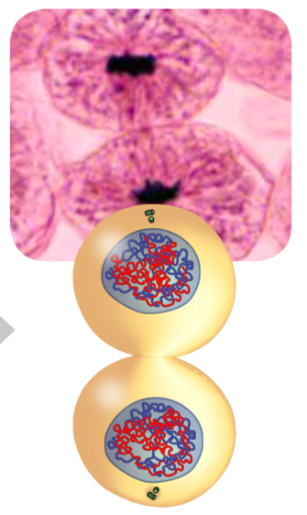
Cell Division: Cytokinesis
Cytoplasm and organelles are divided
Two separate cells form
The cells then begin interphase

Slide 15
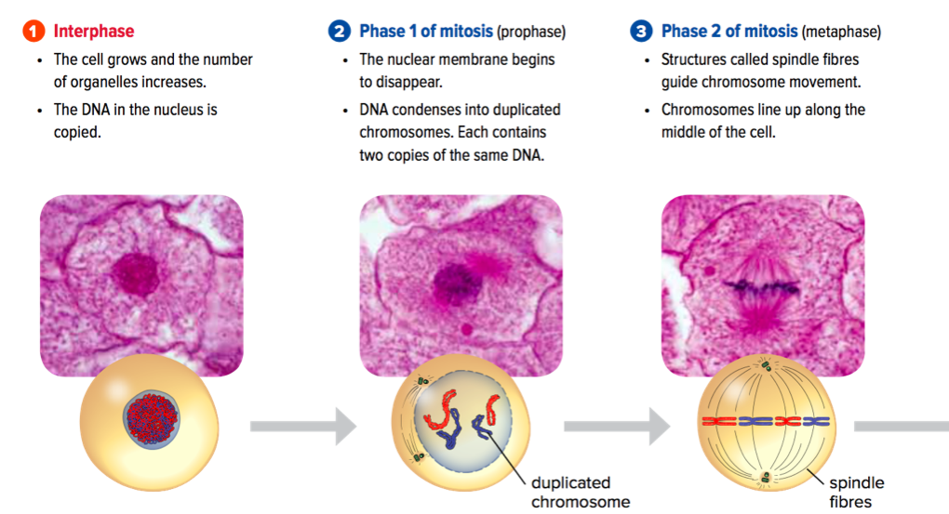
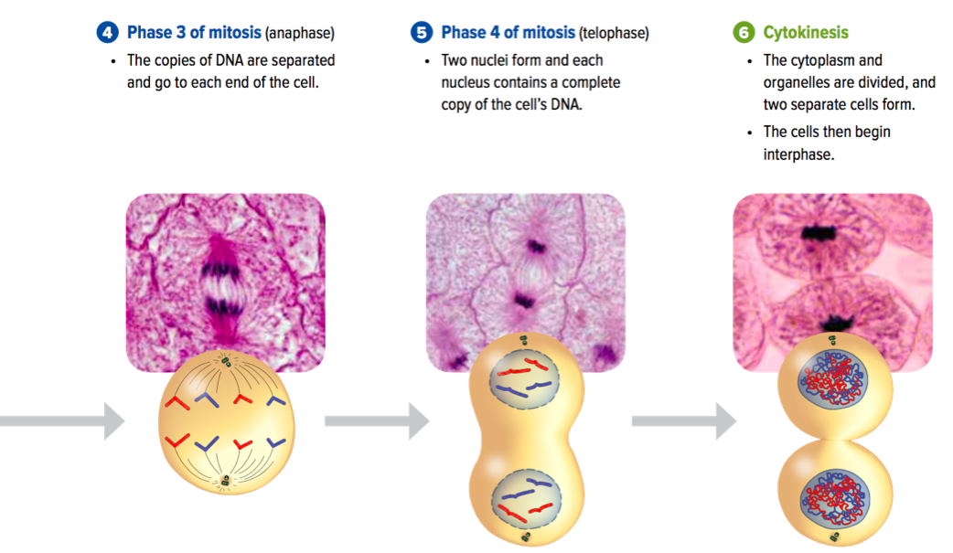
Mitosis: Summary
Figure 1.9: Cell reproduction by mitosis results in daughter cells that are genetically identical to each other and to the parent cell.

Slide 16
Discussion Questions
What happens to the DNA in a cell during interphase? Why is this step important for the reproduction process?
In two or three sentences, describe what the cell cycle is.

Slide 17
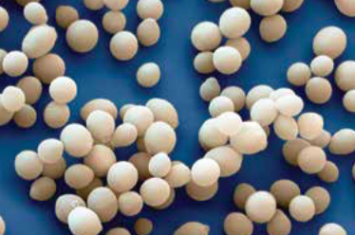
Concept 3: Yeasts reproduce by budding.
Yeasts are unicellular eukaryotic micro-organisms, in the kingdom of Fungi (not plants or animals)
Commonly used to make dough, bread, pretzels, soy sauce, cheese, vinegar
Reproduce by asexual reproduction: budding
Figure 1.11: Yeast

Slide 18
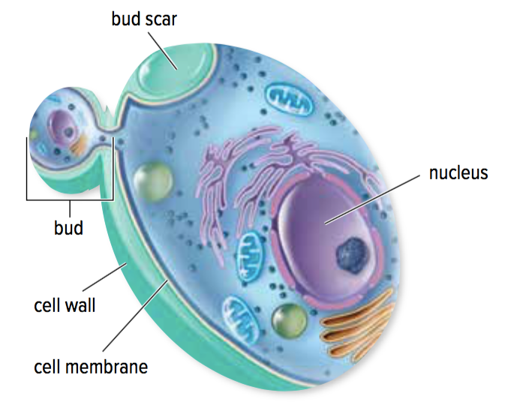
Asexual Reproduction in Yeast: Budding
Budding:
Yeast cell grows a bud that pinches off to become a separate cell
New cell is smaller than original cell at first
Eventually grows to the same size as other yeast cells
Figure 1.11: Yeasts reproduce asexually by budding.

Slide 19
Discussion Questions
In what ways is reproduction in yeasts and bacteria similar? In what ways is it different?
Why is a daughter yeast cell identical to the parent cell?

Slide 20
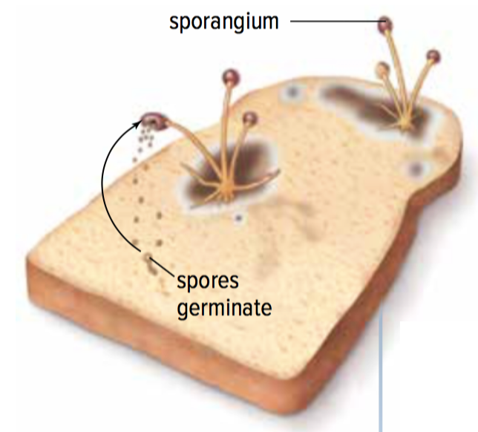
Concept 4: Moulds reproduce using spores.
Moulds are multicellular eukaryotic fungi
Reproduce by asexual reproduction using spores
Figure 1.12: Moulds reproduce using spores.

Slide 21
Asexual Reproduction in Moulds: Spores
Moulds form spores that are genetically identical to the mould cells they come from
Spores are released into the air from a structure called a sporangium
When a spore lands in a favourable environment (warm, moist), it grows and divides by mitosis and cytokinesis
Figure 1.12: Moulds reproduce using spores.

Slide 22
Discussion Questions
What role do spores play in the asexual reproduction of moulds?

Slide 23
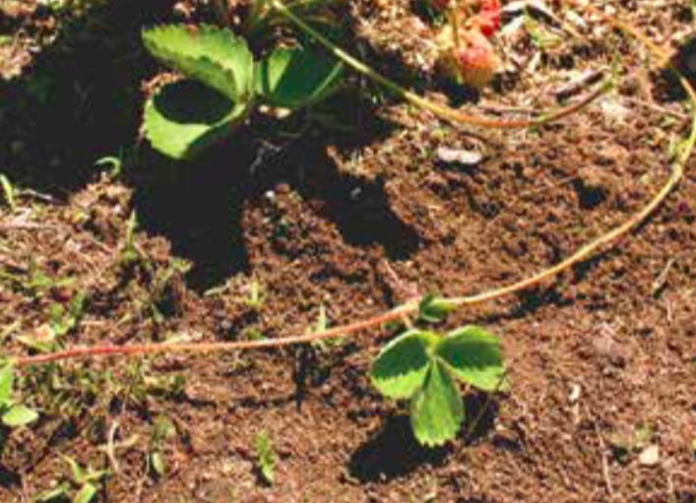
Concept 5: Plants have many ways to reproduce asexually.
Plants reproduce sexually and asexually
Asexual reproduction: Vegetative propagation
New plants grow from a portion of the roots, stems, or leaves from an existing plant
New plants are clones (copies) of the parent plant
Figure 1.13: If you look closely at a field of strawberry plants, you will see smaller plants growing near a larger plant. These smaller plants are new plants that grow along runners. Runners are like stems that grow horizontally, above the ground, from a full-grown plant. Eventually runners die, leaving independent, identical plants.

Slide 24
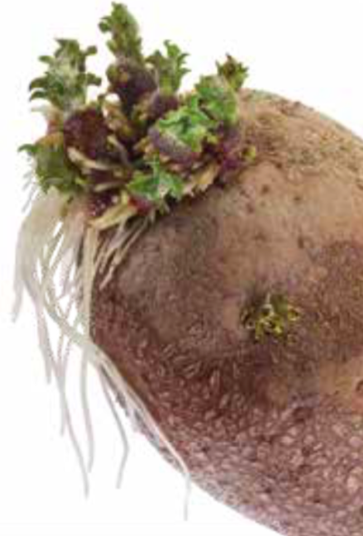
Vegetative Propagation: Example
Potatoes:
New roots and shoots grow from the eyes of a potato
If you plant a potato with this new growth, a potato plant will develop
The new plant will be identical to the parent plant
Figure 1.13

Slide 25
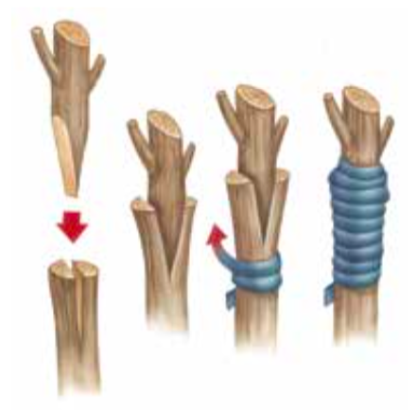
Artificial Vegetative Propagation
Artificial vegetative propagation uses techniques to produce plants with specific characteristics
Example: Grafting
A bud, stem, or root is cut from one plant and joined to another
Used to produce trees with high-quality fruit or resistance to disease

Slide 26
Discussion Questions
Describe an example of vegetative propagation.
Why are new strawberry plants that form from runners identical to the parent plant?

Slide 27
Topic 1.2 Summary: What are different ways that living things reproduce asexually?
Bacteria reproduce by binary fission.
All eukaryotic cells reproduce by the cell cycle.
Yeasts reproduce by budding.
Moulds reproduce using spores.
Plants have many ways to reproduce asexually.

