Slide 1
BC Science Connections 9
Unit 1: The continuity of life depends on cells being derived from cells

Slide 2
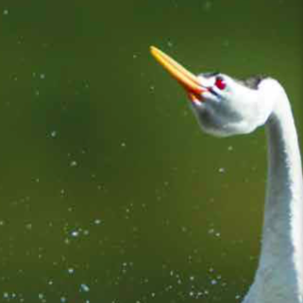
Topic 1.3: How do living things sexually reproduce?
Male and female reproductive cells combine to produce a zygote.
Reproductive cells are formed by meiosis.
Development of the human zygote occurs in stages.
Sexual reproduction takes many forms.

Slide 3
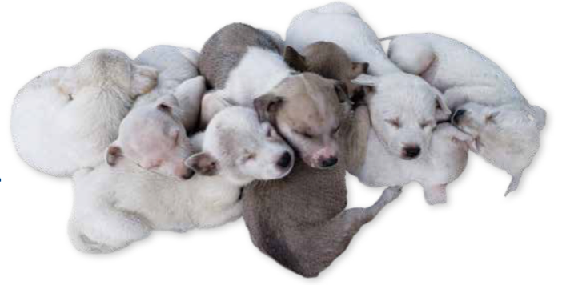
Concept 1: Male and female reproductive cells combine to produce a zygote.
Animals and many other living things reproduce sexually
Half of an offspring’s DNA is from the female parent
Other half is from the male parent
Figure 1.14: In sexual reproduction, each of the two parents contributes characteristics to the offspring. What do you think the male and female parents of this litter might look like? What is your reasoning?

Slide 4
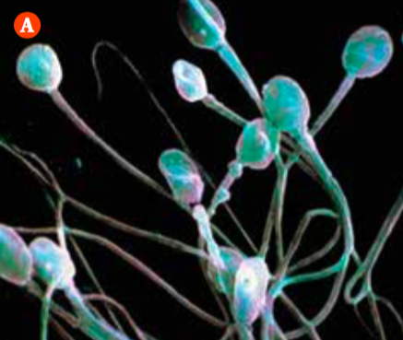
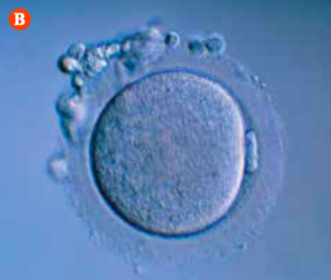
Sex Cells: Gametes
Sex cells (gametes):
Male or female reproductive cells; the cells that combine during sexual reproduction
Male gamete: sperm cell produced in testes
Female gamete: egg cell (ovum) produced in ovaries
Figure 1.15: A) Sperm cells have a unique look, with their long “tails” or flagella. B) Egg cells are much bigger than sperm cells and lack flagella. What does the presence or absence of flagella on sex cells tell you about their mobility?

Slide 5
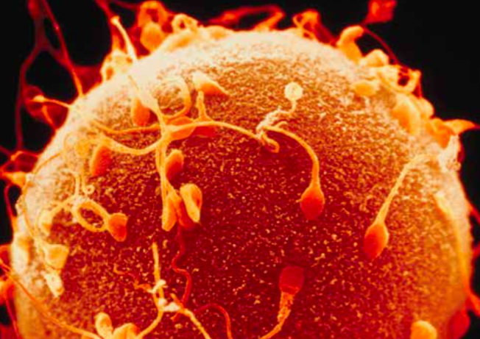
Sex Cells: Gametes (continued)
Central event of sexual reproduction:
Contact between the gametes (sperm and egg)
Sperm and egg (and their genetic information) combine to produce a new single cell that develops into an offspring
Figure 1.16: Of the many sperm that approach and surround an egg, only one can fertilize the egg.

Slide 6
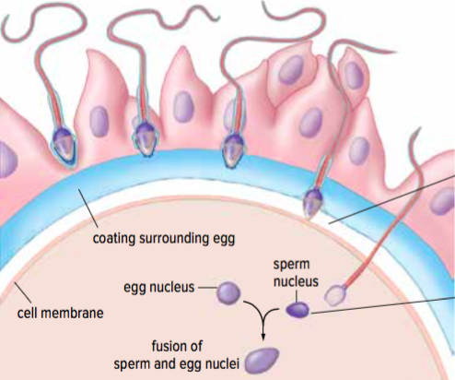
Fertilization
Fertilization: the process in which male and female gametes combine
Nuclei of two gametes fuse together to form a single cell called a zygote
Zygote contains genetic information from the sperm cell and egg cell
Figure 1.17: When a sperm cell fertilizes an egg cell, the two nuclei fuse and a zygote forms.

Slide 7
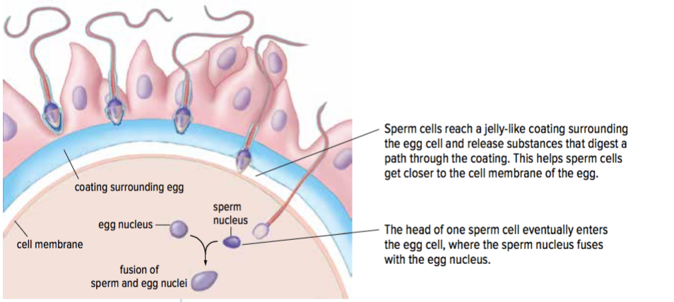
Fertilization (continued)
Figure 1.17: When a sperm cell fertilizes an egg cell, the two nuclei fuse and a zygote forms.

Slide 8
Discussion Questions
How does the process of fertilization occur?
What is needed for fertilization to occur?

Slide 9
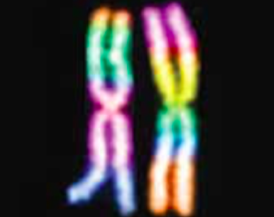
Concept 2: Reproductive cells are formed by a cell-dividing process called meiosis.
Humans have 46 chromosomes (23 pairs)
Paired chromosomes are called homologous chromosomes
During fertilization, each parent contributes one chromosome of each pair
Figure 1.18: A duplicated pair of homologous chromosomes, the female parent contributes one chromosome, and the male parent contributes the other.

Slide 10
Number of Chromosomes in Cells: Haploid and Diploid
Gametes are haploid cells (have half the number of normal chromosomes)
When they combine in sexual reproduction, they form a zygote which is a diploid cell (have the full number of chromosomes)
Body cells are diploid cells (example: skin cells)

Slide 11
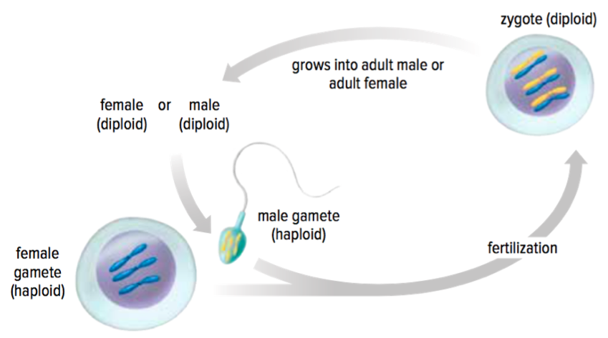
Number of Chromosomes in Cells: Haploid and Diploid (continued)
Figure 1.19: When haploid gametes combine together, they form the diploid zygote.
How do diploid organisms produce haploid gametes?

Slide 12
Meiosis Produces Unique Gametes
Cells that produce gametes undergo a type of cell division called meiosis
Meiosis: a diploid cell divides twice to produce four haploid cells
Offspring are genetically different from parents and from one another (gametes from parents are not genetically the same)

Slide 13
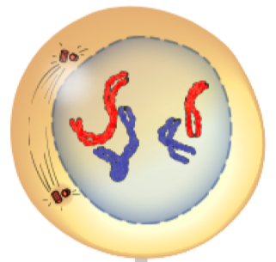
Meiosis: Prophase I
Nuclear membrane begins to disappear
DNA condenses into duplicated chromosomes
Homologous chromosomes are paired

Slide 14
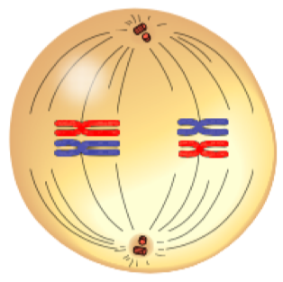
Meiosis: Metaphase I
Spindle fibres guide chromosome movement
Homologous chromosome pairs line up along the middle of the cell

Slide 15
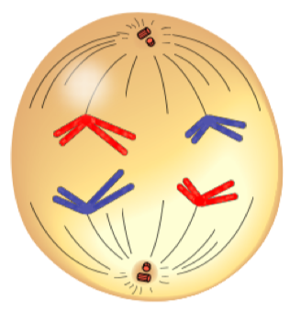
Meiosis: Anaphase I
Homologous chromosome pairs separate and go to each end of the cell

Slide 16
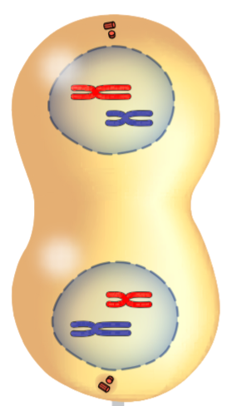
Meiosis: Telophase I
Two nuclei form
Each nucleus contains half of the parent cell’s chromosomes but still in pairs
Cell divides, forming two cells

Slide 17
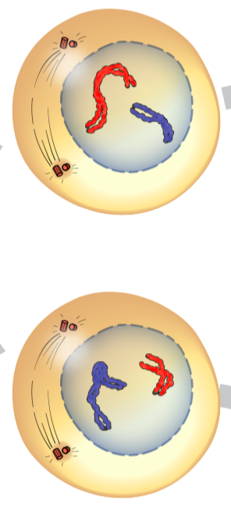
Meiosis: Prophase II
Nuclear membrane begins to disappear
DNA exists as chromosomes

Slide 18
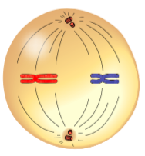
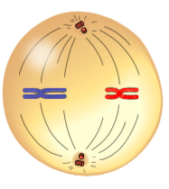
Meiosis: Metaphase II
Chromosomes line up along the middle of the cell

Slide 19
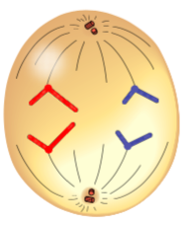
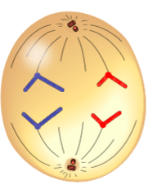
Meiosis: Anaphase II
Copies of DNA are separated and go to each end of the cell

Slide 20
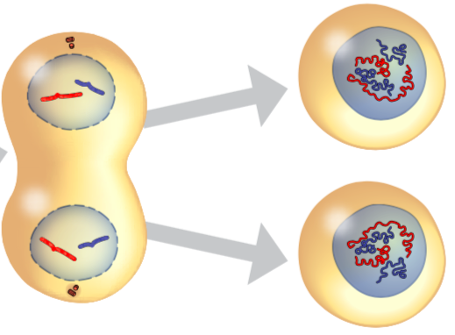
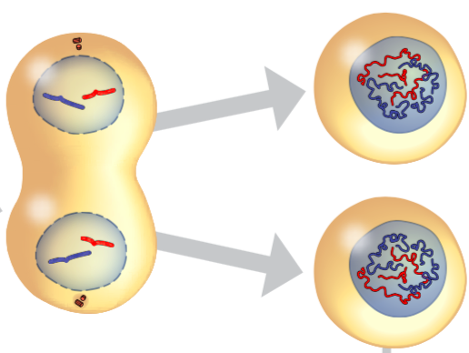
Meiosis: Telophase II
Four nuclei form
Cell divides, forming four new cells
Daughter cells have one copy of each chromosome (instead of the usual two copies).
Whether they have the maternal or paternal version of each is random

Slide 21
Meiosis: First Cell Division Summary
Figure 1.20: Meiosis produces four haploid cells from one diploid cell. These haploid cells are the gametes that take part in sexual reproduction.

Slide 22
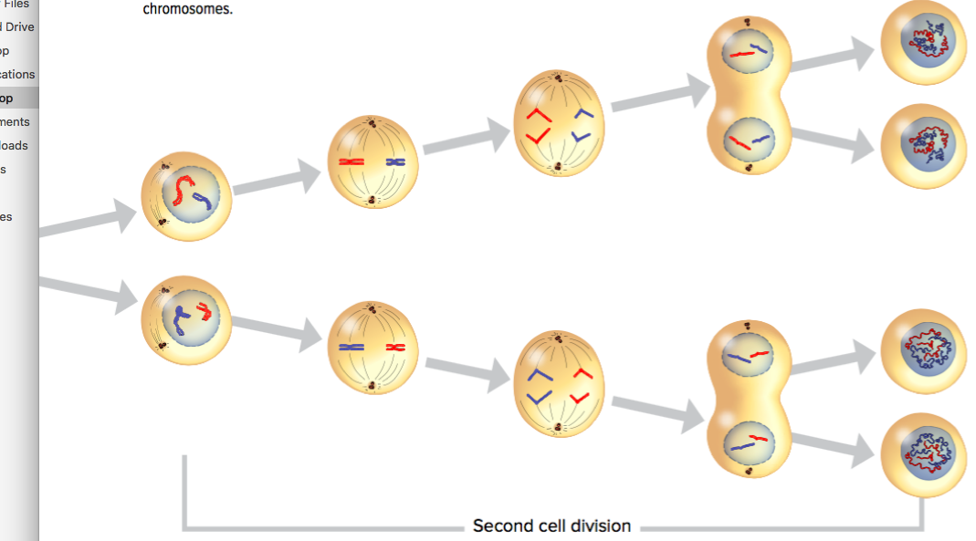
Meiosis: Second Cell Division Summary
Figure 1.20: Meiosis produces four haploid cells from one diploid cell. These haploid cells are the gametes that take part in sexual reproduction.

Slide 23
Discussion Questions
What role does meiosis play in sexual reproduction?
Use a graphic organizer to show how meiosis is similar to and different from mitosis.

Slide 24
Concept 3: Development of the human zygote occurs in stages.
Human prenatal (before birth) development begins when fertilization occurs
Within 30 hours: Zygote divides by mitosis
Cell division continues rapidly
Mass of dividing cells travels and implants to the lining of the uterus
Figure 1.21: In the first stages of cell division, the overall size of the zygote stays the same.
Notes:
‹#›

Slide 25
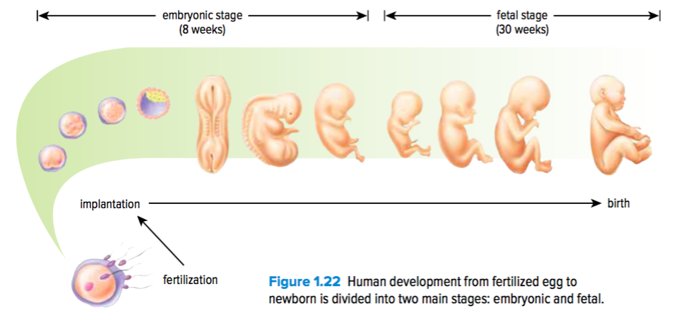
Human Prenatal Development: Embryonic and Fetal Stages
Embryonic stage: 8 weeks
Fetal stage: 30 weeks
Total: 38 weeks from fertilization to birth
However pregnancy is often measured by doctors from the date of the last menstrual period = 40 weeks
Figure 1.22: Human development from fertilized egg to newborn is divided into two main stages: embryonic and fetal.

Slide 26
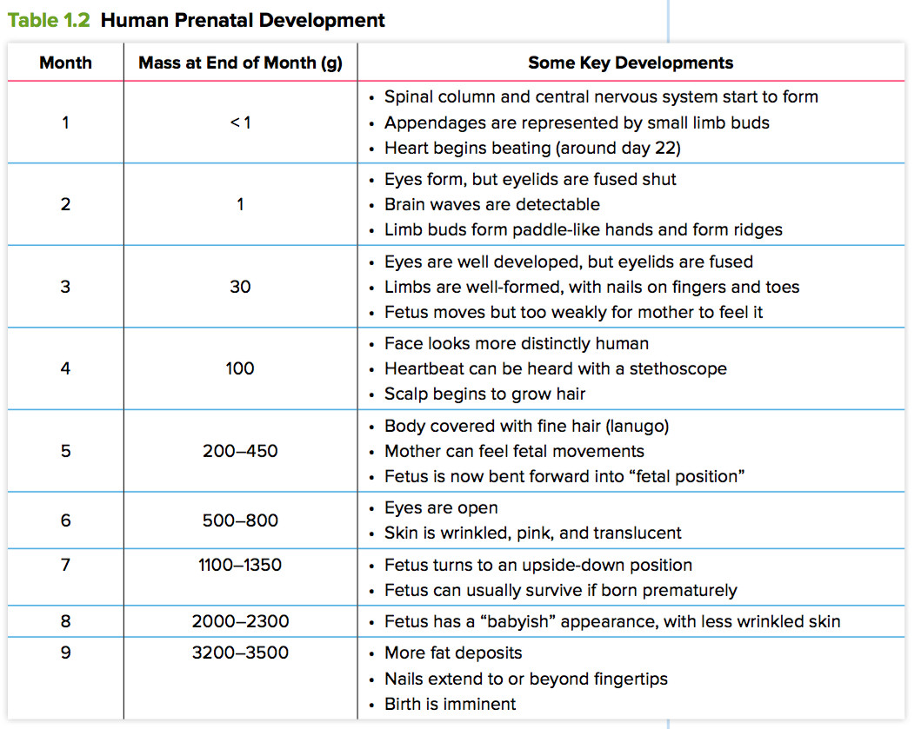
Human Prenatal Development: Summary
Notes:
‹#›

Slide 27
Discussion Questions
During which part of human development are cells dividing by meiosis? by mitosis?
On page 52, the words divides and multiplies are both used in describing prenatal development. Explain why this isn’t as confusing as it might seem at first.

Slide 28
Concept 4: Sexual reproduction takes many forms.
Sexual reproduction can vary based on:
Reproductive behaviours
Methods of fertilization
Ways that offspring develop

Slide 29
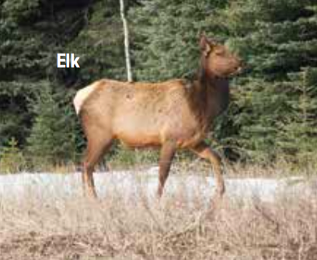
Sexual Reproduction Features: Mammals
Development from fertilized egg to offspring occurs inside the female
Female is also source of nourishment
Notes:
gamete: male or female reproductive cell
‹#›

Slide 30
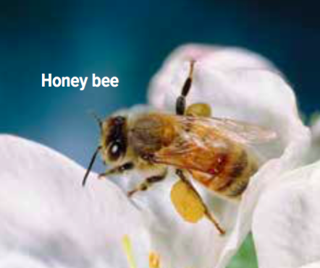
Sexual Reproduction Features: Insects
Reproduction in insects is usually sexual
Some insects (bees) develop without fertilization:
Unfertilized eggs become males
Fertilized eggs become females

Slide 31
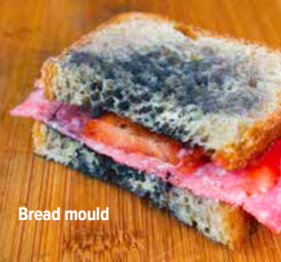
Sexual Reproduction Features: Fungi
Fungi (yeasts, moulds, mushrooms) reproduce sexually and asexually
Notes:
fertilization: the process in which male and female gametes combine
‹#›

Slide 32
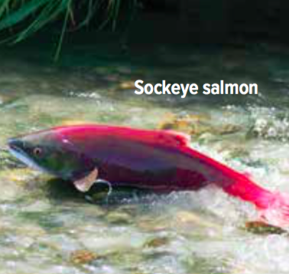
Sexual Reproduction Features: Fish, Frogs, and Birds
Fertilized eggs develop offspring outside the female’s body
Offspring are released when eggs hatch

Slide 33
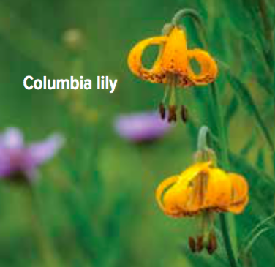
Sexual Reproduction Features: Plants
Plants the grow from seeds require pollination for fertilization
Pollen (which produces sperm) can be transferred by wind or by animals (bees, birds)
Notes:
haploid: a cell with half the number of chromosomes as the parent cell
diploid: a cell with a complete set of chromosomes
‹#›

Slide 34
Discussion Questions
Identify three ways that sexual reproduction differs in different organisms.
What do all forms of sexual reproduction have in common?

Slide 35
Topic 1.3 Summary: How do living things sexually reproduce?
Male and female reproductive cells combine to produce a zygote.
Reproductive cells are formed by meiosis.
Development of the human zygote occurs in stages.
Sexual reproduction takes many forms.

