Slide 1
BC Science Connections 9
Unit 1: The continuity of life depends on cells being derived from cells

Slide 2
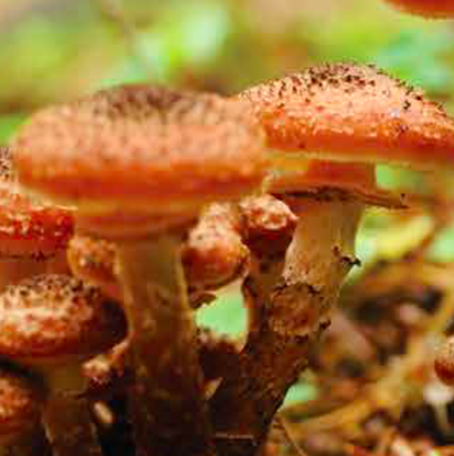
Topic 1.4: How does reproduction contribute to the variety of life on Earth?
Asexual reproduction results in many genetically identical offspring in a short amount of time.
Sexual reproduction results in genetically varied offspring.

Slide 3
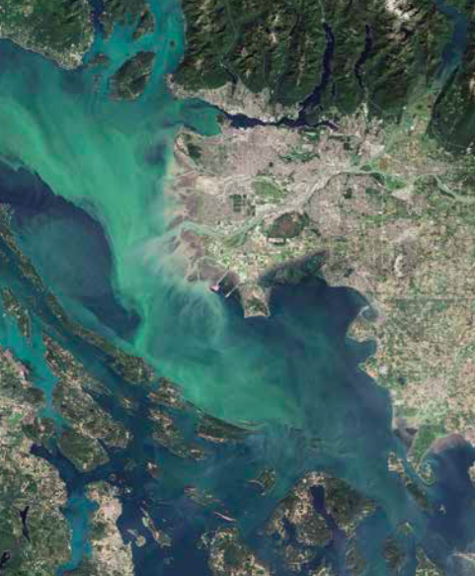
Concept 1: Asexual reproduction results in many genetically identical offspring in a short amount of time.
Algae are plant-like organisms that mainly reproduce asexually
Can multiply very quickly under optimum temperature and nutrient conditions to form an algal bloom
Algal blooms pollute shellfish and make them toxic
Figure 1.24: Algal blooms are a common sight along the Pacific coast any time of year but especially in the summer. Why would algal blooms be especially common in summer?

Slide 4
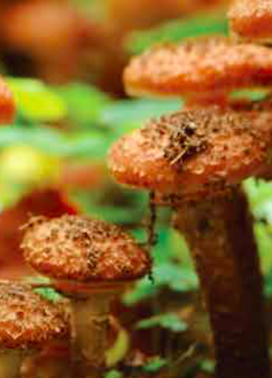
Advantages of Asexual Reproduction
Only one parent is needed (no need to find a mate)
Reproduction occurs quickly
Offspring mature and start reproduction quickly
Offspring are genetically identical to the parent
Can live and interact with their environment with the same success as their parent

Slide 5
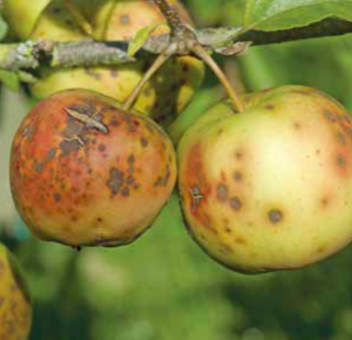
Disadvantages of Asexual Reproduction
Lack of genetic diversity
All individuals in a population are vulnerable to changes in their environment (example: drought, disease)
Since all the individuals are genetically identical, they will all respond in the same way (example: die or become diseased)
Figure 1.26: If the conditions change or a disease occurs, it may cause a crop to die or the yield of produce to be severely reduced.

Slide 6
Discussion Questions
Describe one advantage and one disadvantage of asexual reproduction. Give an example of each.

Slide 7
Concept 2: Sexual reproduction results in genetically varied offspring.
Genetic variation:
Variation in the DNA sequences of each individual in a species
Variation in DNA results from sexual reproduction
Figure 1.27: Although members of this family share similar traits, their different genetic material makes them unique individuals.

Slide 8
Advantages of Sexual Reproduction
Genetic variation/diversity
Genetic diversity allows some individuals in a population to survive if the environment changes
Example:
If the environment changes, some individuals will be less successful at living and reproducing
Other individuals may have certain features (due to genetic differences) that allow them to live and reproduce in the new conditions more easily

Slide 9
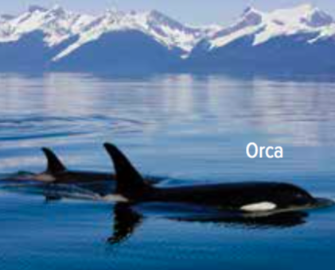
Disadvantages of Sexual Reproduction
Searching for a mate takes time, and may expose individuals to predators, disease, or harsh environmental conditions
Fewer offspring are produced (takes longer for a population to grow)
Offspring take longer to reach maturity (and reproduce)
Offspring require a lot of time and energy to raise until they are independent from their parents

Slide 10
Discussion Questions
Describe one advantage and one disadvantage of sexual reproduction. Give an example of each.

Slide 11
Topic 1.4 Summary: How does reproduction contribute to the variety of life on Earth?
Asexual reproduction results in many genetically identical offspring in a short amount of time.
Sexual reproduction results in genetically varied offspring.

