Slide 1
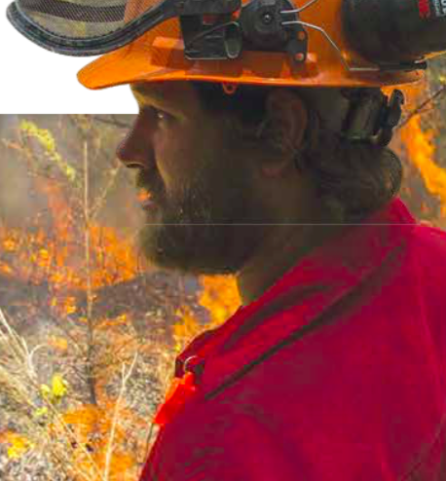
Topic 2.1: How and why do we study matter?
Matter and its interactions make up our world.
Safety is key when working with matter.

Slide 2
Concept 1: Matter and its interactions make up our world.
Matter: anything that has mass and takes up space
Classification of matter
Pure substance: made up of one type of particle; cannot be separated by physical means
Mixture: made up of two or more pure substances; can be separated by physical means

Slide 3
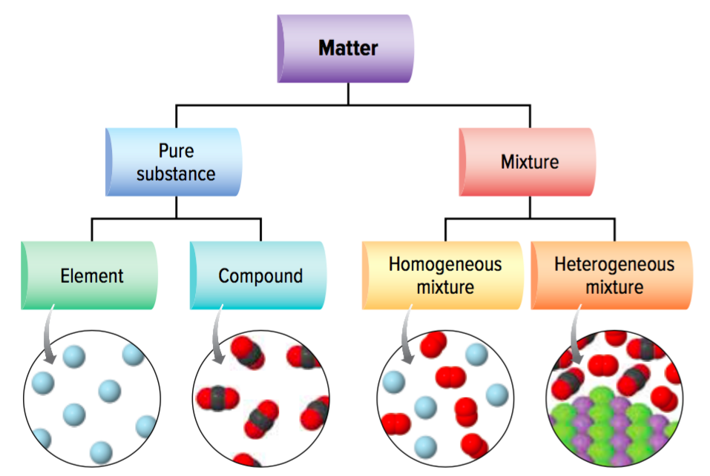
Matter is either a pure substance or a mixture
Figure 2.1

Slide 4
Mixtures: Homogeneous and Heterogeneous Mixtures
Mixtures can be classified as
Homogeneous mixtures (solutions): mixed uniformly; cannot see their components
Example: air (nitrogen, oxygen, hydrogen), steel (iron and other elements)
Heterogeneous mixture: have different components that you can see
Example: beach sand, salad dressing

Slide 5
Pure Substances: Compounds and Elements
Pure substances can be classified as
Elements: made up of one type of atom; cannot be broken down into simpler substances (example: gold)
Compounds: made up of two or more elements; can be broken down into simpler substances (example: sodium chloride)

Slide 6
Mixtures, Compounds, and Elements
Figure 2.2

Slide 7
Properties of Matter
Matter can be described by
Physical properties: characteristics that can be observed or measured without changing is chemical identity (examples: colour, texture)
Chemical properties: describe the ability of matter to react with another substance to form different substances (examples: combustibility, lack of reactivity)

Slide 8
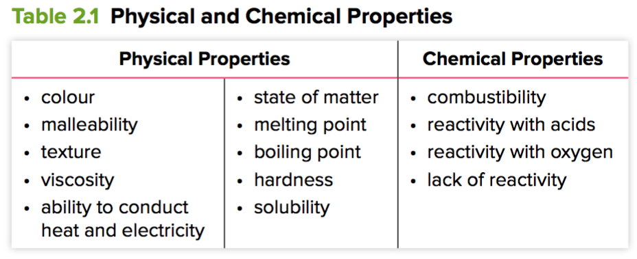
Physical and Chemical Properties

Slide 9
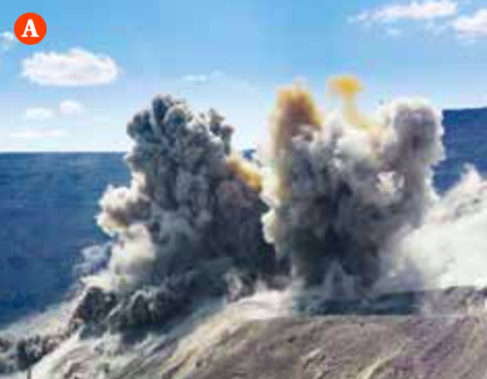
Chemical Reactions
Chemical reaction: one or more pure substances interact to form a different substance or substances
Elements can react to form compounds
Compounds and elements can react to form new compounds
Compounds can break apart to form elements and simpler compounds
Figure 2.3: A) Explosive chemical reactions are used in mining to break apart rock and soil.

Slide 10
Discussion Questions
What is the difference between a pure substance and a mixture? Use diagrams in your answer.
List three physical properties of water at room temperature.

Slide 11
Discussion Questions
Give one example of an element and one example of a compound. Explain how they are different.
What happens in a chemical reaction?

Slide 12
Topic 2.1 Summary: How and why do we study matter?
Matter and its interactions make up our world.
Safety is key when working with matter.

