Slide 1
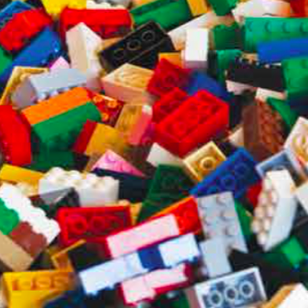
Topic 2.2: How does the periodic table organize the elements?
Elements are the building blocks of matter.
Elements can be organized by their properties.
The modern periodic table organizes elements in groups and periods.
Elements are classified as metals, non-metals, or semi-metals.

Slide 2
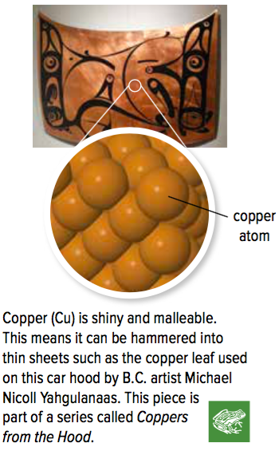
Concept 1: Elements are the building blocks of matter.
Elements:
The basic building blocks of matter
Made up of one type of atom (cannot be broken down further)
About 90 elements occur naturally (carbon, silver, oxygen)
Some elements are synthesized in labs
Have varying properties
Figure 2.6: Copper is made up of one type of atom, and cannot be broken down further.

Slide 3
Element Names and Symbols
Each element has a
Chemical name
Based on Latin words, countries, names of famous scientists
Chemical symbol
One or two letters (first letter is capitalized)
Until very recently, unnamed synthetic elements had placeholder names or three-letter symbols until their discovery was confirmed

Slide 4
Element Names and Symbols (continued)

Slide 5
Discussion Questions
How many elements occur naturally on Earth?
What distinguishes one element from another?

Slide 6
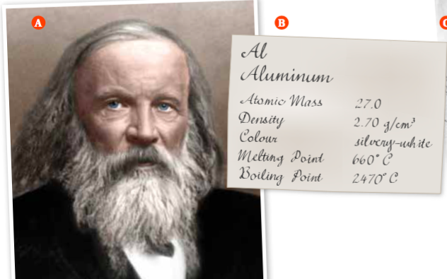
Concept 2: Elements can be organized by their properties.
1860s: Dmitri Mendeleev
Russian teacher and chemist
Looked at different ways to organize the elements
Wrote properties of elements on cards so that he could rearrange them and compare properties (“chemical solitaire”)
Properties included atomic mass (average mass of an atom of an element), density, and melting point
Figure 2.7: A) Dmitri Mendeleev B) Mendeleev wrote the properties of elements on cards like this one so he could rearrange them and compare properties.

Slide 7
The Predictive Power of Mendeleev’s Table
Mendeleev’s periodic table:
Ordered the elements by increasing atomic mass
Grouped elements into “families” based on similar properties (density, melting point)
Left gaps in his periodic table to predict the existence of elements not yet found yet
These missing elements would have properties similar to other elements in the same families

Slide 8
The Predictive Power of Mendeleev’s Table (continued)
Figure 2.8: The gaps in Mendeleev’s table predicted the existence of yet-to-be-discovered elements. Mendeleev used the properties of other elements in the same families to predict the properties of these elements.

Slide 9
Discussion Questions
Why did Mendeleev leave gaps in his periodic table?
How was Mendeleev able to predict the properties of gallium and germanium?

Slide 10
Concept 3: The modern periodic table organizes elements in groups and periods.
Mendeleev’s periodic table was ordered by increasing atomic mass:
Did not work perfectly – some elements were out of order so they would fit in a family that had similar properties
Modern periodic table is ordered by increasing atomic number:
Henry Moseley: scientist that determined an element’s atomic number (the number of protons in an atom)
When elements are arranged according to increasing atomic number, the elements fit perfectly and do not require re-ordering

Slide 11
Meet the Modern Periodic Table
The modern periodic table consists of
Groups (1-18): A vertical column of elements; also called a family
Periods (1-7): A horizontal row of elements

Slide 12
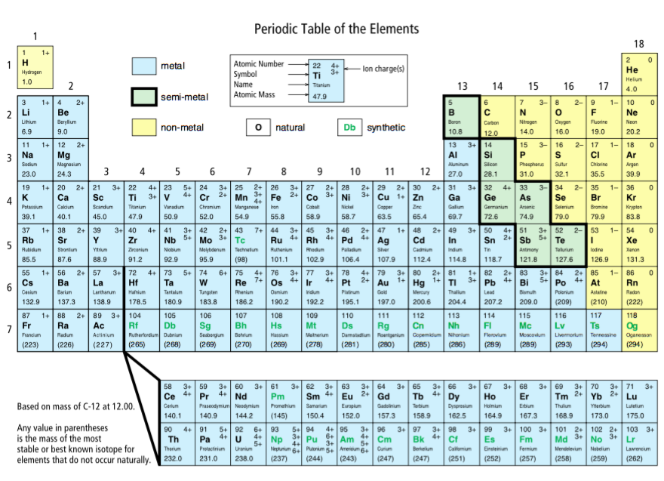
Meet the Modern Periodic Table (continued)
Figure 2.9
Group/Family
Period

Slide 13
It’s actually looooooooong

Slide 14
Meet the Modern Periodic Table (continued)
Figure 2.10: A typical box from the periodic table tells you the element’s name, symbol, atomic number, and atomic mass. The symbol’s font tells you the element’s state.

Slide 15
Discussion Questions
What was Moseley’s contribution to the periodic table and what problem did it resolve?
Give the symbol and atomic number for each of the following elements:
manganese
magnesium
arsenic
astatine

Slide 16
Concept 4: Elements are classified as metals, non-metals, or semi-metals.
Three broad categories of elements shown on the periodic table (Figure 2.9):
Metals (blue)
Non-metals (yellow)
Semi-metals (green)
Elements of Groups 1, 2, and 13 to 18 are called main-group elements or representative elements
Elements in Groups 3 to 12 are called transition elements

Slide 17
Metals
Metal:
Shiny and hard (typically)
Malleable and ductile (can be made into sheets and drawn out into wires)
Conducts electricity and heat
Found to the left of the zigzag line on the periodic table

Slide 18
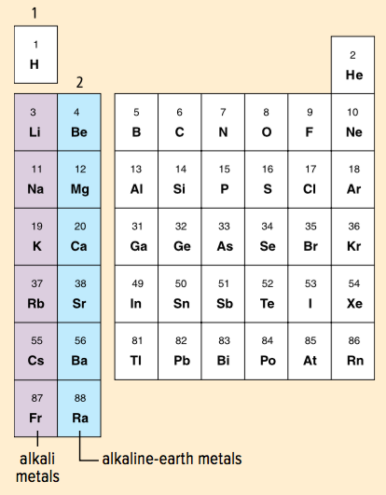
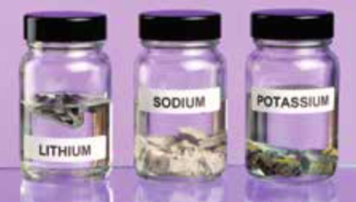
Metals: Alkali Metal
Alkali metals:
Found in Group 1 (all elements, except hydrogen)
Shiny and soft
Highly reactive with water and oxygen (often stored in a non-reactive liquid such as oil)
Figure 2.12: This periodic table only shows the main-group elements.

Slide 19
Metals: Alkaline-earth Metals
Alkaline-earth metals:
Found in Group 2
Shiny and soft (but not as soft as alkali metals)
Highly reactive (but not as reactive as alkali metals)
Figure 2.12: Magnesium (left) burns easily in air when ignited.

Slide 20
Non-metals
Non-metal:
Not shiny, malleable, or ductile
Poor conductor of electricity and heat
Found to the right of the zigzag line on the periodic table
Generally gases or brittle, dull solids

Slide 21
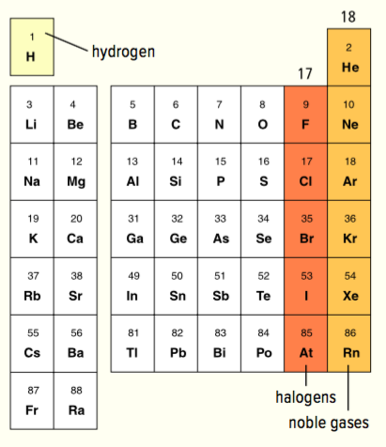
Non-metals: Hydrogen
Hydrogen:
Usually on the left side of the periodic table
Lightest element
Colourless, odourless, tasteless
Highly flammable
Makes up over 90% of atoms in the universe
On Earth: Most hydrogen is found combined with oxygen as water
Figure 2.13

Slide 22
Non-metals: Halogens
Halogens:
Found in Group 17
Highly reactive (therefore usually found in nature as part of compounds)
Figure 2.13

Slide 23
Non-metals: Noble Gases
Noble gases:
Found in Group 18
Odourless, colourless gases
Least reactive of all the elements
Helium and neon never form compounds
Other noble gases form compounds with great difficulty
Figure 2.13

Slide 24
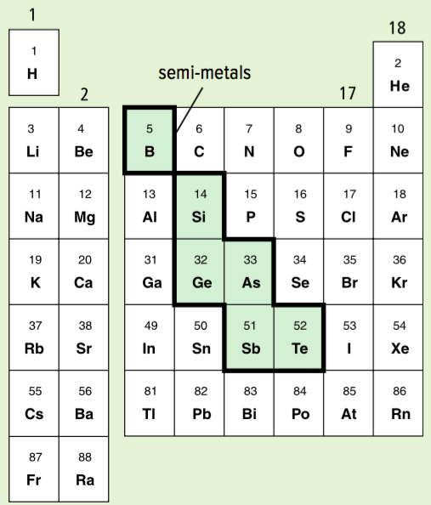
Semi-metals
Semi-metals:
Also known as metalloids
Found in the green boxes in a staircase shape
Have physical and chemical properties of both metals and non-metals
Shiny (like metals)
Brittle and not ductile (like non-metals)
Poor conductors of heat and electricity (like non-metals)
Figure 2.14

Slide 25
Semi-metals: Silicon
Silicon:
Second-most abundant element in Earth’s crust (after oxygen)
Used in many electronic devices (computers, smartphones)
Used to make silicone (material used in cookware, contact lenses, prosthetics)

Slide 26
Discussion Questions
Make a table to summarize the characteristic properties of metals, non-metals, and semi-metals.
What makes hydrogen an unusual element?
What characteristics define semi-metals?

Slide 27
Topic 2.2 Summary: How does the periodic table organize the elements?
Elements are the building blocks of matter.
Elements can be organized by their properties.
The modern periodic table organizes elements in groups and periods.
Elements are classified as metals, non-metals, or semi-metals.

