Slide 1
Topic 2.3: How can atomic theory explain patterns in the periodic table?
The structure of atoms can be represented using simple diagrams.
Elements in chemical groups have similar electron arrangements.
The periodic table shows how properties of elements change in predictable ways.

Slide 2
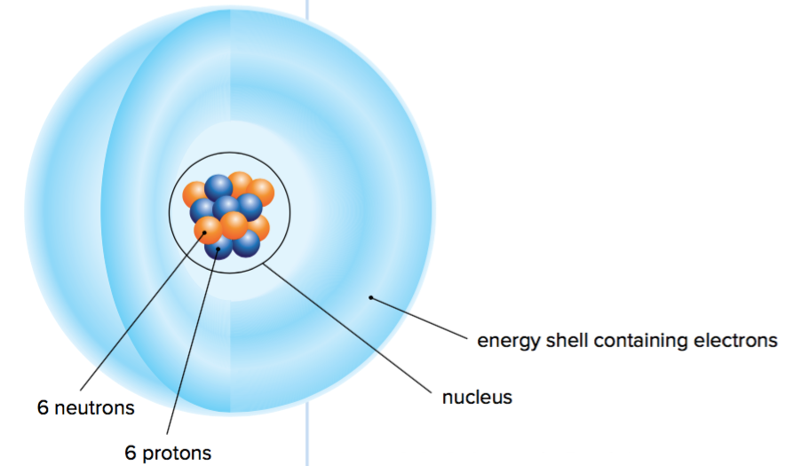
Concept 1: The structure of atoms can be represented using simple diagrams.
The atom: Smallest unit of an element that has the properties of that element
Figure 2.15: Carbon atom

Slide 3
Key Features of Atomic Structure
Each atom has a tiny, dense nucleus with neutrons and protons
Nucleus is surrounded by electrons, which exist in specific electron energy shells
Most of the mass of the atom is in the nucleus
Figure 2.15: Every carbon atom has six positively charged protons in its nucleus and six negatively charged electrons surrounding the nucleus. (Most carbon atoms have six neutrons, but some have seven or eight.)

Slide 4
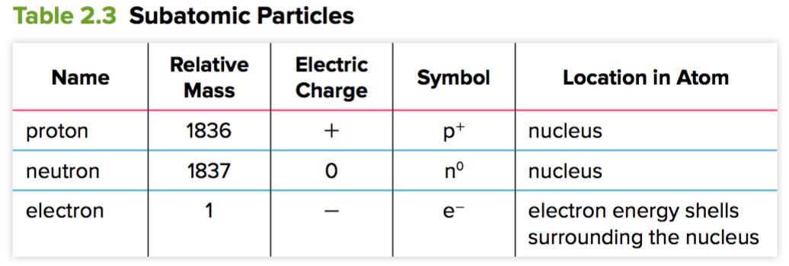
Key Features of Atomic Structure (continued)

Slide 5
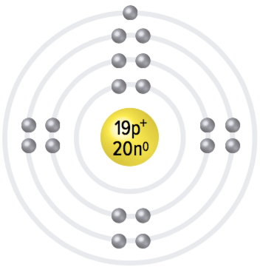
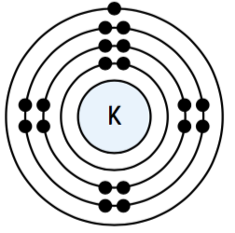
Bohr Diagrams Are a Useful Way to Model Atoms
Bohr diagrams represent the electron arrangements of atoms using energy shells
Show how many electrons occupy each specific energy level or shell
Figure 2.15: Two types of Bohr diagrams representing an atom of potassium (K).

Slide 6
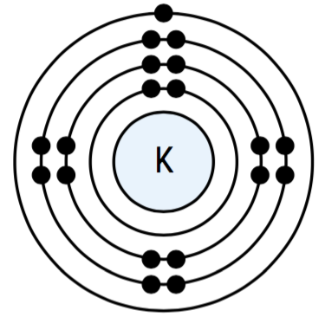
Bohr Diagrams and Energy Shells
First energy shell: maximum two electrons
Second and third energy shell: maximum eight electrons (for the first 20 elements)
Valence shell (outermost energy shell): occupied by valence electrons (electrons in the outermost occupied energy shell of an atom)

Slide 7
Discussion Questions
Draw a diagram of an atom, labelling protons, electrons, and neutrons.
List how many electrons can be found in the first and second energy shells.

Slide 8
Concept 2: Elements in chemical groups have similar electron arrangements.
Key patterns in the periodic table:
Atoms in the same group have the same number of valence electrons
Atoms in the same period have the same number of occupied energy shells

Slide 9
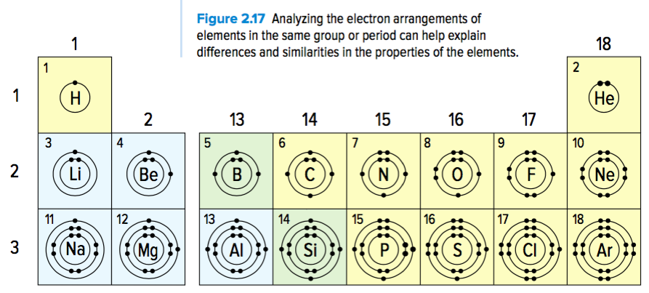
Patterns in the Periodic Table
Figure 2.17

Slide 10
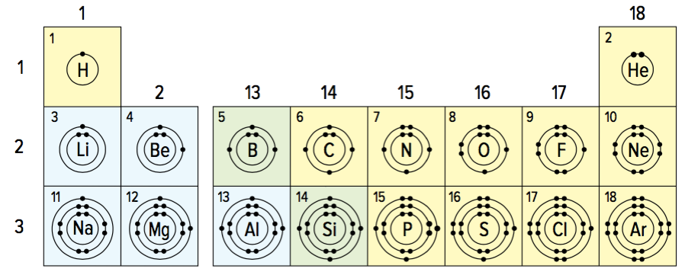
Atoms in the same group have the same number of valence electrons
Figure 2.17:
Group 1: One valence electron
Group 2: Two valence electrons
Groups 13-18: 3, 4, 5, 6, 7, 8 valence electrons
Exception: Helium has 2 valence electrons (other noble gases have 8 valence electrons)

Slide 11
Atoms in the same period have the same number of occupied energy shells
Figure 2.17:
First period (hydrogen and helium): One occupied energy shell
Second period: Two occupied energy shells
Third period: Three occupied energy shells

Slide 12
Noble Gas Stability: A Full Valence Shell
Noble gases are stable (unreactive) because they have full valence shells
Their atoms do not tend to gain, lose, or share electrons
Figure 2.18: The noble gases have full valence shells.

Slide 13
How Other Elements Achieve Full Valence Shells
Other elements can achieve a full valence shell by gaining or losing electrons during a chemical reaction
When a neutral atom gains or loses an electron, it becomes an ion
Loses an electron: becomes positively charged ion
Gains an electron: becomes a negatively charged ion

Slide 14
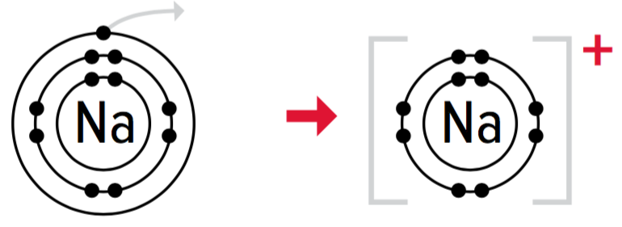
How Other Elements Achieve Full Valence Shells (continued)
Reactivity of an element is linked to how close it is to having a full valence shell
Most reactive elements: Groups 1 and 17 (elements are only one electron away from a full valence shell)
Example: Sodium (group 1) easily gives up an electron, since it exposes the full valence shell underneath
Example: Fluorine (group 17) readily gains an electron, since it completes their valence shell
Figure 2.19: Formation of sodium (Na, top) and fluorine (F, bottom) ions.

Slide 15
Discussion Questions
Explain why metals tend to lose electrons and non-metals tend to gain them.
Use diagrams to compare the electron arrangements of a chloride ion, a potassium ion, and an argon atom.

Slide 16
Concept 3: The periodic table shows how properties of elements change in predictable ways.
Periodic trend:
A regular variation in the properties of elements based on their atomic structure
Periodic table can analyze these trends because it can help you compare variations in groups and periods

Slide 17
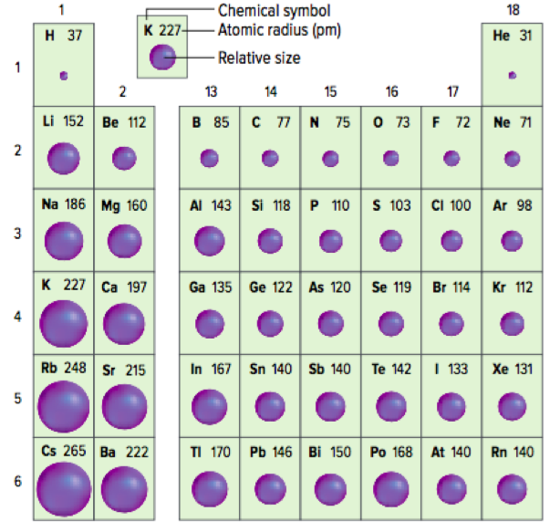
Atomic Size Trends: Atomic Size Increases Moving Down a Group
Atomic size increases moving down a group
As you move down a group, elements have atoms with increasing numbers of energy shells
The greater the number of shells, the farther the valence electrons are from the nucleus, and the larger the atom
Figure 2.20: Atomic size is represented by the spheres. The number under each element is the radius of the atom in picometres (pm).

Slide 18
Atomic Size Trends: Atomic Size Decreases Moving Left to Right Across a Period
Atomic size decreases moving left to right across a period
Elements have increasing numbers of electrons across a period
Number of occupied valence shells stay the same, but the number of protons in the nucleus increases
How does this result in decreasing atomic size across a period?
Figure 2.20: Atomic size is represented by the spheres. The number under each element is the radius of the atom in picometres (pm).

Slide 19
Atomic Size Trends: Atomic Size Decreases Moving Left to Right Across a Period (continued)
Attraction between valence electrons and the nucleus increases because a greater positive charge on the nucleus pulls more strongly on the electrons
Therefore, the electrons are pulled more tightly towards the nucleus, leading to decreasing atomic size
Figure 2.20: Atomic size is represented by the spheres. The number under each element is the radius of the atom in picometres (pm).

Slide 20
Metal Reactivity and Atom Size
Group 1 metals: Potassium is more reactive than sodium
Both have one valence electron
Potassium atom is larger than sodium
Potassium atom’s valence electron is farther away from the nucleus
Pull of the positive charge on the nucleus is weaker
Valence electron is easier to remove (less energy is needed to remove the electron)
Figure 2.21: Potassium (A) is more reactive than sodium (B) because less energy is needed to remove the valence electron from potassium.

Slide 21
Discussion Questions
Explain why atoms get larger down a group on the periodic table.
Explain why atoms get smaller from left to right across a period on the periodic table.

Slide 22
Discussion Questions
Explain why an alkali metal is more reactive than an alkaline-earth metal in the same period.

Slide 23
Topic 2.3 Summary: How can atomic theory explain patterns in the period table?
The structure of atoms can be represented using simple diagrams.
Elements in chemical groups have similar electron arrangements.
The periodic table shows how properties of elements change in predictable ways.

