Slide 1
Topic 2.4: How do elements combine to form compounds?
Compounds account for the huge variety of matter on Earth.
Ionic compounds are made of ions.
Covalent compounds are made of molecules.
Covalent bonding also occurs in elements and network solids.

Slide 2
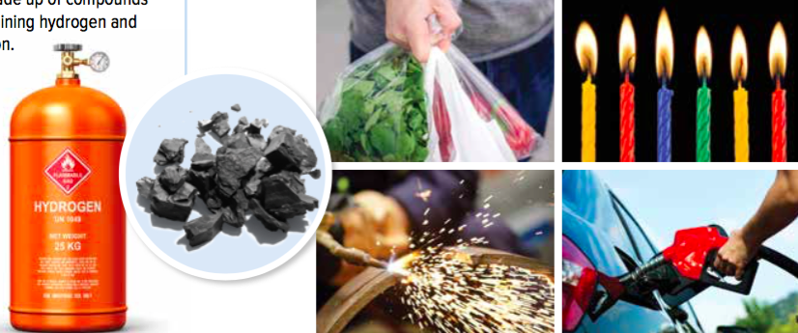
Concept 1: Compounds account for the huge variety of matter on Earth.
All the compounds that exist on Earth are built from elements
118 elements are on the periodic table; only 80 commonly form compounds
10 million known compounds; billions of possible compounds
Figure 2.22: Hydrogen and carbon alone can be combined in millions of ways to make compounds with very different properties.

Slide 3
Discussion Questions
Distinguish between elements and compounds.
Compare the number of elements with the number of compounds on Earth.

Slide 4
Concept 2: Ionic compounds are made of ions.
Ionic compound: a compound made of oppositely charged ions
Ions are held together with ionic bonds (a strong attraction between oppositely charged ions)
Ionic bonds are very strong

Slide 5
Formation of Ionic Compounds
Binary ionic compounds:
Contain two elements (metal and a non-metal)
Form when atoms of the metal element each lose one or more electrons to atoms of the non-metal element
Results in the formation of ions that have full valence shells
Stability of a full valence shell drives the formation of compounds

Slide 6
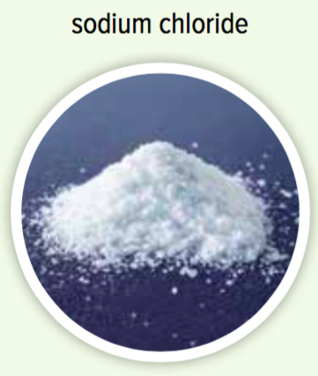
Formation of Ionic Compounds: Sodium Chloride
Example: Sodium chloride (salt)
Sodium (metal) reacts with chlorine (gas)
Forms when sodium atoms each transfer one electron to chlorine atoms
Each sodium atom becomes positive ion (Na⁺)
Each chlorine atom becomes a negative ion (Cl⁻)

Slide 7
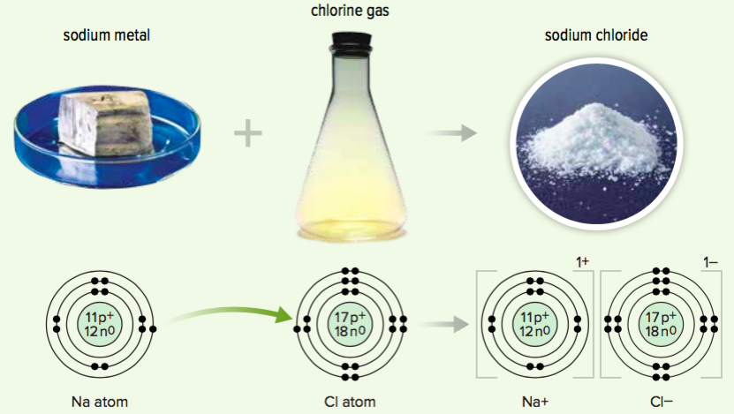
Formation of Ionic Compounds: Sodium Chloride (continued)
Valence shells of both the sodium ion (Na⁺) and chlorine ion (Cl⁻) are full
Recall: The stability of a full valence shell drives the formation of compounds
Figure 2.23

Slide 8
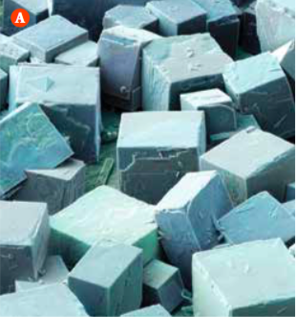
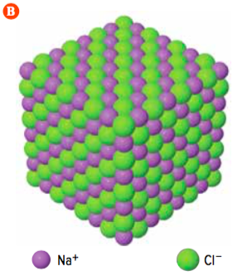
The Structure of Ionic Compounds
Ionic compounds consist of positive and negative ions arranged in regular repeating patterns called lattices
Example: Sodium chloride
Sodium chloride crystals consist of sodium and chloride ions arranged in a lattice
Figure 2.24: A) Cubic structure of sodium chloride crystals. B) Sodium chloride crystals consist of sodium and chloride ions arranged in
a repeating pattern.

Slide 9
Properties of Ionic Compounds: High Melting Points
Ionic compounds have high melting points
Melting requires breaking ionic bonds: the strong forces holding the ions together in the lattice structure
A large amount of energy is required to break ionic bonds
Example: Melting point of sodium chloride is 801°C
Notes:
ionic compound: a compound made of oppositely charged ions
ionic bond: a strong attraction that forms between oppositely charged ions
‹#›

Slide 10
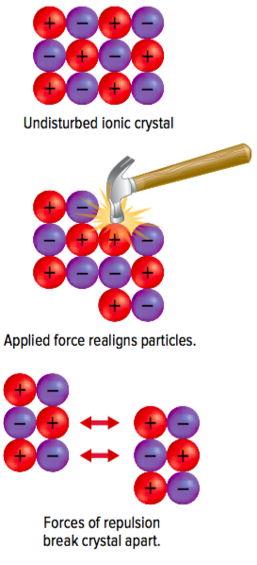
Properties of Ionic Compounds: Hard and Brittle
Ionic compounds are hard and brittle
Ionic solids are hard because ionic bonds are very strong
When enough force is applied, ions will shift
Causes ions with the same charge to be close together
Results in repulsive forces that break the solid apart
Figure 2.25: When a force strong enough to overcome the strong forces of attraction between oppositely charged ions is applied, ions with like charges come close together. They repel one another and the solid cracks.

Slide 11
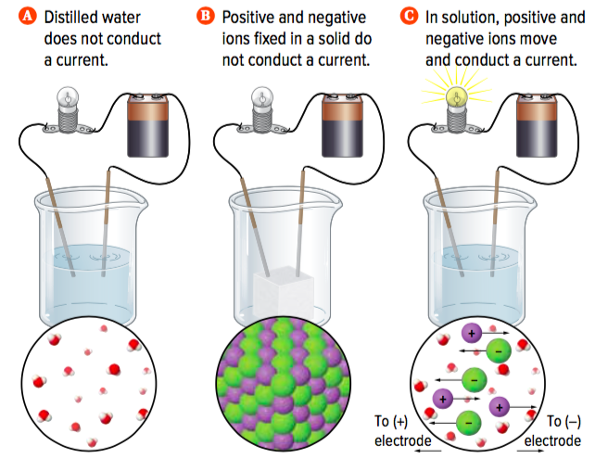
Properties of Ionic Compounds: Conduct Electric Current
Ionic compounds conduct electric current when liquid or dissolved
Electric current: the flow of charged particles
Solid form: do not conduct electric current since ions are held rigidly in place
Dissolved or liquid form: ions are free to move, and can conduct electric current
Figure 2.26

Slide 12
Properties of Ionic Compounds: Conduct Electric Current (continued)
Figure 2.26

Slide 13
Discussion Questions
What is an ionic bond?
Describe the formation of sodium chloride from sodium and chlorine.

Slide 14
Discussion Questions
Binary ionic compounds form when which two types of elements react?
When do ionic compounds conduct electric current? Explain.

Slide 15
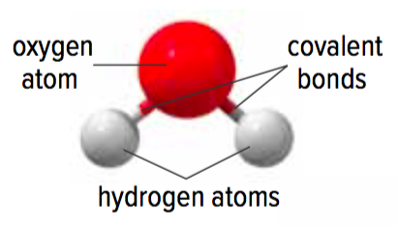
Concept 3: Covalent compounds are made of molecules.
Covalent bond: a strong attraction between atoms that forms when atoms share valence electrons
Covalent compound:
Made of molecules
Molecule: a particle made up of two or more neutral atoms bonded together by covalent bonds
Figure 2.27: Water molecules consist of two hydrogen atoms bonded to one oxygen atom.

Slide 16
Covalent Bonds: Tug of War
Covalent bonds are similar to a game of tug of war
Each team (atom) tries to pull the rope (shared electrons) toward itself
Neither side wins, and the bond is the rope that connects them
Figure 2.28

Slide 17
Achieving Stability by Sharing Electrons
Formation of a covalent compound is based on achieving stability with a full valence shell
Non-metals in covalent compound share electrons to get a full valence shell

Slide 18
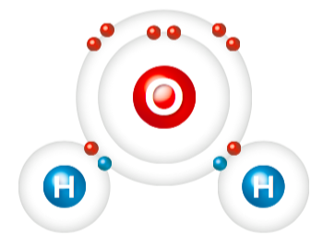
Achieving Stability by Sharing Electrons (continued)
Example: Water
Covalent bond is formed from a single pair of shared electrons
Each hydrogen atom contributes a single electron to the shared pair of electrons
Each oxygen atom contributes a single electron to the shared pair of electrons
Hydrogen atoms achieve a full valence shell of 2 electrons
Oxygen atom achieves a full valence shell of 8 electrons
Figure 2.30: Each hydrogen atom contributes a single electron to the shared pair of electrons in its covalent bond with oxygen.

Slide 19
Three Ways That Atoms Become Stable (Achieve a Full Valence Shell)
Metal atoms can lose electrons to achieve a full valence shell
Non-metal atoms can gain electrons to achieve a full valence shell
Non-metal atoms can share electrons with other non-metal atoms to achieve a full valence shell
Notes:
‹#›

Slide 20
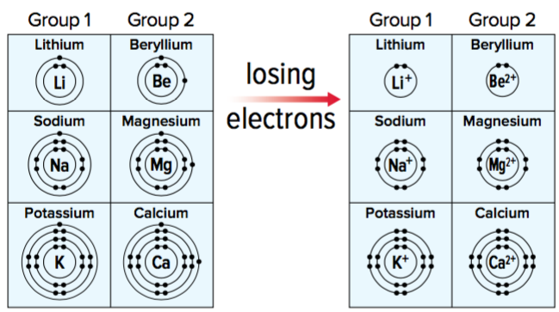
Three Ways That Atoms Become Stable: Metal Atoms Can Lose Electrons
Metals can lose electrons to achieve a full valence shell
Form positive ions because they lose electrons
Retain the same number of protons in the nucleus
Example:
Group 1 metal ions have a 1+ charge because they have lost one electron
Group 2 metal ions charge: 2+
Group 3 metal ions charge: 3+
Notes:
molecule: a particle made up of two or more neutral atoms bonded together by covalent bonds
covalent bond: a strong attraction between atoms that forms when atoms share valence electrons
covalent compound: a compound that results when atoms of two or more elements bond covalently
‹#›

Slide 21
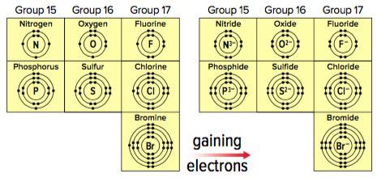
Three Ways That Atoms Become Stable: Non-metal Atoms Gain Electrons
Non-metal atoms can gain electrons to achieve a full valence shell
Form negative ions because they gain electrons
Non-metal ions end in –ide
Example:
Group 17 non-metals ion charge is 1- because they have gained one electron
Group 17 non-metal ions charge: 2-
Group 18 non- metal ion charge: 3-

Slide 22
Three Ways That Atoms Become Stable: Non-metal Atoms Share Electrons
Non-metal atoms can share electrons with other non-metal atoms to achieve a full valence shell

Slide 23
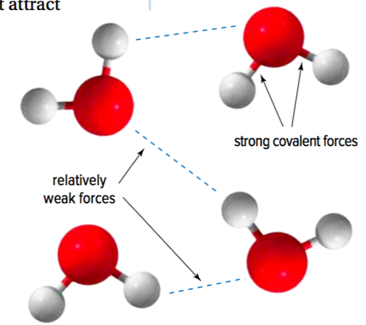
Properties of Covalent Compounds
Have low melting points:
Bonds holding atoms together in a molecule are strong
Forces that attract molecules to one another are relatively weak; therefore, not as much energy is needed to “break” the weak bond melt at low temperatures
Figure 2.31

Slide 24
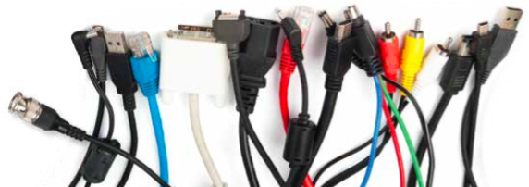
Properties of Covalent Compounds (continued)
Relatively soft: Weak forces between molecules mean that it’s easier for molecules to move and shift
Poor conductors: covalent compounds do not have free electrons, and they are poor conductors of electric current and heat
Figure 2.32: Covalent compounds are poor conductors of electric current. This makes them useful as insulating covers for computer cables.

Slide 25
Discussion Questions
What type of bond is formed when two non-metal atoms share electrons?
What is a molecule?
Why do covalent compounds tend to have low melting points?

Slide 26
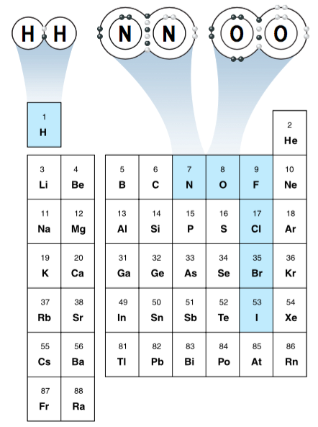
Concept 4: Covalent bonding also occurs in elements and network solids.
Seven elements are made up of molecules held together with covalent bonds under normal conditions:
H₂, F₂, Cl₂, Br₂, I₂: Two atoms share one electron in a covalent bond
O₂: Two atoms share two pairs of electrons to form two covalent bonds (double bond)
N₂: Two nitrogen atoms share three pairs of electrons to form three covalent bonds (triple bond)
The SUPER SEVEN!
Label these on your table
Figure 2.33

Slide 27
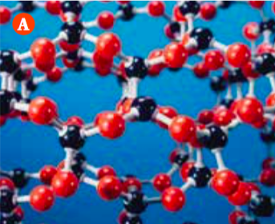
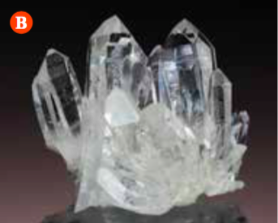
Network Solids
Network solid:
Consists of non-metal elements containing covalent bonds that connect their atoms in one large network; essentially consist of one giant molecule
Example: Silicon dioxide (SiO₂)
Figure 2.34: (A) Atoms are bonded in a regular, repeating structure by covalent bonds (B) In real quartz crystals, billions of atoms are bonded together in the same repeating structure, forming one giant molecule.
Figure 2.34

Slide 28
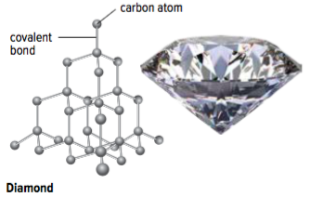
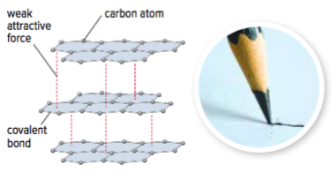
Network Solids: Carbon (Diamond Form)
Carbon (diamond form – network solid):
Each carbon atom is bonded to four other carbon atoms by covalent bonds
Forms strong 3-D structure
Carbon (graphite form – not a network solid):
Each carbon atom forms covalent bonds with three other carbon atoms, forming sheets
Sheets are weakly attracted to each other and can slide around
As you write on paper, layers of graphite slide off the pencil tip and onto the page
Figure 2.35: Diamond and graphite both contain covalent bonds but have very different properties due to their structure.

Slide 29
Discussion Questions
Describe a molecule of hydrogen.
Why does neon gas consist of individual, unbonded neon atoms while chlorine exists as diatomic chlorine molecules?
What is a network solid?

Slide 30
Topic 2.4 Summary: How can atomic theory explain patterns in the periodic table?
The structure of atoms can be represented using simple diagrams.
Elements in chemical groups have similar electron arrangements.
The periodic table shows how properties of elements change in predictable ways.

