Slide 1
Topic 2.5: How do we name and write formulas for compounds?
The chemical name of an ionic compound communicates its composition.
You can determine the formula of an ionic compound from its name.
Multivalent metals form more than one ion.
Polyatomic ions are made up of more than one atom.
Names and formulas of covalent compounds reflect their molecular structure.

Slide 2
Concept 1: The chemical name of an ionic compound communicates its composition.
Binary ionic compound:
Made up of ions of one metal element and ions of one non-metal element; joined by ionic bonds
Binary in chemistry means “composed of two elements
Figure 2.36: Potassium iodide is a binary ionic compound that is added to table salt to prevent iodine deficiency. Seaweed contains compounds that include iodide ion. Iodine deficiency leads to swellings called goitres.

Slide 3
Names of Binary Ionic Compounds
The name of a binary ionic compound comes from the name of its elements.
Example: potassium iodide
The first part names the positive ion, potassium (K⁺)
In a binary ionic compound, the positive ion is always a metal and its name is the same as the name of its element
The second part names the negative ion, iodide (I⁻)
In a binary ionic compound, the negative ion is always a non-metal and has the suffix –ide
The negative ion of iodine is iodide

Slide 4
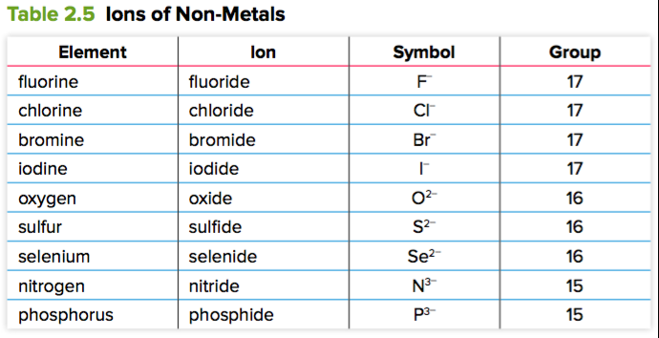
Names of Binary Ionic Compounds (continued)

Slide 5
Discussion Questions
Each of the following pairs of elements react to form a binary ionic compound. What is the name of the compound in each case?
lithium and oxygen
calcium and fluorine
magnesium and sulfur
rubidium and bromine.

Slide 6
Discussion Questions (continued)
What is the difference between the name of a non-metal element and the name of the negative ion it forms?

Slide 7
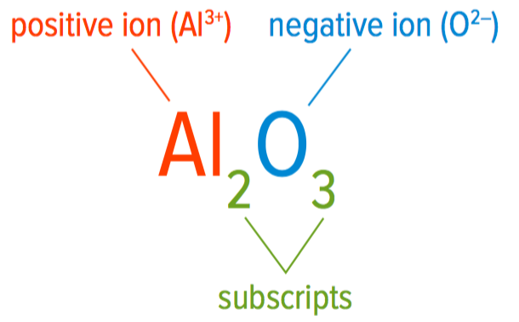
Concept 2: You can determine the formula of an ionic compound from its name.
Formulas for binary ionic compounds:
Positive ion (metal) first, negative ion (non-metal) second
Subscripts indicate the ratio of each type of ion in the compound (no subscript: assume the number is 1)
Chemical formula represents the smallest repeating part of the crystal lattice (formula unit)
Figure 2.37: Formulas for ionic compounds are always written with the positive ion first and the negative ion second. In binary ionic compounds, the positive ion is a metal ion and the negative ion is a non-metal ion.

Slide 8
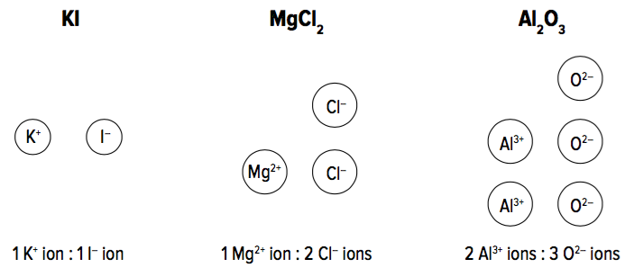
Examples of Chemical Formulas of Binary Ionic Compounds
Figure 2.38: The subscripts in chemical formulas of ionic compounds tell you the ratio of the ions in the compound.

Slide 9
Writing Formulas of Ionic Compounds
Although an ionic compound is made up of ions, the compound’s overall charge is 0 (it is electrically neutral)
Positive charges on the metal ions must balance the negative charges on the non-metal ions
Example: Aluminum oxide has two aluminum ions, Al^{3+,} and three oxide ions, O²⁻. What is the total charge?
O²⁻ ions

Slide 10
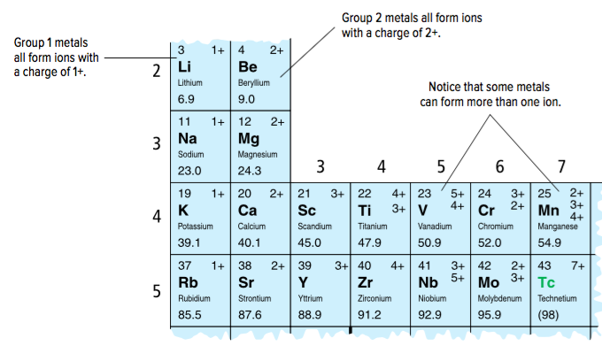
Writing Formulas of Ionic Compounds (continued)
When writing the formula of a binary ionic compound, you first need to determine the charges on the ion.
For non-metals: Look at the periodic table or refer to Table 2.5
For metals: Look at the periodic table. Some metals can form more than one ion (each ion has a different charge).
Figure 2.39: The periodic table lists the charges of ions commonly formed by the various elements.

Slide 11
Sample Problem: Writing the Formulas of Ionic Compounds (Step 1)
Problem:
What is the chemical formula for calcium chloride?
Step 1: Identify each ion and its charge
Look at the periodic table to find the ion charge
Calcium is a Group 2 metal, so its ion charge is 2+: Ca²⁺
Chlorine is a Group 17 non-metal, so its ion charge is 1-: Cl⁻

Slide 12
Sample Problem: Writing the Formulas of Ionic Compounds (Step 2)
Problem:
What is the chemical formula for calcium chloride?
Step 2: Determine the number of ions needed to balance positive charges with negative charges.
A calcium ion (Ca²⁺) has a charge of 2+
A chloride ion (Cl⁻) has a charge of 1-
Therefore, two chloride ions are needed to balance the positive charge of one calcium ion

Slide 13
Sample Problem: Writing the Formulas of Ionic Compounds (Step 3)
Problem:
What is the chemical formula for calcium chloride?
Step 3: Use subscripts to write the formula (do not include a subscript if the subscript would be “1”). Remember to write the metal ion first.
Recall: Two chloride ions are needed to balance the positive charge of one calcium ion
Therefore, the formula for calcium chloride is CaCl₂.

Slide 14
Discussion Questions
What is a formula unit and how does it relate to the formula for an ionic compound?
Even though ionic compounds are made up of charged particles, they are electrically neutral. Why is this?

Slide 15
Practice Questions
P. 86 #1
P. 87 #1, 2
P. 95 #1, 2(a,c,e,f), 4

Slide 16
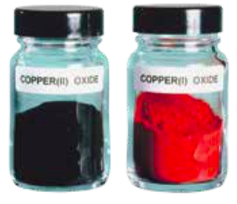
Concept 3: Multivalent metals form more than one ion.
Multivalent metal: a metal element that can form two or more types of ions with different charges
Example: Copper can form ions with a 1+ or 2+ charge
A Roman numeral is written after the name of the metal to distinguish between the ions
Cu⁺: copper(I)
Cu²⁺: copper(II)
Figure 2.41: Although both of these compounds contain copper and oxygen, copper(II) oxide, CuO, is black and copper(I) oxide, Cu₂O, is red.

Slide 17
Writing Formulas for Ionic Compounds Containing Multivalent Metals
To write the chemical formula of a compound with a multivalent metal, follow the same process as for binary ionic compounds.
Difference: You cannot tell the charge on the metal ion by looking at the periodic table alone, since there will be multiple charges listed
Look at the Roman numeral in the name, which will tell you the charge
Example: chromium(III) chloride tells you that the chromium ion is Cr³⁺

Slide 18
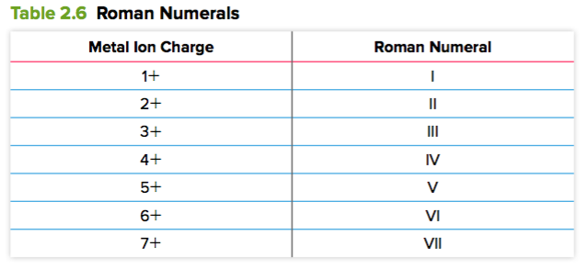
Writing Formulas for Ionic Compounds Containing Multivalent Metals (continued)

Slide 19
Sample Problem: Writing Formulas for Ionic Compounds Containing Multivalent Metals (Step 1)
Problem:
What is the chemical formula for chromium(III) chloride?
Step 1: Identify each ion and its charge.
Look at the periodic table to find the ion charge
Chromium is a multivalent metal (ion charge can be 3+ or 2+).
Its ion charge is 3+ since its name contains the Roman numeral “III”: Cr³⁺
Chlorine is a Group 17 metal, so its ion charge is 1-: Cl⁻

Slide 20
Sample Problem: Writing Formulas for Ionic Compounds Containing Multivalent Metals (Step 2)
Problem:
What is the chemical formula for chromium(III) chloride?
Step 2: Determine the number of ions needed to balance positive charges with negative charges.
A chromium ion (Cr³⁺) has a charge of 3+
A chloride ion (Cl⁻) has a charge of 1-
Therefore, three chloride ions are needed to balance the positive charge of one chromium ion

Slide 21
Sample Problem: Writing Formulas for Ionic Compounds Containing Multivalent Metals (Step 3)
Problem:
What is the chemical formula for chromium(III) chloride?
Step 3: Use subscripts to write the formula (do not include a subscript if the subscript would be “1”). Remember to write the metal ion first.
Recall: Three chloride ions are needed to balance the positive charge of one chromium ion
Therefore, the formula for chromium(III) chloride is CrCl₃.

Slide 22
Sample Problem: Naming an Ionic Compound with a Multivalent Metal (Step 1)
Problem:
What is the name of Fe₂O₃?
Step 1: Identify each ion and its charge
Look at the periodic table to find the ion charge
Iron is a multivalent metal (ion charge can be 2+ or 3+): Fe²⁺ or Fe³⁺
Oxygen’s ion charge is 2-: O²⁻

Slide 23
Sample Problem: Writing Formulas for Ionic Compounds Containing Multivalent Metals (Step 2)
Problem:
What is the name of Fe₂O₃?
Step 2: Determine the ratio of ions in the compound.
According to the formula, the compound has 2 iron (Fe) ions for every 3 oxide (O) ions

Slide 24
Sample Problem: Writing Formulas for Ionic Compounds Containing Multivalent Metals (Step 3)
Problem:
What is the name of Fe₂O₃?
Step 3: The compound must be electrically neutral. Which of the two possible iron ions achieves this balance?
Recall:
Iron is a multivalent metal (ion charge can be 2+ or 3+): Fe²⁺ or Fe³⁺
Oxygen’s ion charge is 2-: O²⁻
Since there are 3 oxide ions, there is an overall negative charge of 6- [calculation: 3 x (2-) = 6-]
Since there are 2 iron ions, they must each have a charge of 3+ to give an overall positive charge of 6+ [calculation: 2 x (3+) = 6+]
Therefore the iron ion in this compound is Fe³⁺

Slide 25
Sample Problem: Writing Formulas for Ionic Compounds Containing Multivalent Metals (Step 4)
Problem:
What is the name of Fe₂O₃?
Step 4: Write the name of the compound using a Roman numeral to indicate the charge of the metal ion.
Recall: The iron ion in this compound is Fe³⁺
Therefore, the name of Fe₂O₃ is iron(III) oxide

Slide 26
Discussion Questions
Explain why copper is able to form two different compounds with oxygen (and write both their names and formulae).
Why are Roman numerals included in the names of multivalent metal ions?

Slide 27
Practice
P. 89 #1
P. 90 #1
P. 95 #5

Slide 28
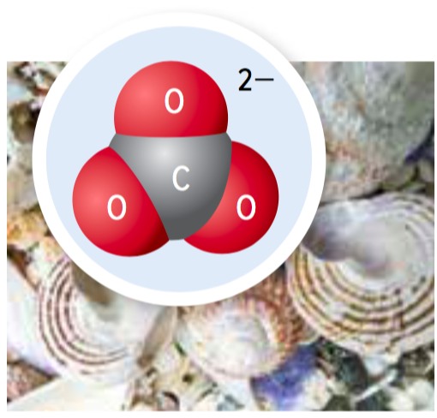
Concept 4: Polyatomic ions are made up of more than one atom.
Polyatomic ion: an ion made up of two or more covalently bonded atoms
Example: carbonate ion (CO₃²⁻)
1 carbon atom
3 oxygen atoms
There are a limited number of polyatomic ions that regularly occur in compounds
Figure 2.43: Shellfish use calcium carbonate to make their shells. The carbonate ion is shown here.

Slide 29
Common Polyatomic Ions

Slide 30
Sample Problem: Writing Chemical Formulas of a Compound with a Polyatomic Ion (Step 1)
Problem:
What is the chemical formula for calcium nitrate?
Step 1: Identify each ion and its charge. Use Table 2.7 to find the formula of the polyatomic ion.
Look at the periodic table to find the ion charge of calcium. Use Table 2.7 to find the formula and charge of nitrate.
Calcium is a Group 2 metal, so its ion charge is 2+: Ca²⁺
Nitrate: NO₃⁻

Slide 31
Sample Problem: Writing Chemical Formulas of a Compound with a Polyatomic Ion (Step 2)
Problem:
What is the chemical formula for calcium nitrate?
Step 2: Determine the number of ions needed to balance positive charges with negative charges.
A calcium ion (Ca²⁺) has a charge of 2+
A nitrate ion (NO₃⁻) has a charge of 1-
Therefore, two nitrate ions are needed to balance the positive charge of one calcium ion

Slide 32
Sample Problem: Writing Chemical Formulas of a Compound with a Polyatomic Ion (Step 3)
Problem:
What is the chemical formula for calcium nitrate?
Step 3: Use subscripts to write the formula (do not include a subscript if the subscript would be “1”). If the polyatomic ion is going to take a subscript, use parentheses to enclose the polyatomic ion before adding the subscript.
Recall: Two nitrate ions are needed to balance the positive charge of one calcium ion
Therefore, the formula for calcium nitrate is Ca(NO₃)₂.

Slide 33
Discussion Questions
What is a polyatomic ion?
How are parentheses used in writing formulas containing polyatomic ions?
Give the names and chemical formulas of two different polyatomic ions that contain nitrogen and oxygen.

Slide 34
Practice
P. 91 # 1, 2
P. 95 # 6

Slide 35
Concept 5: Names and formulas of covalent compounds reflect their molecular structure.
Binary covalent compound: a compound made up of the atoms of two elements joined by covalent bonds
Example: sulfur hexafluoride (SF₆)
Figure 2.44: Sulfur hexafluoride (SF₆) is a gas that does not conduct thermal energy well. It is used to insulate double-glazed windows.

Slide 36
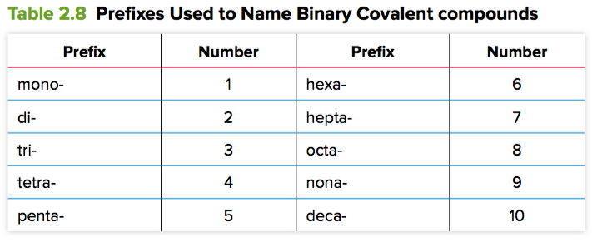
Writing Names of Binary Covalent Compounds
The names of binary covalent compounds have prefixes (Table 2.8) to indicate how many atoms of are present in one molecule of the compound.
Mono- is used only for the second element in the name
No prefix: mono- is implied (example: carbon monoxide)
When mono- comes before -oxide, an “o” is dropped (monoxide, not monooxide)

Slide 37
Sample Problem: Naming a Binary Covalent Compound (Step 1)
Problem:
What is the name of NO₂?
Step 1: Name the leftmost element in the formula first.
The first element is N (nitrogen).

Slide 38
Sample Problem: Naming a Binary Covalent Compound (Step 2)
Problem:
What is the name of NO₂?
Step 2: Name the second element, making sure the name ends with the suffix –ide.
The second element is O (oxygen), which becomes oxide.

Slide 39
Sample Problem: Naming a Binary Covalent Compound (Step 3)
Problem:
What is the name of NO₂?
Step 3: Add a prefix to each element’s name to indicate the number of atoms of each element in a molecule of a compound. If the first element would get the prefix mono, do no include that prefix.
The first element is nitrogen. There is 1 nitrogen atom.
The second element is oxygen, which becomes oxide. There are 2 oxygen atoms. Add the prefix di- to oxide.
Therefore, the name of NO₂ is nitrogen dioxide.

Slide 40
Writing Formulas of Binary Covalent Compounds
Chemical formulas of binary covalent compounds indicate how many atoms of each element are present in a single molecule of a compound
Example: SF₆ (sulfur hexafluoride)
1 sulfur atom
6 fluoride atoms

Slide 41
Sample Problem: Writing Formulas for Binary Covalent Compounds (Step 1)
Problem:
What is the chemical formula for dinitrogen tetroxide?
Step 1: Write the element symbols in the order that they appear in the name.
Look at the periodic table to find the element symbols.
The first element is nitrogen, N.
The second element is oxygen (oxide), O.

Slide 42
Sample Problem: Sample Problem: Writing Formulas for Binary Covalent Compounds (Step 2)
Problem:
What is the chemical formula for dinitrogen tetroxide?
Step 2: Add subscripts based on the prefixes used in the name.
The prefix di from dinitrogen tells you that there are 2 nitrogen atoms
The prefix tetr- from tetroxide tells you that there are 4 oxygen atoms.
Therefore, the formula of dinitrogen tetroxide is N₂O₄.

Slide 43
Discussion Questions
What does the formula for a covalent compound tell you about the compound?
Identify two problems with the name mononitrogen monooxide for the compound NO and correct them.

Slide 44
Discussion Questions (continued)
Sketch a model of a molecule of carbon dioxide, CO₂, and carbon monoxide, CO. How do the names and formulas communicate the difference between these compounds?

Slide 45
Topic 2.5 Summary: How do we name and write formulas for compounds?
The chemical name of an ionic compound communicates its composition.
You can determine the formula of an ionic compound from its name.
Multivalent metals form more than one ion.
Polyatomic ions are made up of more than one atom.
Names and formulas of covalent compounds reflect their molecular structure.

Slide 46
Practice
None in textbook - Worksheet provided
Self Assess:
I can write a chemical formula from its name
I can name a chemical compound from its formula
Not at all | with difficulty | a few mistakes | consistently

