Slide 1
To Submit To Me:
On the next slide there are 3 bullet points. You are to write a summary of those points from the information in the slides
In the slides there are periodic questions, those should be answered and submitted to me as well.
All submissions should be a pdf emailed to dconnor@sd73.bc.ca

Slide 2
Topic 3.1: How is electrical energy part of your world?
Electrical energy has many applications.
Many different types of energy can be transformed into electrical energy.
Electrical energy is generated in different ways from different sources.

Slide 3
Concept 1: Electrical energy has many applications.
Electrical energy: the energy of charged particles
What uses electrical energy?
The human body
Technology (touch-sensitive screens, robots, maglev trains)
Figure 3.1

Slide 4
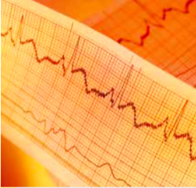
Electrical Energy Applications: The Human Body
The human body uses electrical energy
Moving your eyes to read relies on electrical signals in your muscle and nerve cells
Electrical signals help maintain breathing and heart beats
Figure 3.1

Slide 5
Electrical Energy Applications: Technology
Different types of technology use electrical energy
Touch-sensitive screens
Robots (made of flexible plastic that response to electrical signals like your own muscles)
Maglev trains (hover above electrified coils along tracks)
Figure 3.1

Slide 6
Discussion Questions
Describe three ways that you have depended on electrical energy since you woke up this morning.

Slide 7
Concept 2: Many different types of energy can be transformed into electrical energy.
Energy is the ability to do work. Energy is neither created or destroyed
It is transformed from one kind of energy to another kind of energy
Many types of energy can be transformed into electrical energy

Slide 8
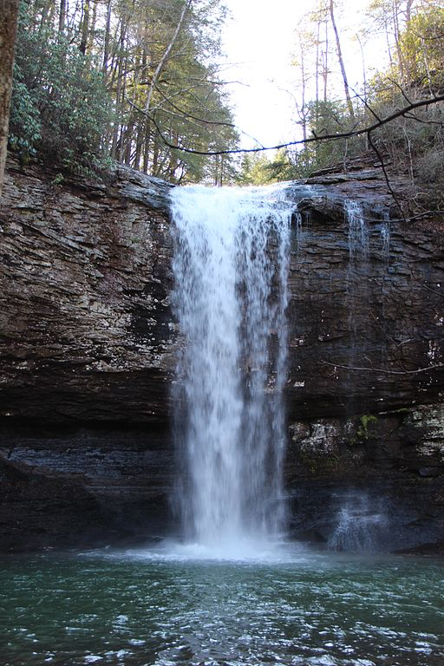
Energy That Can Be Transformed Into Electrical Energy: Mechanical Energy
Mechanical energy: The sum of kinetic energy and potential energy
Kinetic energy: Energy of motion
Potential energy: Stored energy that a system has due to its position or condition
Example: Water at the top of a waterfall, just before it falls, has potential energy because of its position, and kinetic energy because it is moving

Slide 9
Energy That Can Be Transformed Into Electrical Energy: Chemical Energy
Chemical energy: Energy stored in chemical bonds, and released when a chemical reaction occurs
Batteries store chemical energy
Chemical energy stored in animals and plants is called biomass
Fossil fuels (coal, oil, natural gas) store chemical energy
Figure 3.2

Slide 10
Energy That Can Be Transformed Into Electrical Energy: Solar Energy
Solar energy: Energy carried by electromagnetic radiation given off by the Sun
Fossil fuels and biomass result form energy from the Sun being captured by plants and plant-like organisms
Figure 3.2

Slide 11
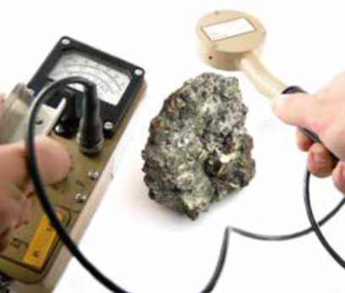
Energy That Can Be Transformed Into Electrical Energy: Nuclear Energy
Nuclear energy: Energy generated by forming new atoms
Nuclear fusion: New atoms are made as smaller atoms collide and fuse (occur in the Sun and stars)
Nuclear fission: New atoms are made by splitting larger atoms (carried out in reactors on Earth)
Figure 3.2
Figure 3.2

Slide 12
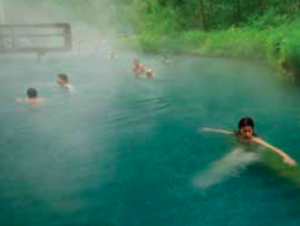
Energy That Can Be Transformed Into Electrical Energy: Thermal Energy
Thermal energy: Energy due to the rapid motion of particles that make up an object; detected as heat
Sources include nuclear reactions or from Earth’s interior (geothermal energy), where steam and hot water form naturally
Example: Geysers, volcanoes, hot springs
Figure 3.2

Slide 13
Discussion Questions
Explain the difference between kinetic energy and potential energy.
Describe the relationship among solar energy, biomass, and fossil fuels.

Slide 14
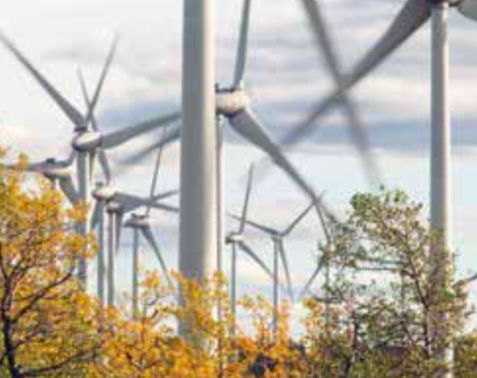
Concept 3: Electrical energy is generated in different ways from different sources.
Different types of energy can be transformed into electrical energy
Most of the electrical energy in Canada is generated by transforming kinetic energy into electric energy
Source of kinetic energy may be moving water, wind, or moving steam produced by nuclear reactions or burning fossil fuels

Slide 15
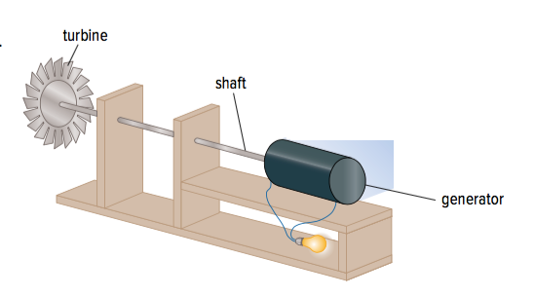
Kinetic Energy to Electrical Energy: Generator System
Generator system: A system that transforms kinetic energy to electrical energy
Turbine: Steam, water, or wind cause the turbine to spin
Shaft: As the turbine spins, the shaft spins
Generator: Kinetic energy of the spinning shaft is transformed into electrical energy inside the generator by a dynamo (spinning coils of wire and magnets, like a motor working in reverse)
Figure 3.3

Slide 16
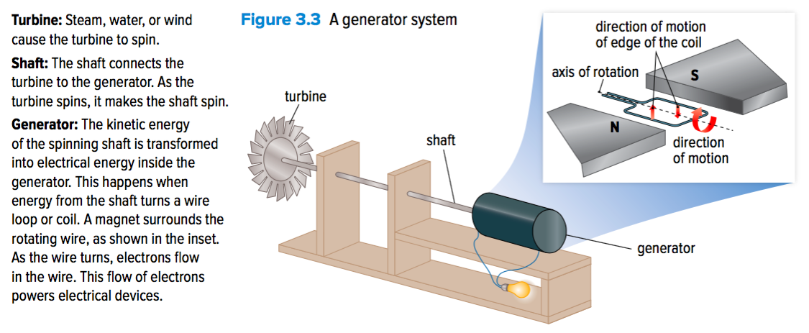
Kinetic Energy to Electrical Energy: Generator System (continued)
Figure 3.3

Slide 17
Generating Electrical Energy in Canada
Most of the electrical energy in Canada comes from river flow, fossil fuels, and nuclear reactions
British Columbia:
River flow is the main source (hydroelectric energy)
Also uses fossil fuels
No nuclear reactors
Notes:
electrical energy: the energy of charged particles
‹#›

Slide 18
Hydroelectric Energy from River Flow
Two systems generate hydroelectric energy:
Dam station (shown below)
Water stored behind dam has potential energy
As water flows downhill, it gains kinetic energy, which turns a turbine connected to a generator
Run-of-river station
Water flowing freely in a river turns a turbine
Figure 3.4

Slide 19
Electrical Energy from Fossil Fuels
Generating station:
Thermal energy from burning coal is used to boil water into steam
Pressure associated with moving steam turns the blades of turbines connected to generators
Figure 3.4

Slide 20
Electrical Energy from Nuclear Reactions
Nuclear reactor:
Uranium or plutonium atoms undergo fission reactions
Splitting one atom sets off a chain reaction that causes more atoms to split, which releases energy
Most of the energy is thermal energy, which is used to boil water into steam
Pressure from the moving steam turns turbines connected to generators
Figure 3.4

Slide 21
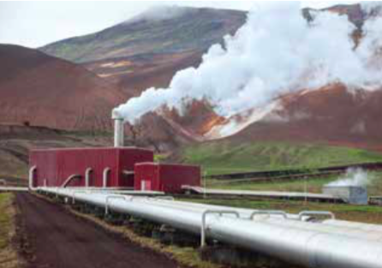
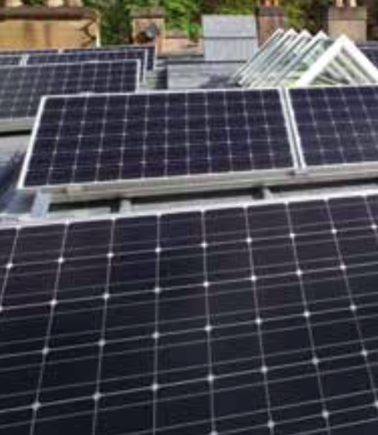
Generating Electrical Energy from Other Energy Sources
Other energy sources include:
Wind
Sunlight
Geothermal sources
Waves and Tides

Slide 22
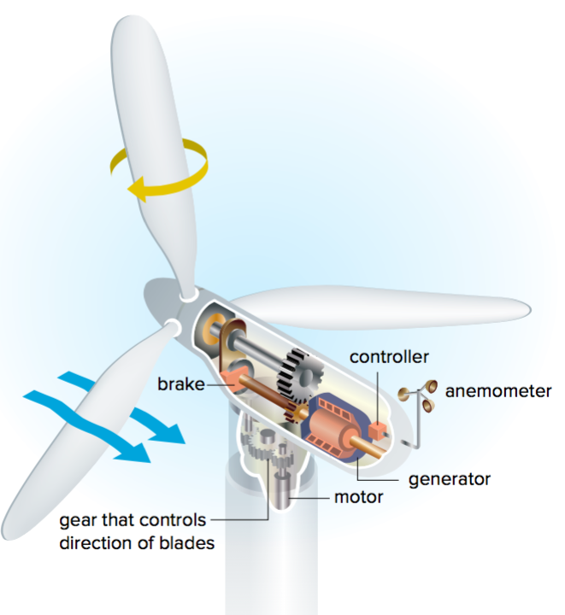
Electrical Energy from Wind
Kinetic energy of wind is transformed into electrical energy as the moving air turns the turbine of a generator system
Wind turbines have an anemometer is used to measure wind speed
Figure 3.5

Slide 23
Electrical Energy from Sunlight
Photovoltaic cells transform the energy of visible light to electrical energy
When light strikes silicon atoms in the photovoltaic cells, the electrons absorb enough energy to flow in a specific direction and generate electrical energy
Figure 3.6

Slide 24
Electrical Energy from Geothermal Sources
Where Earth’s crust is thin and molten rock comes close to the surface
hot steam from boiling groundwater can be used to turn turbines to generate electrical energy
Figure 3.7

Slide 25
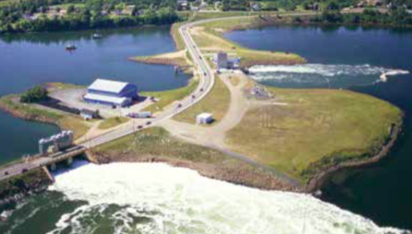
Electrical Energy from Waves and Tides
Tides and the rise and fall of waves can turn turbines to generate electrical energy
Figure 3.8

Slide 26
Discussion Questions
List three key parts of a generator system. Briefly describe their functions.
Use a flowchart to explain how moving water can generate electricity.

Slide 27
Topic 3.1 Summary: How is electrical energy part of your world?
Electrical energy has many applications.
Many different types of energy can be transformed into electrical energy.
Electrical energy is generated in different ways from different sources.

