Slide 1
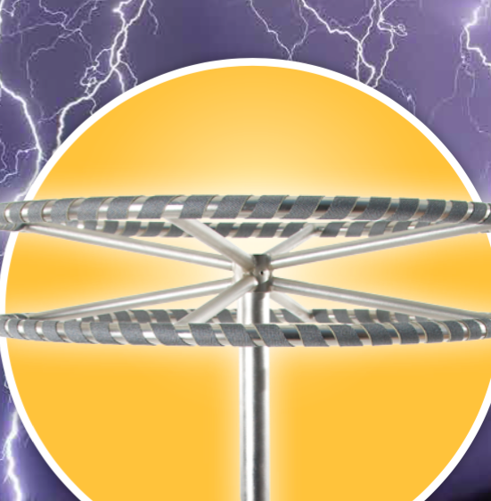
Topic 3.2: How do electrical charges behave?
Electrons carry a negative charge, and protons carry a positive charge.
Opposite charges attract each other, and like charges repel each other.

Slide 2
Concept 1: Electrons carry a negative charge, and protons carry a positive charge.
Negative charges:
The charges of electrons
Surround the nucleus; not permanently attached, can be rubbed off a material
Positive charges:
The charges of protons
Part of the nucleus of atoms and are held firmly in place

Slide 3
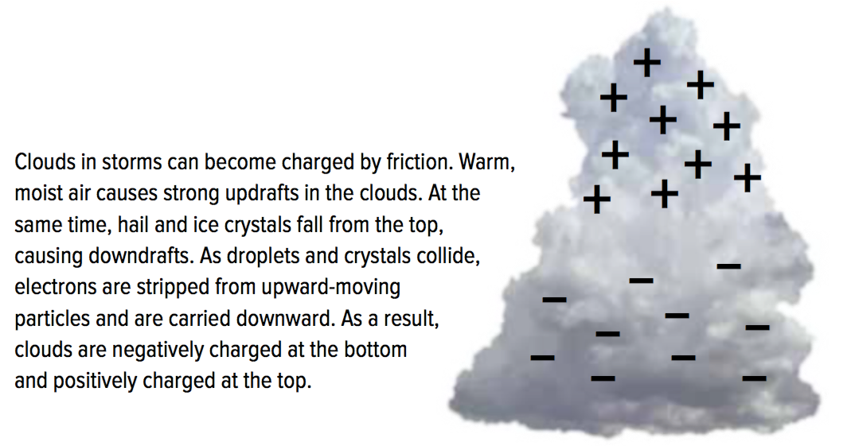
Negative Charges and Positive Charges
Charging by friction: Charging a material by rubbing
When electrons are rubbed off a material, it becomes positively charged
Material gains electrons and becomes negatively charged
Figure 3.9: Clouds may be charged by friction in a thunderstorm.

Slide 4
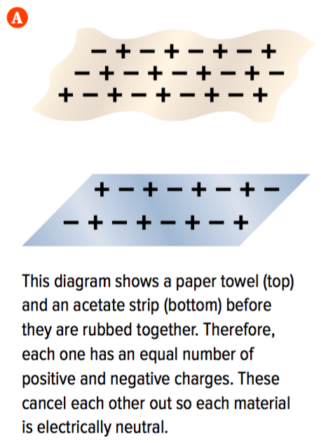
Electrically Neutral and Electrically Charged Materials
Uncharged Materials:
Before two materials are rubbed together: they have equal numbers of protons and electrons
Materials are electrically neutral (equal numbers of positive and negative charges cancel each other out)

Slide 5
Electrically Neutral and Electrically Charged Materials (continued)
Charged Materials:
If electrons rubbed off one material, the protons stay behind and the material becomes electrically charged
The material that gains the electrons also becomes electrically charged
Electrically charged materials have an unequal number of positive and negative charges

Slide 6
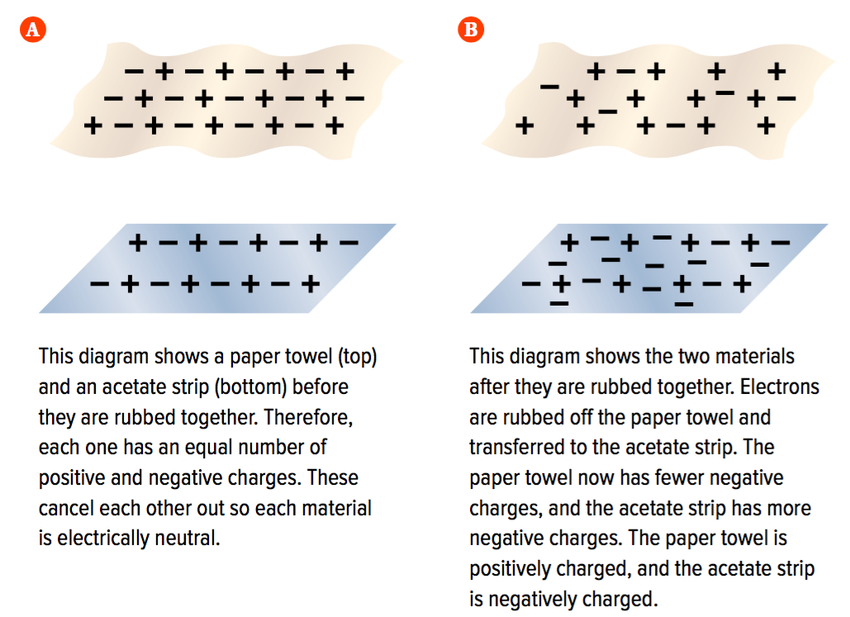
Electrically Neutral and Electrically Charged Materials (continued)
Figure 3.10: Two materials before and after being rubbed together.

Slide 7
Discussion Questions
Explain the relationship among negative charges, positive charges, electrons, and protons.
Describe what sometimes happens in terms of charges when you rub two different types of materials together.

Slide 8
Concept 2: Opposite charges attract each other, and like charges repel each other.
The Law of Electric Charge
Opposite charges attract each other
Like charges repel each other
The law of electric charge applies to all individual charges
Every negative charge attracts every positive charge
Every negative charge repels every other negative charge
Every positive charge repels every other positive charge

Slide 9
Attraction Between Charged Objects and Neutral Objects
The law of electric charge explains why charged objects attract neutral objects
All neutral objects have an equal number of protons and electrons
Figure 3.11: The comb is charged, and the water is neutral.

Slide 10
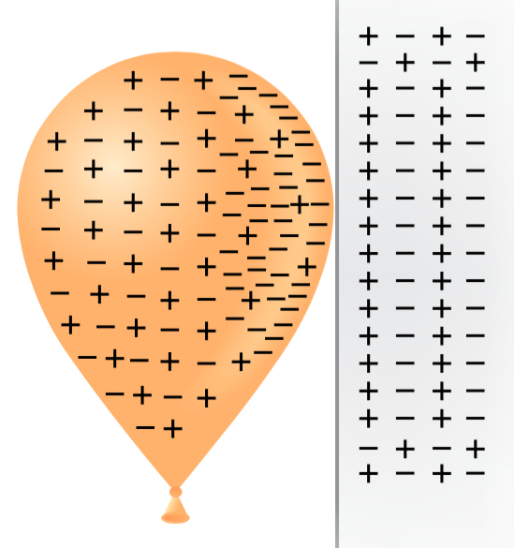
Attraction Between Charged Objects and Neutral Objects (continued)
Why a charged balloon sticks to an electrically neutral wall:
When a charged object (balloon) is brought near a neutral object (wall), the electrons in the neutral object do not come off
Negative charges in the wall are pushed away from the surface by the negative charges on the balloon
Positive ends of the molecules in the wall are attracted to the negative charges on the balloon
This attraction is strong enough to hold the balloon to the wall
Figure 3.12

Slide 11
Discussion Questions
State the law of electric charge.
Refer to Figures 3.11 and 3.12. Make a labelled sketch, including charges, to explain why a stream of neutral water bends toward a positively charged comb.

Slide 12
Topic 3.2 Summary: How do electrical charges behave?
Electrons carry a negative charge, and protons carry a positive charge.
Opposite charges attract each other, and like charges repel each other.

