Slide 1
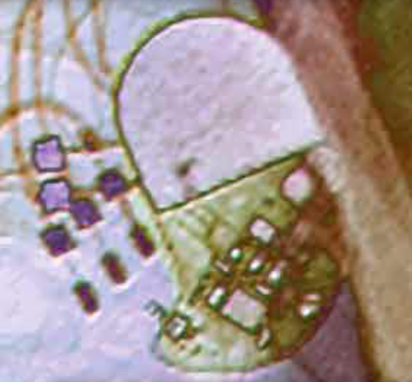
Topic 3.3: How do charges flow through components of a circuit?
Chemical energy separates electrical charges in cells.
Charges can flow through conductors, but not insulators.
Moving electrical charges form an electric current.
A load resists the flow of current.
Conductors must form a closed loop to allow current to flow.
Notes:
‹#›

Slide 2
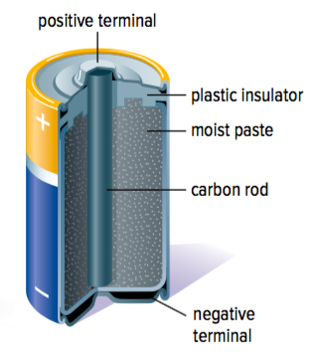
Concept 1: Chemical energy separates electrical charges in cells.
Electrochemical cell:
Transforms chemical energy into electrical energy
Example: An AA “battery” is an electrochemical cell (even though it is commonly known as a “battery”)
Figure 3.13: A dry cell (electrolyte is a paste)

Slide 3
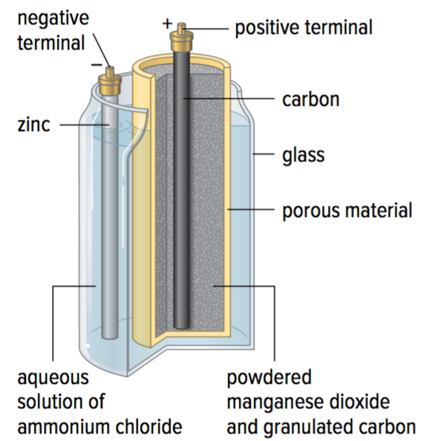
How an Electrochemical Cell Works
Chemical reactions of two different metals or metal compounds occur on the surface of electrodes (Figure 3.13: zinc and carbon)
Electrodes are in a solution called an electrolyte (Figure 3.13: aqueous solution of ammonium chloride)
Figure 3.13: A wet cell

Slide 4
How an Electrochemical Cell Works (continued)
The chemical reactions cause one electrode to become positively charged, and the other to become negatively charged
The electrodes are in contact with terminals in the cell (Figure 3.13: negative terminal and positive terminal)
When the terminals are connected to an electrical pathway, charges flow through
Figure 3.13: A wet cell (electrolyte is an liquid solution)

Slide 5
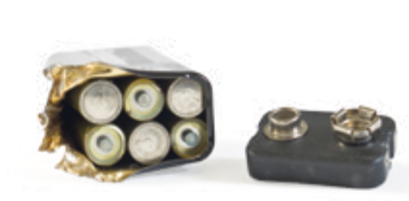
Battery: A Connection Of Two or More Electrochemical Cells
Battery: A connection of two or more electrochemical cells
Example: Several electrochemical cells can be packaged together to make a battery
Electrochemical cells and batteries are sources (anything that supplies electrical energy)
Figure 3.14: The battery shown here is made up of six individual electrochemical cells.
Notes:
source: anything that supplies electrical energy
‹#›

Slide 6
Understanding How an Electrochemical Cell Transforms Chemical Energy into Electrical Energy
An electrochemical cell transforms chemical energy into electrical energy
How does an electrochemical cell become “charged”? (How does a cell transform chemical energy into electrical energy?)
Notes:
‹#›

Slide 7
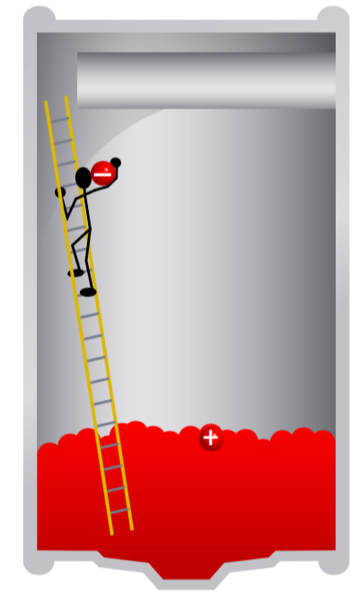
Understanding How an Electrochemical Cell Transforms Chemical Energy into Electrical Energy (Part 1)
The worker (chemical reaction) carries negative charges (electrons) up a ladder and places them at the negative terminal of the cell
The worker leaves positive charges on the bottom at the positive terminal
The first electron is easy to carry up, since one only pair of charges is being separated
Only a small amount of electrical energy is stored in the cell
Figure 3.15: The worker represents chemical energy
Notes:
‹#›

Slide 8
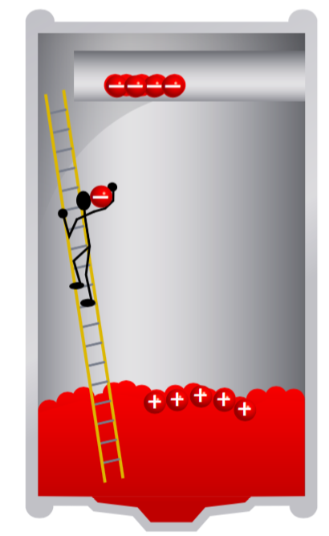
Understanding How an Electrochemical Cell Transforms Chemical Energy into Electrical Energy (Part 2)
After a few charges have been separated, the attraction between the positive charges at the positive terminal and the negative charge of the electron being carried increases
The negative charges of the electrons at the negative terminal are repelling the negative charge of the electron being carried
Therefore, it takes more energy to carry each additional electron
Figure 3.15: The worker represents chemical energy
Notes:
‹#›

Slide 9
Understanding How an Electrochemical Cell Transforms Chemical Energy into Electrical Energy (Part 2 - continued)
The worker (chemical energy) has done a lot of work to separate the charges
This energy is stored in the electrical potential energy of the separated charges
Figure 3.15: The worker represents chemical energy
Notes:
‹#›

Slide 10
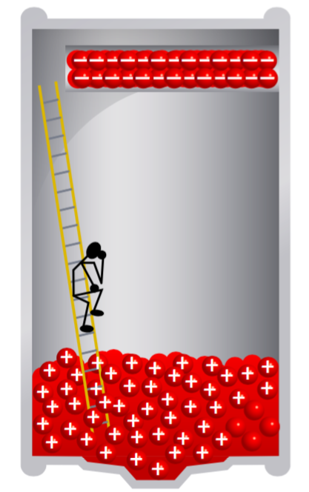
Understanding How an Electrochemical Cell Transforms Chemical Energy into Electrical Energy (Part 3)
Eventually, repulsion of the electron by the negative charges at the negative terminal and the attraction by the positive charges gets so strong that the worker cannot carry any more electrons
No more chemical energy will be transformed into electrical potential energy
The battery is now charged
Figure 3.15: The worker represents chemical energy
Notes:
‹#›

Slide 11
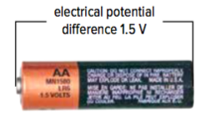
Electrical Potential Difference
A unit of charge gains electrical potential energy when it passes through a source (such as a battery)
Electrical potential difference: A quantity that provides a measure of the electrical potential energy a unit of charge gains when passing through a source
Often called voltage
Symbol: V
Units: volts (V)
Figure 3.16: A typical AA or AAA cell provides an electrical potential difference (voltage) of 1.5V.
Notes:
electrical potential difference: a quantity that provides a measure of the electrical potential energy a unit of charge gains when passing through a source
‹#›

Slide 12
Electrical Potential Difference (continued)
Why is electrical potential difference called a difference?
It measures the difference in electrical potential energy per unit of charge between the positive terminal and the negative terminal in an electrochemical cell
Electrical potential difference is often called the voltage
1.5V cell: It took 1.5 units of energy to separate the last unit of charge (e.g., carry the last unit of charge “up the ladder”)
Figure 3.16: A typical AA or AAA cell provides an electrical potential difference (voltage) of 1.5V.
Notes:
‹#›

Slide 13
Discussion Questions
Use an analogy other than a worker and a ladder to explain how chemical energy is transformed into electrical energy in a cell.
Why is the electrical potential of a source referred to as a difference?

Slide 14
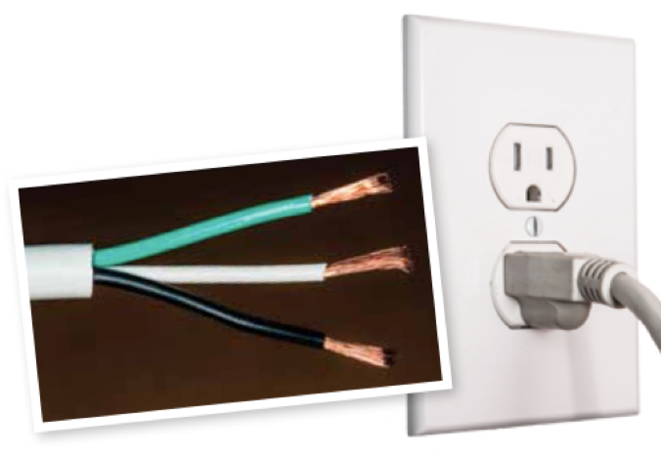
Concept 2: Charges can flow through conductors, but not insulators.
When two different solid materials are rubbed together, electrons can be transferred from one material to the other
Electrons with either stay on the surface of the new material or travel through it
Insulator: A material charges cannot travel through
Conductor: A material charges can travel through
Figure 3.17: Electrical cords are made of a metal conductor covered by an insulator to prevent charges from moving to other objects, including you.
Notes:
conductor: a material charges can travel through
insulator: a material charges cannot travel through
‹#›

Slide 15
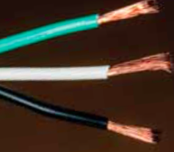
Conductivity: How Easily Charges Travel Through a Material
Conductivity: An indication of how easily charges travel through a material
Electrons can move through almost all metals (conductors); can move through some metals more easily than others
The higher the conductivity of a material, the more easily electrons can move through
Notes:
conductivity: an indication of how easily charges travel through a material
‹#›

Slide 16
Discussion Questions
Explain why electrical wires are covered by an insulator.

Slide 17
Concept 3: Moving electrical charges form an electric current.
Chemical energy from a source (cell or battery) causes charges to move through a conductor (wires), carrying energy to an electrical device (cellphone)
The moving charges are called an electric current
Symbol for current: I
Current is measured in amperes: A
Notes:
current: moving charges
‹#›

Slide 18
Discussion Questions
Describe the relationship between moving charges and electric current.

Slide 19
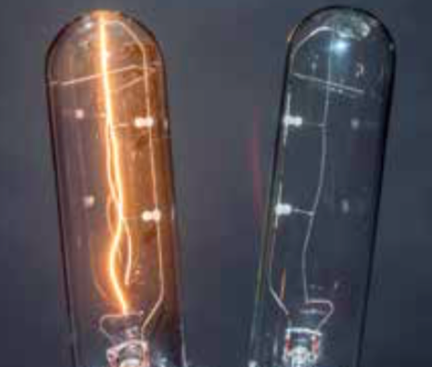
Concept 4: A load resists the flow of current.
Load: A device that converts electrical energy into another form of energy
As electrons pass through a load, they lose energy as electrical energy is converted to another type of energy
Light bulb: A load that transforms electrical energy into light energy
Speaker: A load that transforms electrical energy into sound energy
Figure 3.18: A light bulb is a load because it converts electrical energy into heat and light energy.
Notes:
load: device that converts electrical energy into another form of energy
‹#›

Slide 20
Load: Resists The Flow of Current
A load resists (hinders) the flow of current
Electrons in the current collide with atoms that make up the load, or with each other
Collisions interfere with the flow of current
Notes:
‹#›

Slide 21
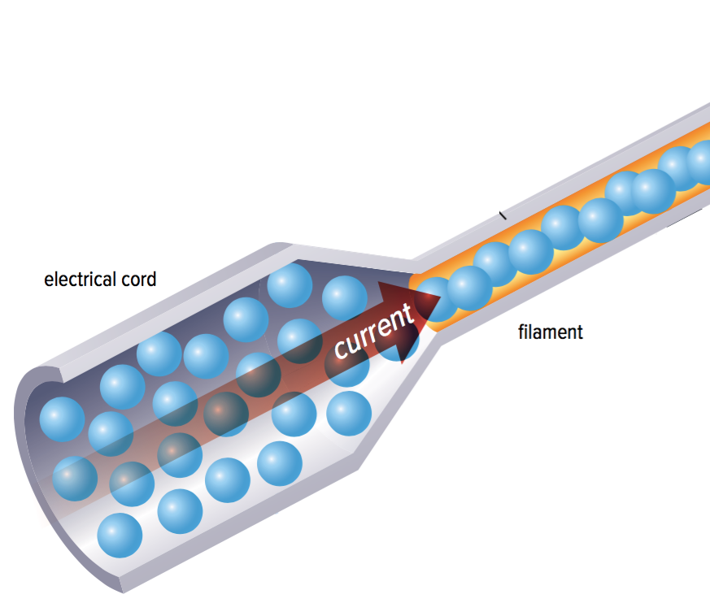
Resistance Describes The Amount of Current Hindered By a Load
Resistance: Describes the amount that current is hindered by a load
Symbol: R
Units: Ω (Ohm)
Example of Resistance: Filament in a Light Bulb
Figure 3.18
Notes:
resistance: describes the amount that current is hindered by a load
‹#›

Slide 22
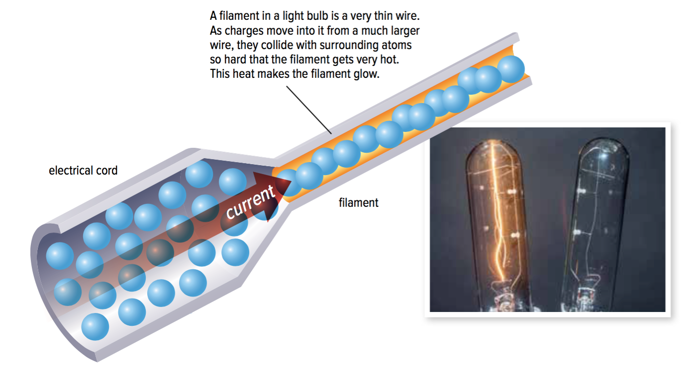
Example of Resistance: Filament in a Light Bulb
Charges move from a large wire (electrical cord) into a very thin wire (filament)
Since the charges have less room in the filament (the filament resists the movement of charges), they collide with atoms so hard that the filament gets very hot
The heat makes the filament glow (“light up”)
Figure 3.18
Notes:
‹#›

Slide 23
Discussion Questions
Use the terms source, current, and load to describe how you think a flashlight works.

Slide 24
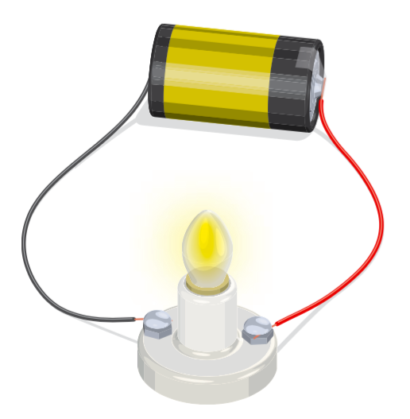
Concept 5: Conductors must form a closed loop to allow current to flow.
Electrical circuit: A source, a load, and wires in a closed loop that allow current to flow
Example: Figure 3.19
Source (electrochemical cell)
Load (lightbulb)
Wires
Figure 3.19: A closed loop allows current to flow and light the bulb.
Notes:
electrical circuit: at a minimum, a source, a load, and wires in a closed loop that allow current to flow
‹#›

Slide 25
Short Circuits
Short circuit: A circuit with a resistance that is too low, making the current so high that it is dangerous
Can happen when a wire touches another wire in the circuit providing a shorter path around the circuit than the path through the load.
Figure 3.19: A closed loop allows current to flow and light the bulb.
Notes:
‹#›

Slide 26
Short Circuits
Example: If there wasn’t a load (light bulb) to resist the flow of current, the current would be so large that the conductor would get very hot and start a fire
Figure 3.19: A closed loop allows current to flow and light the bulb.
Notes:
‹#›

Slide 27
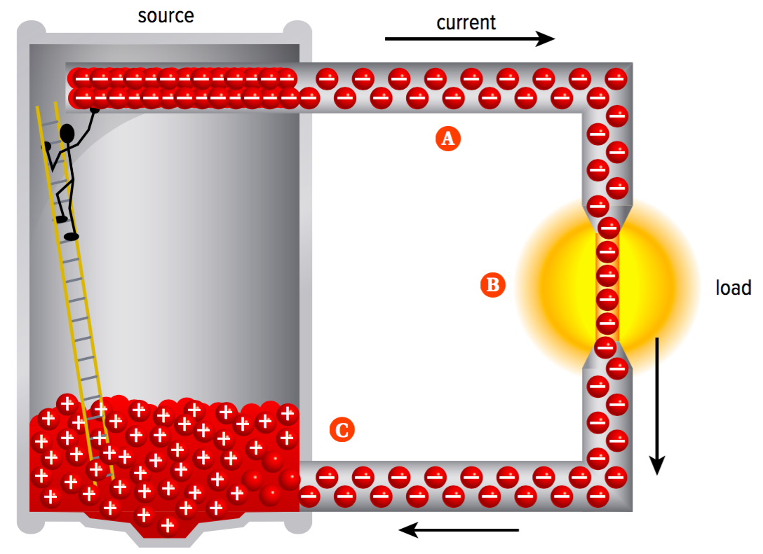
Modelling the Flow of Current (Part A)
Figure 3.20: How current flows through a circuit
Negative terminal repels the negative charges already in the conductor
Positive terminal attracts the negative charges already in the conductor
Electrons move along the conducting wires; electrons from the electrochemical cell move into the conductor
Notes:
‹#›

Slide 28
Modelling the Flow of Current (Part B)
Figure 3.20: How current flows through a circuit
As the electrons pass through the load, they transfer some of their energy to the load
The electrons then leave the load and return to the electrochemical cell
Notes:
‹#›

Slide 29
Modelling the Flow of Current (Part C)
Figure 3.20: How current flows through a circuit
Electrons enter the electrochemical cell; combine with positive ions to become neutral
Over time: fewer electrons at negative terminal; fewer positive ions at positive terminal
The worker (chemical energy) can carry more electrons up the ladder, keeping the number of separated charges equal
Notes:
‹#›

Slide 30
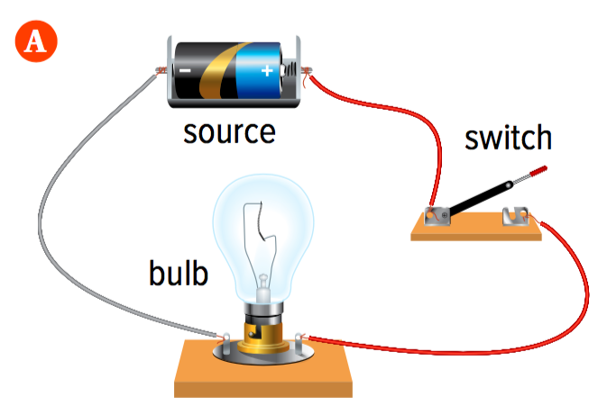
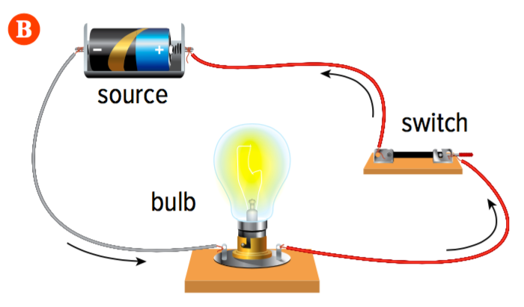
Controlling the Flow of Current
In a typical circuit, a switch controls current in a circuit
Example: Figure 3.21
The switch is open. The circuit is open so the current cannot flow.
The switch is closed. The circuit is closed so the current can flow and the light is on.
Figure 3.21: How a switch controls current in a circuit
Notes:
‹#›

Slide 31
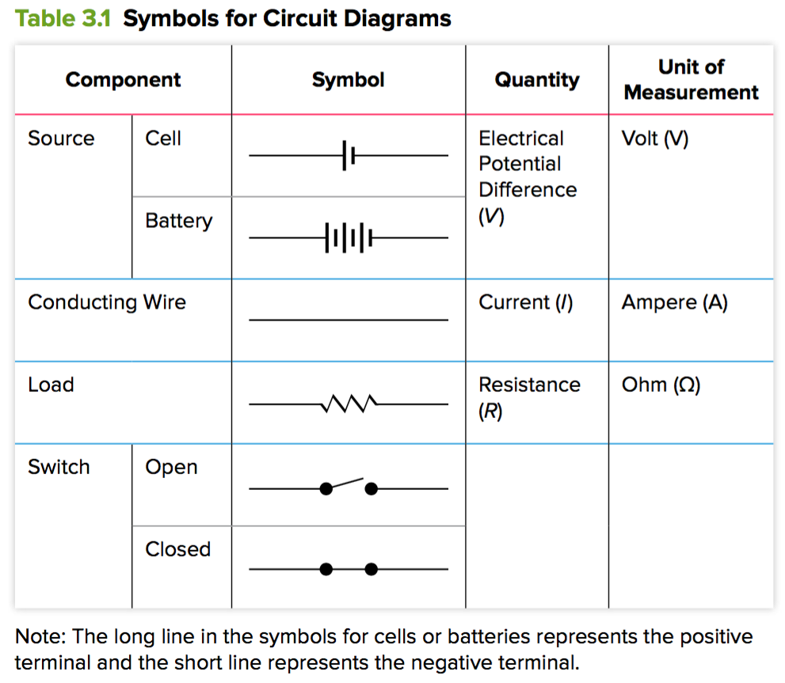
Using Circuit Diagrams
Notes:
‹#›

Slide 32
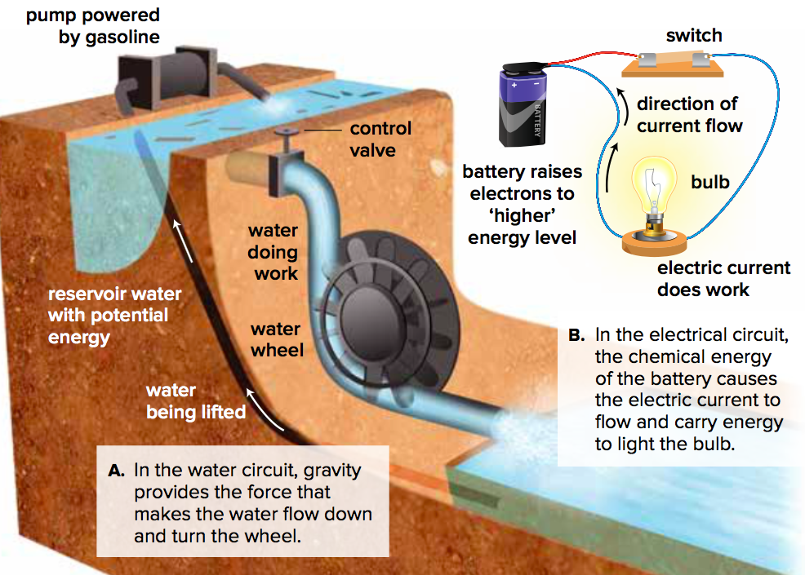
Comparison: Water Circuit and Electrical Circuit
Figure 3.23
Water circuit: A pump lifts the water to a higher level against the pull of gravity
Electrical circuit: The cell or battery is similar to the pump
Notes:
‹#›

Slide 33
Discussion Questions
Explain what “short circuit” means.
Describe the role of a switch in an electrical circuit.
Draw 3 circuit diagrams: one for the circuit shown in Figure 3.21B. another, adding a second light in series. Finally two lights in parallel.

Slide 34
Topic 3.3 Summary: How do charges flow through the components of a circuit?
Chemical energy separates electrical charges in cells.
Charges can flow through conductors, but not insulators.
Moving electrical charges form an electric current.
A load resists the flow of current.
Conductors must form a closed loop to allow current to flow.

