Slide 1
Topic 3.4: How are circuits used in practical applications?
Voltage, current, and resistance in a circuit are related by Ohm’s law.
Loads can be connected in series or in parallel in a circuit.
Parallel loads are practical for circuits in the home.

Slide 2
Concept 1: Voltage, current, and resistance in a circuit are related by Ohm’s law.
Ohm’s Law
The electrical potential difference between two points in a circuit is equal to the current times the resistance between those two points.
V = IR
V: electrical potential difference (voltage) in volts (V)
I: current in amperes (A)
R: resistance in ohms (Ω)

Slide 3
Using Ohm’s Law
You can rearrange the variables in Ohm’s law to calculate any of the other variables if you know the value of the other two.
V = IR
To find resistance: R = V/I
To find current: I = V/R

Slide 4
Using Ohm’s Law: Sample Problem
The filament of a light bulb has a resistance of 20 Ω. A 5.0 V battery is used in the circuit. What is the current?
1) Rearrange Ohm’s law (V = IR) into the formula to find current (I).
V = IR
I = V/R
2) Substitute the values for R and V into the formula:
I = 5.0 V / 20 Ω
I = 0.25 A
The current is 0.25 A.

Slide 5
Discussion Questions
List the three symbols used in Ohm’s law. Explain what each symbol represents and give the units for each of the variables.

Slide 6
Concept 2: Loads can be connected in series or in parallel in a circuit.
There are two main types of circuits:
Series circuit: A circuit in which current can only flow along one path
Parallel circuit: A circuit that has at least one branch point where the current splits into two or more pathways

Slide 7
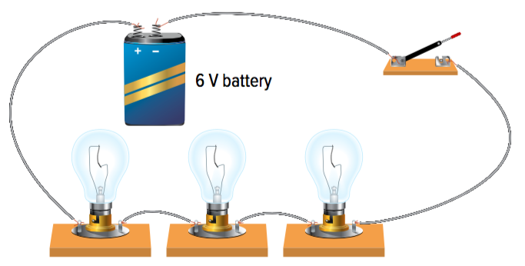
Series Circuit: One Pathway
Series circuit: A circuit in which current can only flow along one path
Example: Figure 3.24
All of the circuit components are connected in series
Three light bulbs (loads) are connected in series
There is only one path in which the current can flow through the battery, switch, and loads
Figure 3.24

Slide 8
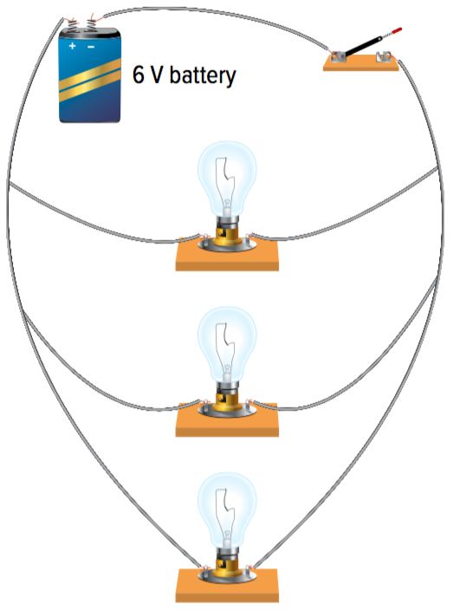
Parallel Circuit: Multiple Pathways
Parallel circuit: A circuit that has at least one branch point where the current splits into two or more pathways
Example: Figure 3.25
The light bulbs (loads) are connected in parallel
The battery and switch are connected in series
At the branch point, the current splits into two pathways (the sum of the currents in the branches is the same as the current in the single conductor before the branch point)
Figure 3.25

Slide 9
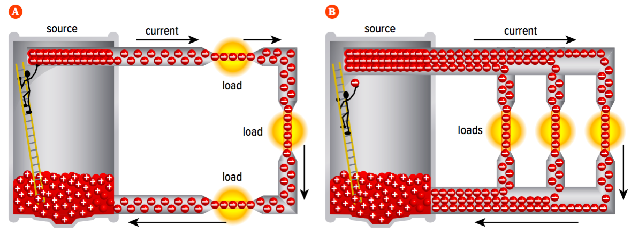
Comparison: Series Circuit and Parallel Circuit
Figure 3.26
Series circuit: One pathway for current to flow; current is equal in all parts of the circuit
Parallel circuit: Current splits into three paths; current is reduced in each path
Notes:
Ohm’s Law: the electrical potential difference between two points in a circuit is equal to the current times the resistance between those two points
‹#›

Slide 10
Loads
Series:
Each time you add a load, they all get dimmer (less energy –shared)
If one load burns out, all the rest go out (the circuit is broken/open)
Parallel
When loads are added, brightness doesn’t change (voltage is constant)
If one load burns out, the others are unaffected

Slide 11
Sources
Series:
Each time you add sources, voltage increases
Parallel
When sources are added, volts stay constant, the sources last longer

Slide 12
Discussion Questions
Use the analogy of two different roads or rivers to compare a series and parallel circuit.

Slide 13
Concept 3: Parallel loads are practical for circuits in the home.
Series circuits are impractical for homes.
Example: Loads connected in series in a kitchen
If one load (ceiling lamp) burns out:
The circuit will be open
Charges stop moving
No other loads (microwave, toaster) in the circuit will work

Slide 14
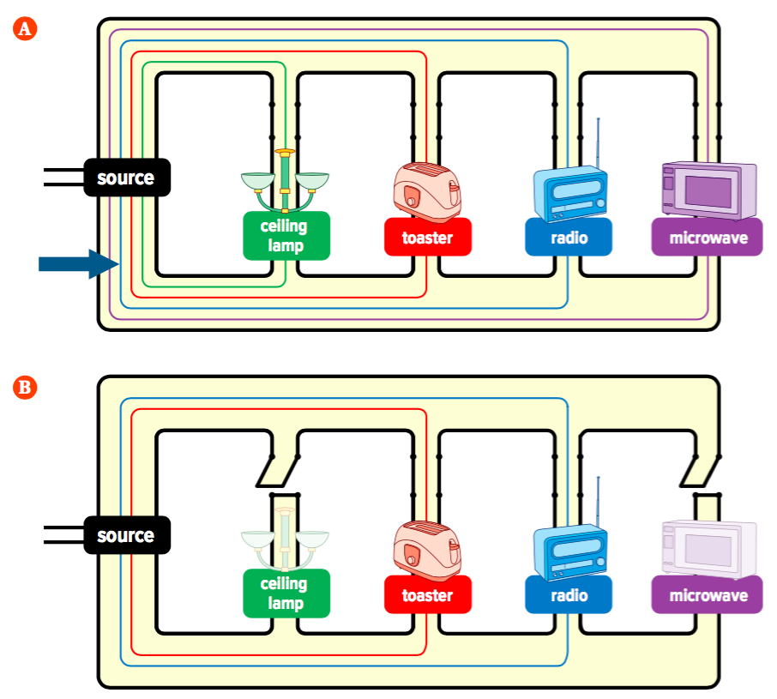
Parallel Loads: Household Circuits
Parallel circuits are practical because each appliance is controlled by its own switch without shutting off others.
Example: Figure 3.27
All of the appliances are running. A large amount of current is passing through the conductor wire (arrow).
When large amounts of current flow through a wire, it can overheat and start a fire.
The ceiling lamp and microwave are turned off, but the toaster and radio are still running
Figure 3.27

Slide 15
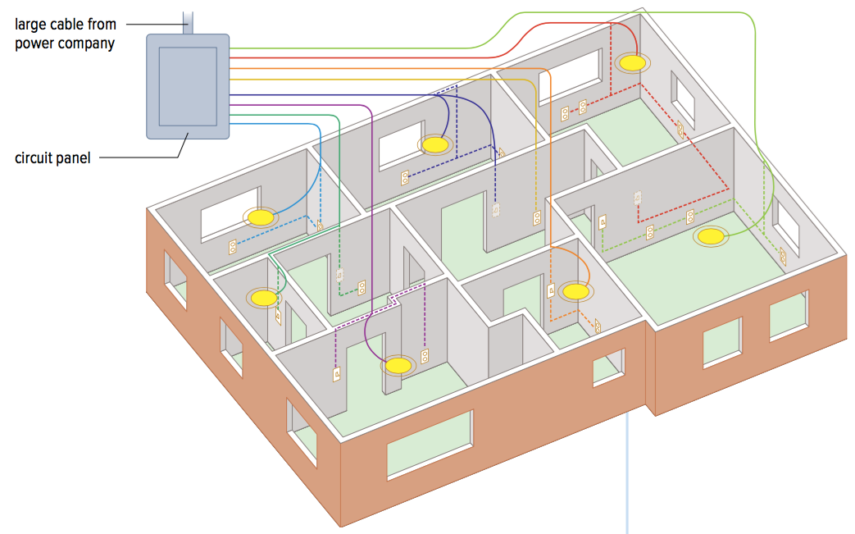
Multiple Circuits Within a Building
Figure 3.28: Buildings have multiple parallel circuits. The yellow disks represent ceiling lights.
Many separate parallel circuits are installed in buildings
A large electrical cable carrying electrical energy branches out and is connected to each parallel circuit in a circuit panel

Slide 16
Discussion Questions
Explain why it would be impractical to wire a home with a circuit in which all loads were connected in series.
Explain why a parallel circuit with too many electrical devices connected to it is not safe.

Slide 17
Topic 3.4 Summary: How are circuits used in practical applications?
Voltage, current, and resistance in a circuit are related by Ohm’s law.
Loads can be connected in series or in parallel in a circuit.
Parallel loads are practical for circuits in the home.

