Slide 1
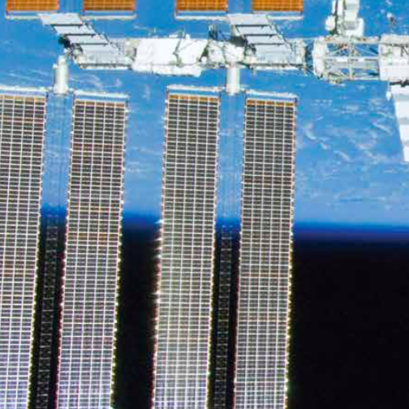
Topic 3.5: How can electrical energy be generated and used sustainably?
Sustainable use of electrical energy begins with understanding how its use is measured.
Making informed choices helps you use electrical energy sustainably.
Renewable energy sources provide sustainable options for generating electrical energy.

Slide 2
Concept 1: Sustainable use of electrical energy begins with understanding how its use is measured.
Electrical energy is measured in two main ways:
Watts and Kilowatts
Kilowatt-Hours

Slide 3
Electrical Power: Watts and Kilowatts
Electrical power: The rate at which electrical energy is used by a load
Load: Usually an appliance (washing machine, TV)
Measured in watts (W) or kilowatts (kW)
1 kW = 1000 watts
This means it uses 1000 units of energy per second
Notes:
electrical power: the rate at which electrical energy is used by a load
‹#›

Slide 4
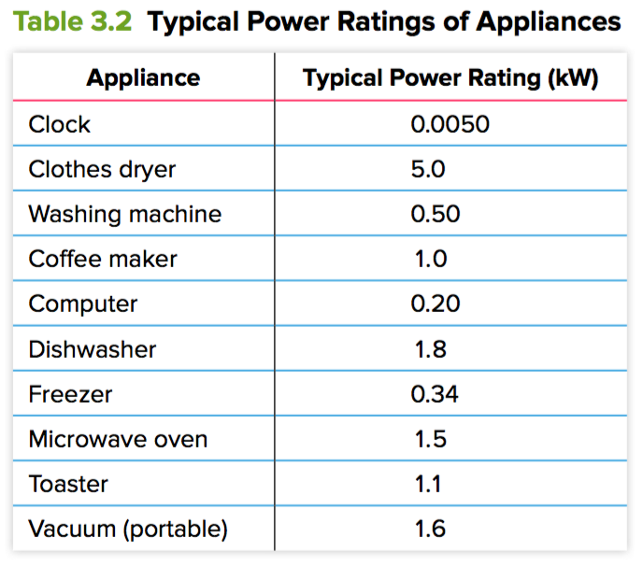
Power Ratings of Appliances
Appliances are labelled with a power rating (the rate they use energy)
Light bulb: 100 W
Iron: 1000 W
If light bulb and iron are on for the same length of time, the iron uses 10 times more energy
Notes:
‹#›

Slide 5
Kilowatt-Hours
Electrical energy used by an appliance over time is measured in kilowatt-hours (kWh)
kWh: Combines the units for power and time
If you use an appliance rated at 1 kW for one hour, you will have used 1 kWh of electrical energy
Notes:
‹#›

Slide 6
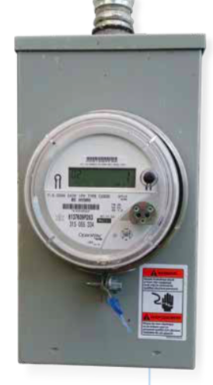
Measuring Electrical Energy Use in Homes and Businesses
Smart meter: An electrical energy meter that measures how energy use changes in a building over the course of the day
Data is sent to the utility company wirelessly
Can encourage “smart” behaviour since it allows consumers to track their electrical energy usage
Figure 3.29
Notes:
smart meter: an electrical energy meter that measures how energy use changes in a building over the course of the day
‹#›

Slide 7
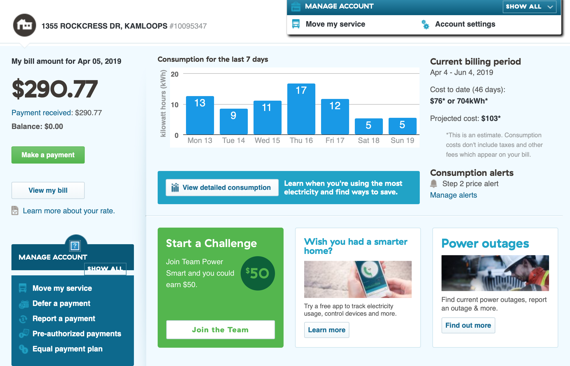
Mr. Spanis’s BC Hydro account page – made possible by Smart Meters

Slide 8
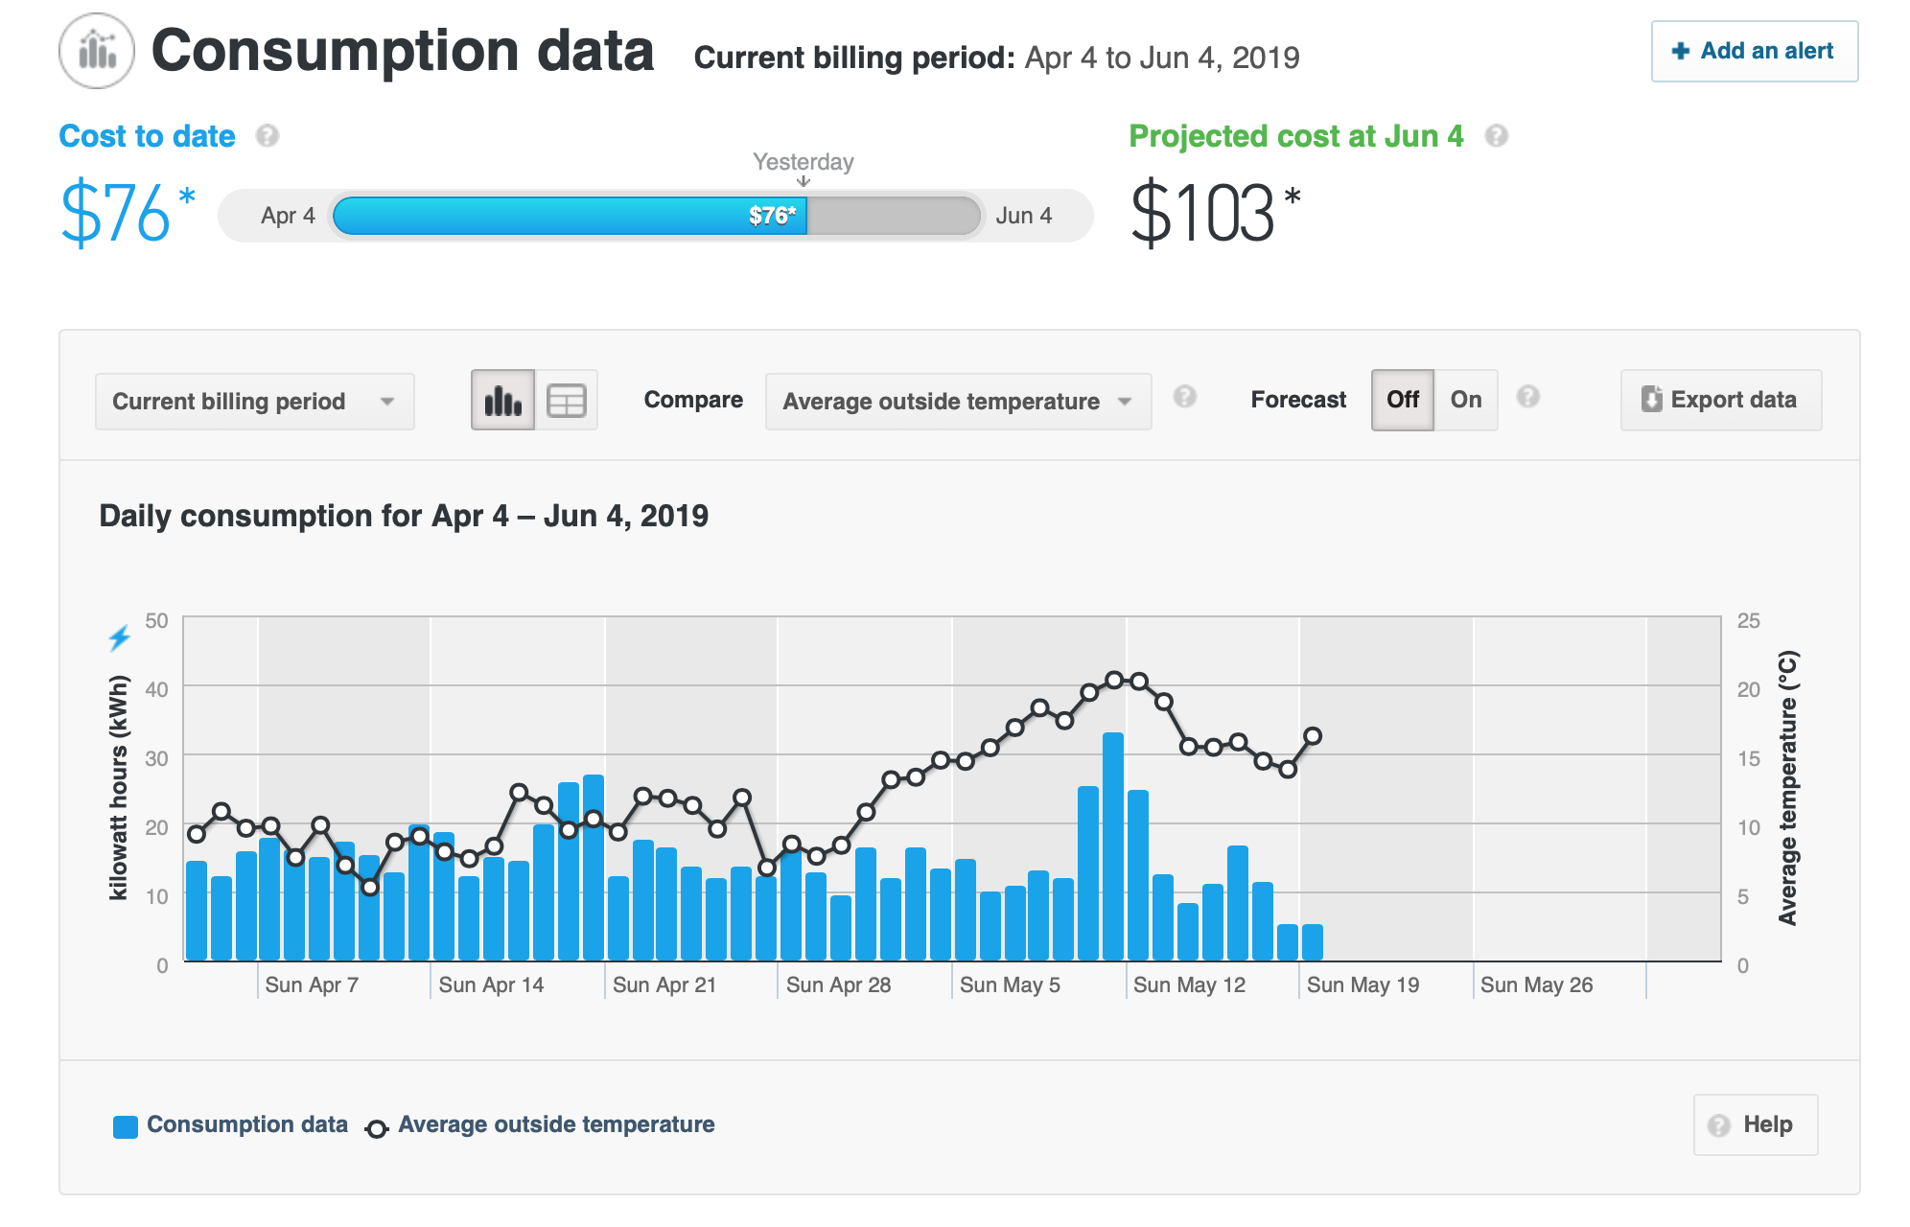
Mr. Spanis’s BC Hydro account page

Slide 9
What do you notice about the relationship between energy usage and outside temperature?
What caused energy use to go up when the average temperature got above 15ºC?
Mr. Spanis’s family decided to save electrical energy; instead of running the air conditioning to cool the house before bedtime, they open all the doors and windows after the outside temperature drops below the inside temperature. Check out his energy usage compared to his neighbours:

Slide 10
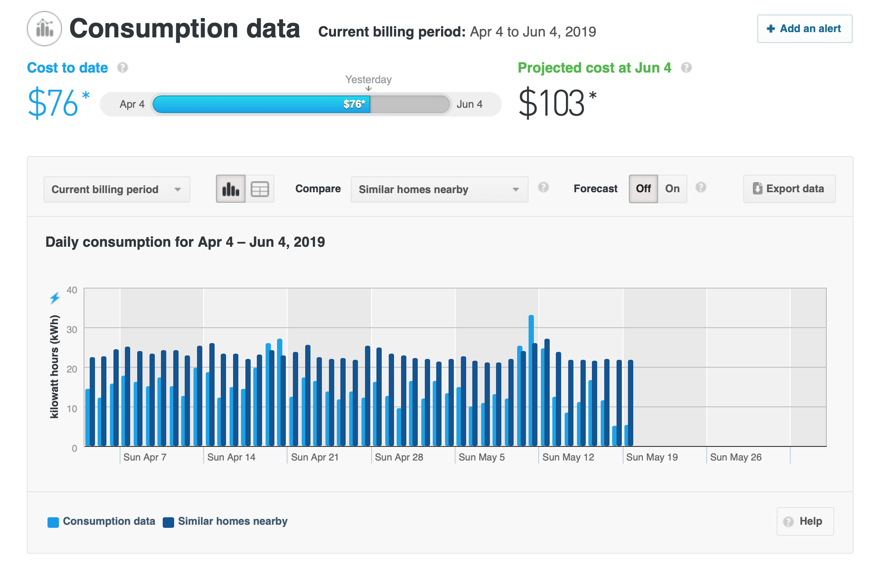
Mr. Spanis’s BC Hydro account page
Mr. Spanis’s Hydro bill is lower than his neighbours. What other behaviours might save energy?
Notes:
Not watching a lot of TV
Turning lights off when leaving the room
Energy efficient appliances
Unplugging sources of phantom load (this comes up later)
‹#›

Slide 11
Discussion Questions
What is electrical power and how is it measured?
Describe one benefit of smart meters.

Slide 12
Concept 2: Making informed choices helps you use electrical energy sustainably.
Appliances have labels that tell you how much energy they use.
Two types of labels used in Canada are:
EnerGuide labels
ENERGY STAR® labels

Slide 13
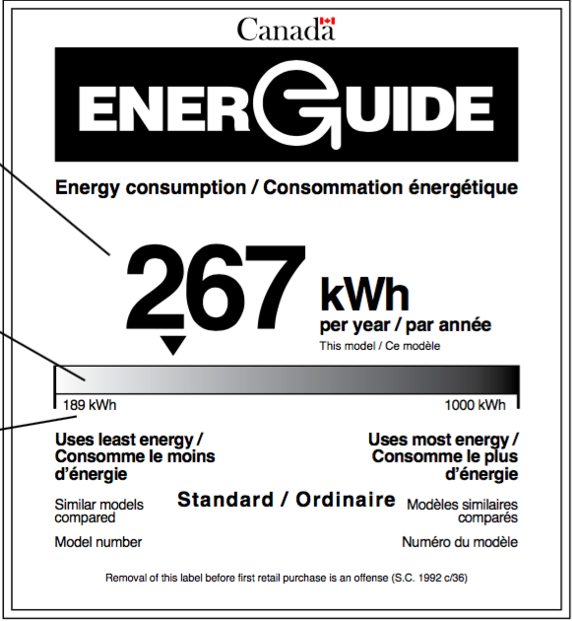
Understanding EnerGuide Labels
Figure 3.30
EnerGuide label: A label that gives details about the amount of energy that an appliance uses in one year of normal use
Large number: Shows how much energy is used in one year of normal use
Shaded bar: Shows how the appliance compares with similar ones on the market
Numbers on the shaded bar: Gives a range of efficiency for yearly energy use
Notes:
EnerGuide label: a label that gives details about the amount of energy that an appliance uses in one year of normal use
‹#›

Slide 14
Understanding ENERGY STAR® Labels
ENERGY STAR® label: Identifies a product as meeting or exceeding certain standards for energy efficiency
Appliances with this label use 10-50% less energy compared with a standard product in the same category
Figure 3.31
Notes:
ENERGY STAR® label: identifies a product as meeting or exceeding certain standards for energy efficiency
‹#›

Slide 15
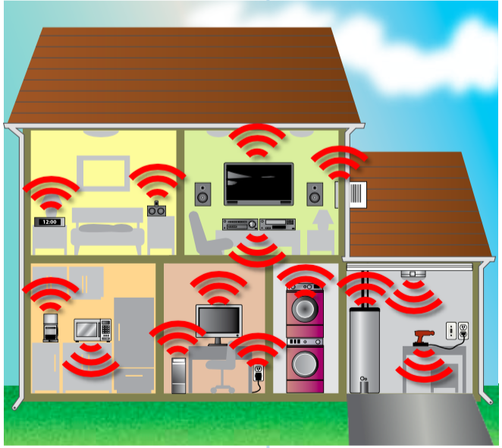
Phantom Loads
Phantom load: Electrical energy a device uses when it is turned off
Appliances in stand-by mode (TVs, computers) are actually “on” and have phantom loads
Phantom loads account for about 900 kWh of energy use each year in the average home
Figure 3.32: Devices with phantom loads are common in a typical home.
Notes:
phantom load: electrical energy a device uses when it is turned off
‹#›

Slide 16
Discussion Questions
Compare the information on an EnerGuide label with the information on an ENERGY STAR® label.
If a family goes away on vacation, why might electrical energy still be consumed in their home?

Slide 17
Concept 3: Renewable energy sources provide sustainable options for generating electrical energy.
Electrical energy is always generated from another source of energy. The sources sources can be:
Nonrenewable energy sources
Renewable energy sources

Slide 18
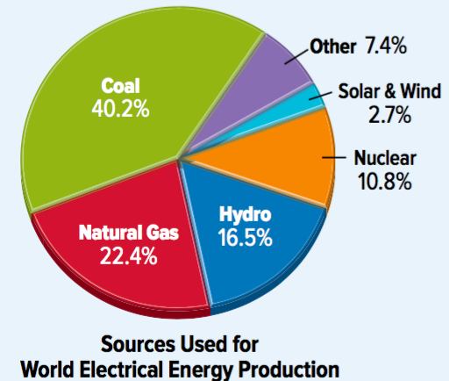
Nonrenewable and Renewable Energy Sources
Nonrenewable energy source: An energy source that is non-replaceable in a human lifetime
Examples: Coal, natural gas, uranium (nuclear reactions)
Renewable energy sources: An energy source that is available on a continuous basis
Examples: Sunlight, wind, river flow, tides and waves, geothermal sources, biomass
Notes:
nonrenewable energy source: an energy source that is non-replaceable in a human lifetime
renewable energy sources: an energy source that is available on a continuous basis
‹#›

Slide 19
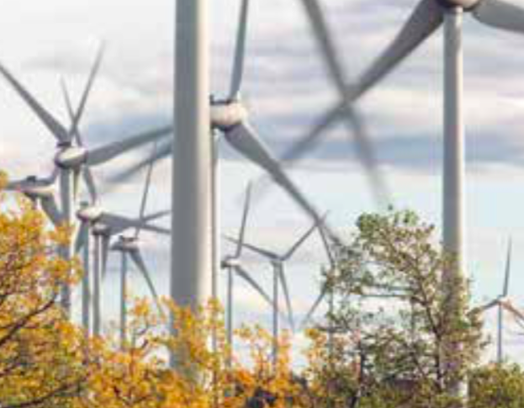
Renewable and Nonrenewable Energy Sources in British Columbia
WAC Bennett Dam (Peace River)
Generates 2730 MW of electrical energy
Provides most of B.C.’s electrical energy
Large-scale hydroelectric dam
Bear Mountain Wind Park (Dawson Creek)
Generates 144 MW of electrical energy
34 wind turbines
Notes:
‹#›

Slide 20
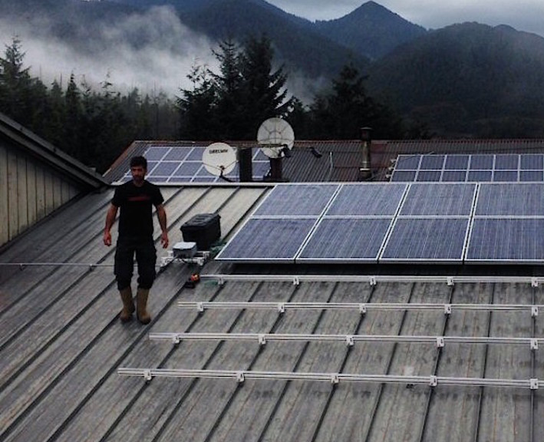
Renewable and Nonrenewable Energy Sources in British Columbia (continued)
The Klemtu Small-scale Hydro and Solar Project
Hydro generates 1.7 MW of energy
Solar generates 0.023 MW of energy
Solar project has photovoltaic cells on the top of the Kitasoo Community School
These projects reduce the community’s reliance on diesel generators
Notes:
‹#›

Slide 21
Moving Toward a Sustainable Future
Sustainable energy system: A sustainable way of perceiving, producing, and using energy
Characteristics of the system include:
Ensuring that the extraction, production, and use of energy have limited impact on environmental and human health
Less reliance on nonrenewable sources
Ensuring the availability of renewable and reliable energy sources for current and future generations
Providing access to affordable energy for Earth’s entire population
Notes:
sustainable energy system: a sustainable way of perceiving, producing, and using energy
‹#›

Slide 22
First Peoples Ecosystem Based Management
Many characteristics of a sustainable energy system are in line with First Peoples Ecosystem Based Management (EBM):
Respect and Responsibility (making decisions that respect the natural world; responsible use of resources)
Intergenerational Knowledge (listening to Elders and sharing knowledge between generations)
Balance and Interconnectedness (balance makes sure future generations are considered; interconnectedness takes many relationships with an ecosystem into consideration)
Giving and Receiving (giving thanks for natural resources recognizes their value; benefits of resources are shared in a community)
Notes:
‹#›

Slide 23
Discussion Questions
Explain why coal is a nonrenewable energy source and why moving water is a renewable energy source.
Identify the four main characteristics of a) a sustainable energy system and b) First Peoples Ecosystem based Management.

Slide 24
Topic 3.5 Summary: How can electrical energy be generated and used sustainably?
Sustainable use of electrical energy begins with understanding how its use is measured.
Making informed choices helps you use electrical energy sustainably.
Renewable energy sources provide sustainable options for generating electrical energy.

