Slide 1
Ionic Compounds
Why are they formed? How do we go about naming and writing formulae?

Slide 2
Compounds
Recall from the last section that compounds are:
Pure substances that contain more than one type of atom chemically combined in the same proportions
In other words compounds contain the same elements and always in the same whole number ratio

Slide 3
Chemical Formulae
Like elemental symbols, scientists use chemical formulae to provide information about compounds:
Describes what elements are present in a chemical compound
Gives the relative proportions of those elements
Examples:
CaCl₂- contains one atom of calcium and 2 atoms of chlorine
Mg(OH)₂- contains one atom of magnesium, two atoms of oxygen, and two atoms of hydrogen

Slide 4
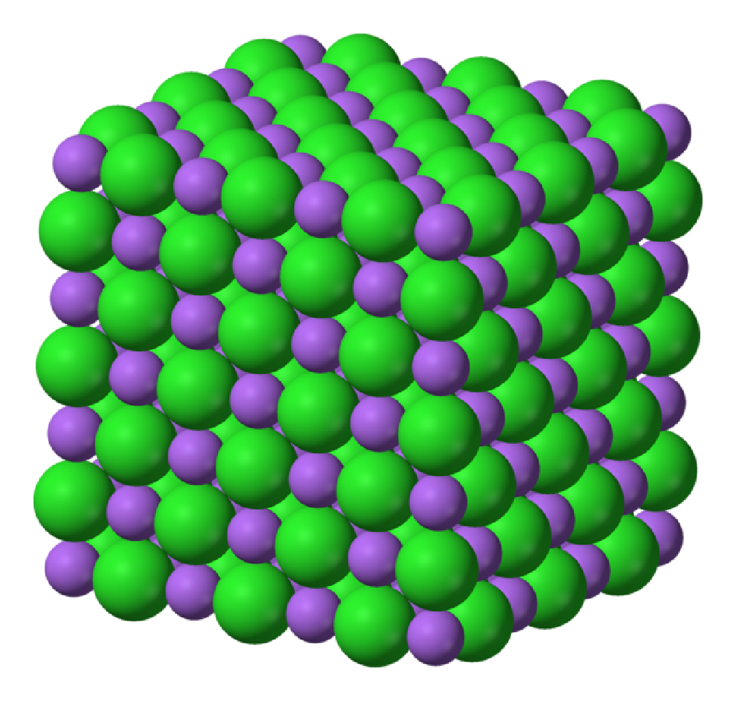
Ionic Compounds
Contain a metal (becomes a cation) and a non-metal (becomes an anion)
Are held together by the attraction of oppositely charged ions, formed by an electron transfer
All of the positives and negatives organize nicely.
Negative-positive attract
Negative-negative and positive-positive repel

Slide 5
Naming Ionic Compounds
The name of an ionic compound = cation + anion-ide
For example, an ionic compound forms between magnesium and oxygen
The cation is the first part of the name, magnesium
The anion forms part of the ending of the name, oxygen
Add -ide to the end of the name to form
MAGNESIUM OXIDE.

Slide 6
Ionic formulas are based on the ions of the atoms involved!
For example, what is the name of Ca₃N₂?
Ca, the cation, is calcium Ca²⁺
N, the anion, is nitrogen N³⁻
Drop the end of the anion and add –ide
The name of the compound is Calcium Nitride
What do you notice about the number of positive charges and the number of negative charges based on its formula???
Ca²⁺
Ca²⁺
Ca²⁺
N⁻³
N⁻³

Slide 7
Writing formulas for ionic compounds
As we just noticed, in ionic compounds the positive charges balance out the negatives so that the compound is neutral
The ratio of positive : negative charges gives the proper formula
The ratio is always written in reduced form
For example, what is the formula for magnesium phosphide?

Slide 8
Magnesium Phosphide
Magnesium is Mg²⁺ Phosphorous is P^{3–}
Lowest common multiple of 2 and 3 is 6
3 Mg²⁺ ions and 2 P^{3–} ions
Mg₃P₂
P⁻³
Mg²⁺
Mg²⁺
Mg²⁺
P⁻³
Do you notice anything about the charge on the cation and the number of atoms of the anion? (and vice versa?)

Slide 9
A short-cut… The “Criss-cross Method”
Another way to predict the formula is to “criss-cross” the charge on the cation to produce the number of anions required (i.e. the subscript behind the anion), and vice versa
Ca ²⁺
N ³⁻
Ca ₃ N ₂

Slide 10
Now you try: Predict the formula for CALCIUM OXIDE
Calcium is Ca²⁺ oxygen is O^{2–}
1 Ca²⁺ ion and 1 O^{2–} ion
Therefore the compound is CaO
If you were “criss-crossing” the charges on the ions you would predict: Ca₂O_{2,}
This is simplified to CaO
Ca²⁺
O⁻²

Slide 11
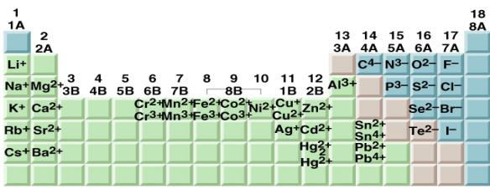
Multivalent metals
Some transition metals are multivalent, meaning they have more than one ion form.
In the name of the compound, Roman Numerals are used following the cation to indicate which ion was used

Slide 12
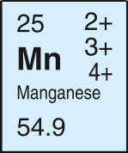
Example: Formula for a multivalent ionic compounds
For example: What is the formula for Manganese (III) sulphide?
This manganese is Mn³⁺ Sulphur is S^{2–}
Lowest common multiple of 3 and 2 is 6
2 Mn³⁺ ions and 3 S^{2–} ions
Mn₂S₃

Slide 13
Now you try: Predict the name for the compound TiCl₄.
Titanium is Ti⁴⁺ or Ti³⁺ Chlorine is Cl–
1 Ti⁴⁺ ion and 4 Cl– ions
Titanium (IV) chloride
Ti³⁺
Ti⁴⁺
Cl⁻
Ti⁴⁺
Cl⁻
Cl⁻
Cl⁻
Cl⁻

Slide 14
Some Helpful Things!
http://www.youtube.com/watch?v=fQx_sDvJyQA

Slide 15
Ionic Compounds: Polyatomic Ions
Why are they formed? How do we go about naming and writing formulae?

Slide 16
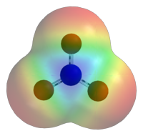
POLYATOMIC ION
- A group of atoms that tend to stay together and act as one charged ion

Slide 17
Formulae containing polyatomic ions
If more than one of a polyatomic ion is needed to balance charges, brackets are used to indicate you need more than one of the entire ion e.g. Ca (OH)₂ contains 2 hydroxide (OH⁻) ions to balance Ca²⁺

Slide 18
Examples:
Predict the compound formed from:
Na⁺ and OH⁻
Mg²⁺ and NO₃⁻
NH₄⁺ and SO₄²⁻
NaOH
Mg(NO₃)₂
(NH₄)₂SO₄

Slide 19
Naming compounds containing polyatomic ions
If there is a formula which contains more than two elements you must go to the data sheet to determine the polyatomic ion(s) in the formula and the name the group is given
e.g. Na₃PO₄ contains phosphate
The name of the polyatomic is written unchanged!

Slide 20
Examples:
Predict the compound name:
CaCO₃
KCN
Ca₃(PO₄)₂
Calcium carbonate
Potassium cyanide
Calcium phosphate

Slide 21
IMPORTANT: You must always remember to check for multivalent ions!
e.g. Fe(OH)₂ Iron can be Fe²⁺ or Fe ³⁺
So this compound is:
Iron (II) hydroxide

