Slide 1
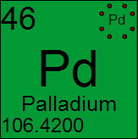
Lewis Dot Structures

Slide 2
Lewis Dot Diagrams…
Bohr had one way of depicting the atom and it’s sub atomic particles (p+, n, and e-). But another man, Gilbert Lewis used a different model, and he only showed the valence e- in it. His model is called the Lewis dot diagram He put dots around the symbols so that we can see the valence electrons for the elements (we can easily see which e- are going to react)

Slide 3
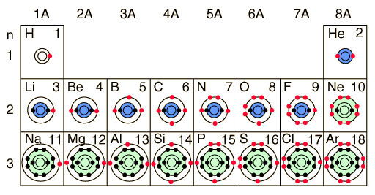
The red dots show you the VALENCE ELECTRONS in each element’s atoms

Slide 4
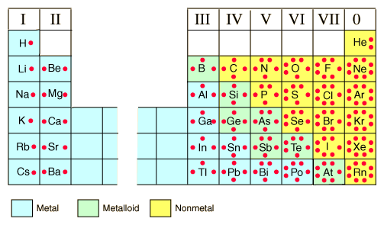
Lewis Dot Structures

Slide 5
See the difference??... Lewis just shows the valence e-
P: 11
N:12
Na
Bohr model of Sodium Atom
Lewis Structure of Sodium Atom

Slide 6
Lewis Dot Structures
Lewis dot structures are really simple – they are just the valence e- represented as dots around an element. 2 electrons together is called a lone pair.
The # of valence e- is … 8
8 is the # we want – it’s stable – like a noble gas

Slide 7
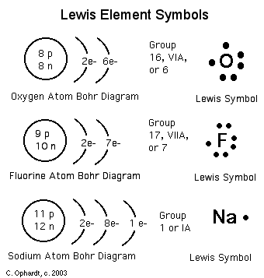
How to draw …

Slide 8
Try some …
Remember, up to 4 e-, you put separately on each side of the symbol, once you get to 5, you have to start pairing up.
1) Magnesium 2) Nitrogen
3) Flourine 4) Argon
Bonding pair
N
Mg
F
Ar

Slide 9
So what happens when atoms meet?
When 2 atoms move close together, their valence electrons interact, and they form a chemical bond between them if they are a good pair (more stable together than apart)
Having a full valence shell is what each element wants! So it will bind with other elements that make that happen!

Slide 10
Lewis Diagrams of ions
Lewis diagrams make drawing ions, and ionic bonds much less work than Bohr diagrams.
For positive ions, one electron dot is removed from the valence shell for each positive charge of the ion.
For negative ions, one electron dot is added to each valence shell for each negative charge of the ion.
Square brackets are placed around each ion to indicate transfer of electrons
See page 179
–
2+
–
• •
• •
• •
• •
• •
• •
• •
• •
• •
• •
• •
• •
• •
• •
• •
• •
• •
• •
• •
• •
• •
• •
• •
• •
• •
• •
• •
• •
• •
• •
• •
• •
Be
Cl
Cl
Be
Cl
Cl
Be
Cl
Each beryllium has two electrons to transfer away, and each chlorine wants one more electron
Since Be²⁺ wants to donate 2 electrons and each Cl– wants to accept only one, two Cl– ions are necessary
Beryllium chloride

Slide 11
Lewis Diagrams of covalent bonds
Lewis diagrams of covalent bonds are also very easy.
Like Bohr diagrams, valence electrons are drawn to show sharing of electrons.
All atoms wish to have a full valence shell
The shared pairs of electrons are usually drawn as a straight line
See page 179

Slide 12
Lewis Diagrams of diatomic molecules
Diatomic molecules: 2 of the same element are bonded
Eg. Cl₂, F₂, O₂, etc..
• •
• •
• •
• •
• •
• •
• •
• •
• •
• •
• •
• •
• •
• •
• •
• •
• •
• •
• •
• •
• •
• •
• •
• •
O
O
O
O
O
O
Several non-metals join to form diatomic molecules
Valence electrons are shared, here in two pairs!
This is drawn as a double bond
Take the Section 4.1 Quiz
See page 180

Slide 13
Things to note…
Every electron wants to have a full outer orbit – then they are stable – so…
if an electron has it’s 1st orbit full and stable – it will have 2 valence e-
if an electron has it’s 2nd , or 3rd orbit full and stable – it will have 8 valence e- (we call that a Stable octet)
Everything wants to bind together to get a maximum of 8 valence e- shared between them

Slide 14
CovAlent Compounds
+
1.
F
H
→
H
F
+
N
H
2.
N
H
→
H
H
H
+
3.
C
H
→
H
C
H
H

Slide 15
Ionic Compounds
2+
2-
+
O
1.
Mg
O
→
Mg

Slide 16
Diatomic Compounds
+
F
F
→
F
F
Remember to show the difference between a bonding pair and a lone pair.

