Slide 1
The Origin of it All
Pale Blue Dot

Slide 2
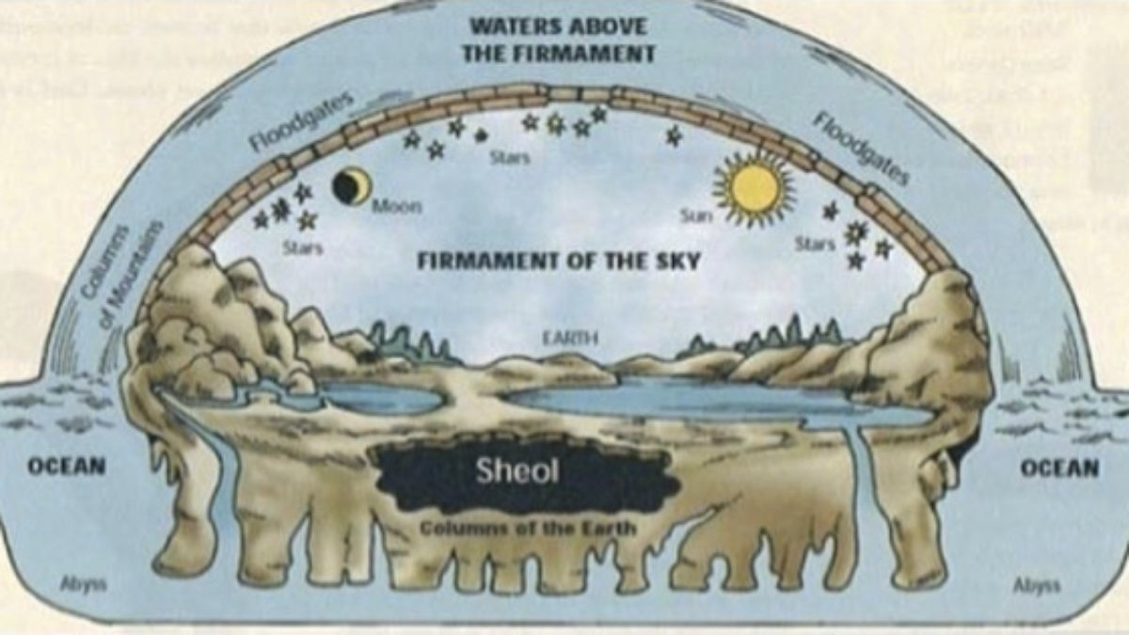
Flat Earth
From the perspective of a single person it was reasonable to think of the Earth as being flat.
The flood waters came from a ‘firmament’ that encased the Earth.

Slide 3
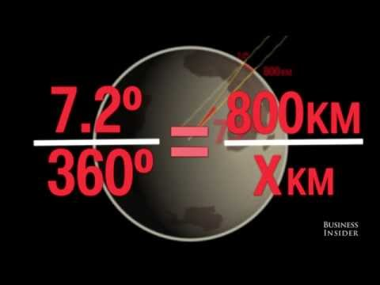
...But it’s round!
...and we knew this way before Columbus sailed the ocean blue.

Slide 4
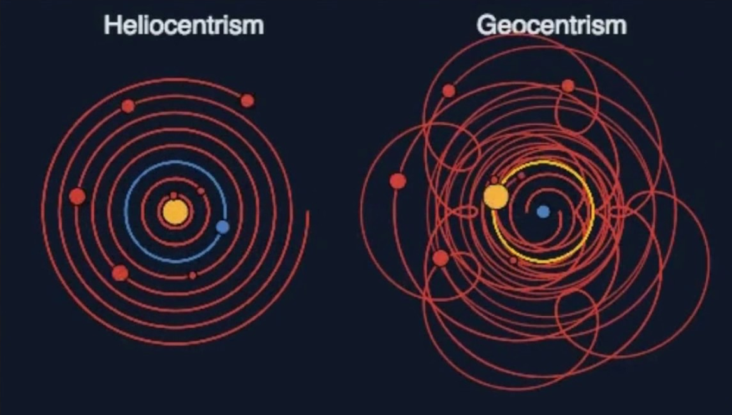
But at least the Earth is at the center, right?
Occam’s Razor:
When faced with two possibilities the simpler of the two is most likely correct.

Slide 5
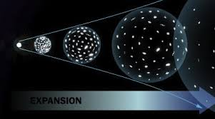
Expansion
In the 1920’s Edwin Hubble recorded observations that everything in the night sky was moving away from Earth.

Slide 6
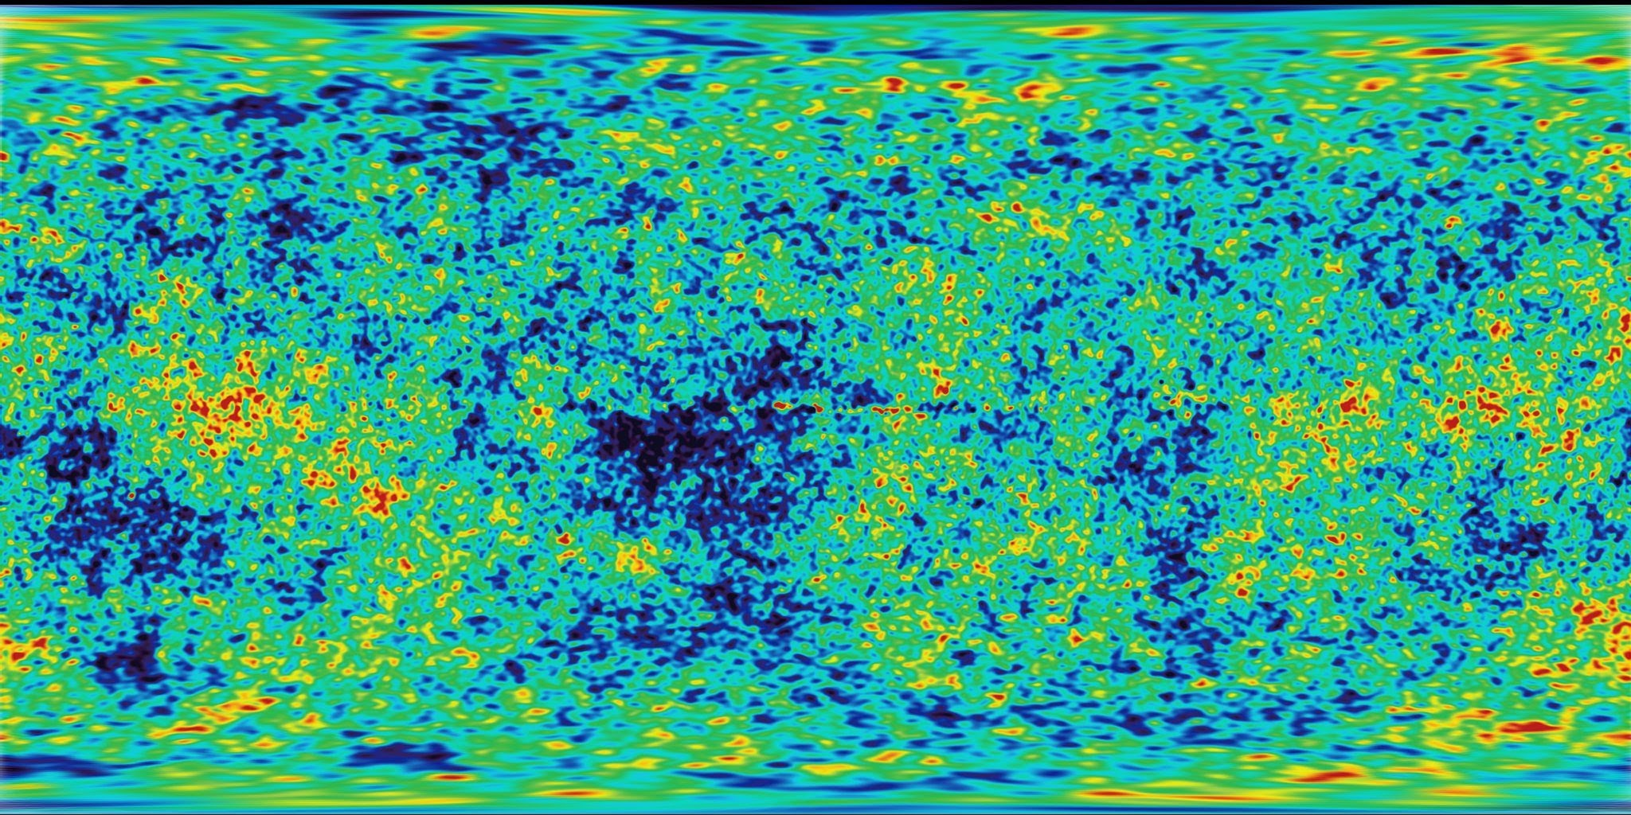
Then Space Should have some residual heat
Cosmic Microwave Background Explorer (CMBE) satellite launched in 1991 confirmed that the background radiation field has exactly the spectrum predicted by a Big Bang origin for the universe.

Slide 7
Early Universe
The Big Bang should have created equal amounts of matter and antimatter in the early universe. But today, everything we see from the smallest life forms on Earth to the largest stellar objects is made almost entirely of matter. Comparatively, there is not much antimatter to be found. Something must have happened to tip the balance. One of the greatest challenges in physics is to figure out what happened to the antimatter, or why we see an asymmetry between matter and antimatter.
Cern website

Slide 8
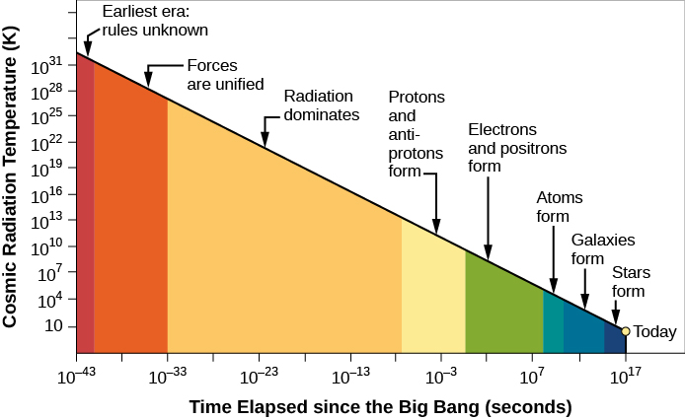
E=mc²
Energy can and will become matter. We started to have lots of matter form from the energy of the big bang. 80/20 hydrogen to helium mix.

Slide 9
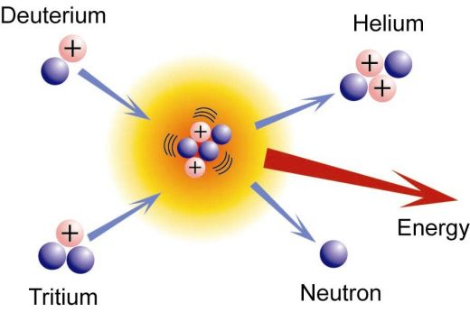
Formation of Suns
Gravity takes hold and hydrogen undergoes nuclear fusion to become helium and on up the periodic table until iron.

Slide 10
Supernova
Eventually suns large enough to become supernova are formed.
These suns explode with massive energy when they die and heavier elements are formed.

Slide 11
